Slide 1
Validating Counterparty Risk Models
Martin Goldberg, Ph. D.
martin@validationquant.com
Presented at Risk Training
Managing Model Risk in Pricing and Risk Models
New York, October 16 – 17, 2014

Slide 2
The Usual Caveats
This presentation expresses my own personal opinions and experience, and may not represent the views of any current or former employer. I am not speaking as an authorized spokesperson for AIG. I am speaking as a validator, and my talk assumes you are one also.
No proprietary or confidential information is included in these slides. You might decide afterwards that no information at all is in here.
I may go off-topic either deliberately or upon request.
This talk is intended more to suggest questions than to give answers. Regulatory changes may invalidate some or all of the current approaches.
This topic is hard, and a 90-minute talk will not make you an expert. It may point you in some interesting directions, but there are many devils in the details.

Slide 3
Table of Contents
What is counterparty risk
What should validation include
Pre-validation checks on paperwork and regulatory compliance
Comparison to Issuer Credit Risk
Validating CVA, DVA, and FVA for smaller banks
Validating CVA, DVA, and FVA for SIFI
Basel Capital
Conclusions

Slide 4
What is counterparty risk?

Slide 5
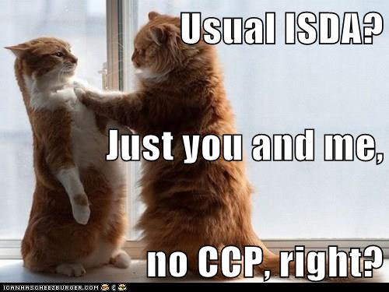
Risky Counterparty

Slide 6
Counterparty Risk
Counterparty risk is the credit risk that you will have a loss on a derivative position because your counterparty defaults / downgrades when they owe you money.
    Less when your counterparty has a better credit rating.
    Less if unrealized P/L is collateralized.
Different from issuer credit risk since the contract’s value does not depend explicitly on the counterparty.
    If the issuer and the counterparty are highly correlated, this is called “wrong-way risk.”
    Example – buying a CDS on the Greek government from a Greek bank.
    Worse example – buying a CDS on Citi from Citi.
  Since the loss is floored at zero, this introduces an additional layer of optionality – swaps become swaptions, options become compound options, etc.
  Basel-type regulations take a simplified view which is easier to implement and less messy but maybe not as realistic.
  As usual for credit risk regulations, they see everything as a loan equivalent as much as possible.

Slide 7
Credit Risk
If counterparty risk is credit risk, then it can be viewed, like the usual credit risk, as
  CCR = PD * LGD * EAD
    where CCR is counterparty credit risk
    PD is Probability of Default of the counterparty
    LGD is the percent loss of “the” value, given default
    EAD is the exposure, or “value,” at default
    PD and LGD are relatively easy to model and validate. EAD is so messy that it may fundamentally change all derivatives pricing.
  Note the above is a default-only view, which is not sufficient – counterparty risk involves downgrade risk as well.

Slide 8
Alphabet Soup
There are several acronyms involved with counterparty risk:
Netting set – a portfolio of derivatives that legally can be netted at bankruptcy
CVA – Credit Valuation Adjustment is the incremental dollar exposure of a netting set to counterparty default
DVA – Debit Valuation Adjustment is the counterparty’s incremental exposure to your firm’s default
FVA – Funding Valuation Adjustment is the incremental P/L of funding the derivative positions and hedges and collaterals.
LVA – Liquidity Valuation Adjustment is controversial and not completely accepted
NVA – Nonlinearity Valuation Adjustment is a Brigo/Pallavicini correction since their method otherwise involves double-counting

Slide 9
More Alphabet Soup
PFE – Potential Future Exposure is the maximum on a given future date of {zero, value of the portfolio} under a particular scenario
PE – Peak Exposure is the n% confidence level highest PFE on a given date under many scenarios – similar to a VaR
MPE – Maximum PE between now and a given date
EE – Expected Exposure is the average (note: Monte Carlo) of the distribution of PFE exposures from the derivative portfolio at each future date
EPE – Effective Positive Exposure is the weighted time-average EE
EEE – Effective Expected Exposure is the maximum EE between now and some particular future date
EEPE - Effective Expected Positive Exposure is the weighted time-average EEE
CSA – Collateral Support Annex adds bilateral collateralization to the netting agreement.

Slide 10
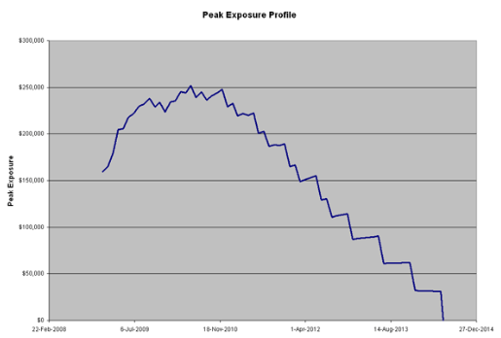
Archetypal PE graph
MPE

Slide 11
Hull-White View
  The market-clearing price is the price on the screen, which is the same for all market participants.
  An additional CVA charge for taking the counterparty’s credit risk, less a DVA charge for them taking on your credit risk, can be passed on as part of the trade’s cash exchange at inception.
  Other costs of production (funding, hedging, funding the hedge, etc. should not be part of the price passed on from seller to buyer, because it could lead to arbitrage and perverse incentives.
  This view is comforting, but it does not explain some of the odd behavior during the crisis. Some prices of vanilla instruments on the screen began to violate standard no-arbitrage relationships.
  Do we really need to abandon our usual models just because they failed during the GFC?
  Compare with widget pricing in the non-finance world

Slide 12

The next crisis

Slide 13
Brigo-Pallavicini View
  In the older paradigm without counterparty risk, derivatives were priced in isolation from their buyers, sellers, or environment, they were, as the QED physicists would say, “naked” prices.
  Including realistic things like funding the trades, collateral, credit risk of the counterparty defaulting, your credit risk increasing if you borrow money to fund the trade, etc., the trade’s value is “dressed.” The various “adjustments” CVA, DVA, FVA, and possibly others, are the “clothing.”
  With counterparty risk, the “Law of One Price” does not apply internally – the risk-neutral value now includes asymmetric components so the accounting value of the exit price differs from the seller’s value, which differs from the buyer’s value.
  Viewed this way, the price is the actual dollar amount paid directly at deal inception from buyer to seller, which is not the seller or the buyer’s change in value due to the new position, and may include some CVA/DVA. The adjustments are the difference.
  Since no two firms are exactly alike, the adjustments for one firm differ from those of the counterparty. They are not quite additive.
  How much of these adjustments can the seller pass on to the buyer?

Slide 14
What should validation include?

Slide 15
What Validation Isn’t
There are no Laws of Finance. Financial data do not follow any stochastic process, but Wall Street uses heuristics – build models as if the models worked, so an approximate answer can be found.
The “Law of One Price” may go away with counterparty risk included, so don’t go calling the model cops.
Models are not intended to capture all the nuances of the real world.
All models are based on one or more assumptions.
Models are never “valid” in an absolute sense. They rely on assumptions about the behavior of people, organizations, acts of the natural world, and the use of other models by market participants.
A model is a mixture of behavioral psychology, statistics, numerical methods, and subjective opinions, and some parts of any model are dictated by law, regulation, or company policy. Validation of Basel 3 regulations is out of scope for any model’s validation.

Slide 16
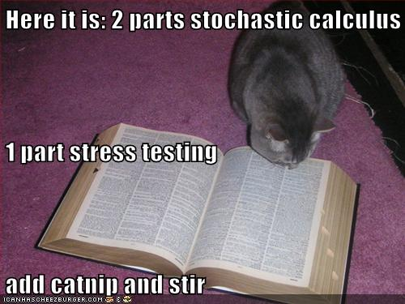
There is no Validation cookbook

Slide 17
Development Cookbook
Curiously, an electrician who installed an outlet in my basement had these same 3 rules for his work.
1. Pay Attention
What are the instruments you are trying to model? Did you use the right netting agreement? What did Basel actually ask for?
2. Think About What You Are Doing
You are going to dinner at Nobu in an hour, and the TV in the kitchenette is broadcasting your favorite team’s tie-breaking game. Neither of these should affect the nesting of parentheses on your if statement.
3. Double-Check Your Work
Limiting cases and backtesting
Benchmarking against other models
Compiler warning messages, rereading the term sheet, etc.
A second set of eyes (independent validation)

Slide 18
What validation is
I would define the validation of a financial model as a test of how suitable it is for its intended use, which involves a simultaneous test of assumptions, inputs, calibration, implementation, and usage.
  The physical sciences have laws of nature called "theories," that observation or experiments can verify or disprove.
  In finance, however, there are merely significant tendencies and patterns
  Quantitative financial models are necessarily generalizations that events in the real world will sometimes contradict..
  Different assumptions and different intended uses will in general lead to different models.
  Models intended for one use may not be suitable for other uses.

Slide 19
What validation doesn’t cover
The two crucial elements of validation are independence and effective challenge
The validator asks questions, but often it is not their job to answer
You validate the model you are given, not the one you wanted to see
Be very careful with alternative models – if they adopt your model then you might no longer be independent enough to validate it
    I suggest that whenever you offer an alternative, offer at least two so you avoid them saying “I just did what you told me to do”

Slide 20
Your First Model - Eyesight
Look at another person’s face. Every few seconds, you will see their eyelids as they blink. You, too, blink every 2 – 10 seconds. Does your perception of the outside world include the reality of it disappearing briefly when you blink, and seeing your eyelids?
It does not. Your vision model is hardwired to disregard the momentary blackouts caused by blinking. What you perceive is a somewhat idealized model of what photons do or don’t hit your retina.
My point is that models are not reality even when you think they are, and that their deliberate omissions may be helpful and desirable. Simplification to emphasize what’s important is a good thing.

Slide 21
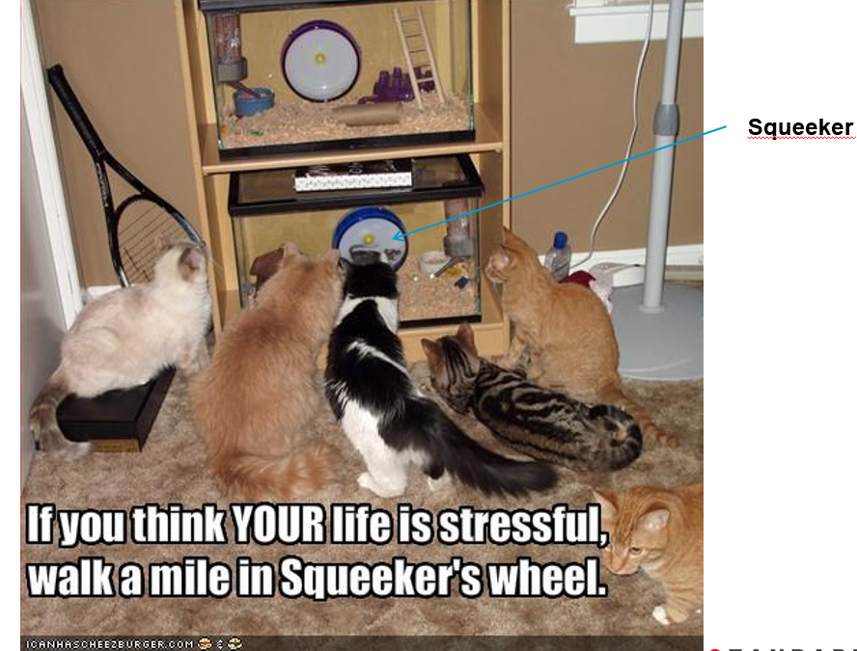
When Does a Counterparty Default?
Most of the time no investment-grade counterparty defaults.
Most counterparty defaults happen during stress periods. A stress event is not just a bad day – it has different dynamics, and needs a specialized model.
  A bad day is more cats.
  Stress is when the glass breaks.

Slide 22
Pre-validation checks on paperwork and regulatory compliance

Slide 23
Netting Sets
Portfolios of derivatives between your firm and the same counterparty might lead to a single net exposure at default, or might not. An important aspect of validating counterparty risk is to ensure that each derivative position is assigned to the right netting set in a legally binding way.
A netting set is the set of derivatives covered by the same netting agreement.
Each counterparty may have zero, one, or more netting agreements with you. Some may be collateralized (CSA), some use a Central Counterparty (CCP), some maybe neither.
At default, the creditors will try to collect on any position where the solvent counterparty owes the defaulted one, and try to say that those positions do not net with any others, if you cannot prove otherwise.
Verify that all the netting agreements have good legal opinions, and that your trade capture systems put the positions into the proper netting set. Is there a process to monitor netting set assignments and correct errors quickly?
The Lehman vs. LBHI case shows how this issue can tie up funds for years.

Slide 24
Netting Set Schematic
Your Firm
Collateral
Collateral
Collateral
Netting Set A
Netting Set B
Netting Set C
Netting Set D
Netting Set E
Trades 1-20
Trade 21
Trades 22-70
Trades 71-90
Trades 91-200
Collateral
Collateral
Collateral
Counterparty

Slide 25
Dealing with Regulators
There are several ways to model counterparty risk, which are mutually exclusive. Basel has strict rules against using one method for some trades but a different one for others. The most complex method probably leads to lower charges, but is more computationally intensive and may be infeasible for some exotic derivatives.
You can’t easily change your mind about which to use.

Slide 26
Comparison to Issuer Credit Risk

Slide 27
Formula for Credit Risk
Credit Risk is usually measured as Risk = EAD × LGD × PD
PD is the Probability of Default
  Do not assume that the PD of counterparties to derivatives transactions is the same as for a typical bond issuer or loan borrower.
  Part of your validations should be to check whether the PD in the model is calibrated to the kind of counterparty who does OTC derivatives with your firm.
LGD is the Loss Given Default, which is 1 – Recovery Rate
  Again, this may be different for derivatives counterparties than your usual corporates.
  Until 2007, you might not have had much default data to calibrate a counterparty LGD model.
  After Lehman, Merrill, Bear-Stearns, etc. you probably have lots of data. Did the model developer use it?
EAD is Exposure At Default. Here is where the fun begins.

Slide 28
The Nature of Derivatives
The price of a derivative varies with time, the price of the underlying, the market’s perceived implied volatility (for options), discounting rates, etc.
Once you add counterparty risk, everything is an option – the counterparty can choose to default or you can choose to default., so the payoff of CVA / DVA has an extra level of optionality compared to the default-free valuation.
Collateral mitigates but does not extinguish counterparty risk – the side that fails to post collateral after a margin call has some time – the “cure period” also called the margin period of risk– to post it, and the market moves during that time. Typically this is 5 days for CCP and 10 days for a standard CSA.
Central Clearing Parties (CCP) – not to be confused with the old Soviet Union – CCCP – are not considered entirely risk-free. Historically, clearinghouses almost never go bankrupt, but they sometimes drive some or all of their clearing members into insolvency.
Once you buy / sell an underlying, you don’t care who you bought it from / sold it to. For derivatives, you are still exposed to the seller / buyer.
If the counterparty defaults on a centrally cleared trade, and nobody bids in the auction, then you could have a much larger loss.

Slide 29
Validating CVA, DVA, and FVA for Smaller Banks

Slide 30
The Current Exposure Method
The CVA is measured by a very approximate Basel rule. DVA and FVA are more-or-less ignored.
CVA is set to current MTM exposure plus a PFE set at notional times the conversion factor based on instrument types and tenors in the netting set. The netting of PFE is mandated to be
PFEnet = [.4 * Σ(individual PFE)]
+ [.6 * Σ(individual PFE * Net-to-gross ratio) ]
Not much here to validate. Just compare the model to Basel and to the Fed rules.
This method gives little or no insight into your actual counterparty risks, unless you are very long or very short. However, be sure you can pass the use test.

Slide 31
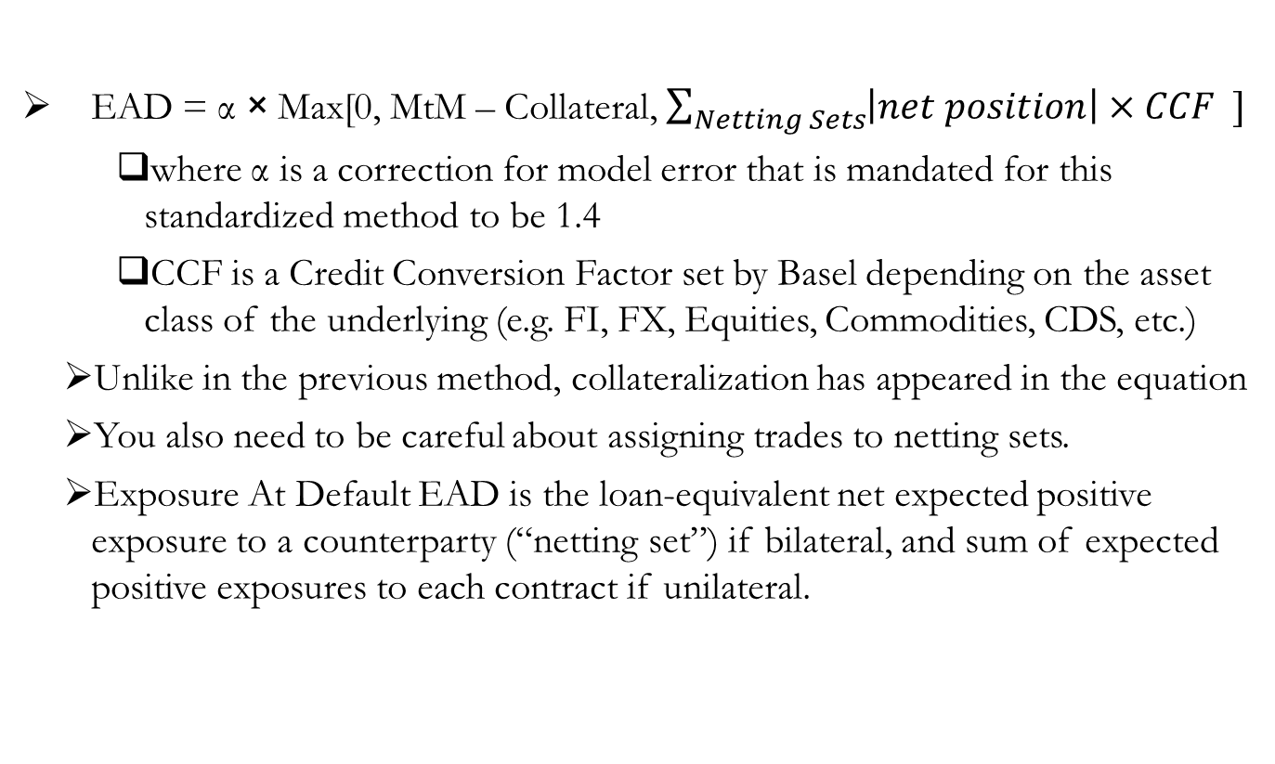
The Standardized Method
EAD = α × Max[0, MtM – Collateral, $\sum_{Netting Sets}{\left|net position\right|×CCF ]}$
    where α is a correction for model error that is mandated for this standardized method to be 1.4
    CCF is a Credit Conversion Factor set by Basel depending on the asset class of the underlying (e.g. FI, FX, Equities, Commodities, CDS, etc.)
  Unlike in the previous method, collateralization has appeared in the equation
  You also need to be careful about assigning trades to netting sets.
  Exposure At Default EAD is the loan-equivalent net expected positive exposure to a counterparty (“netting set”) if bilateral, and sum of expected positive exposures to each contract if unilateral.

Slide 32
Validating CVA, DVA, and FVA for SIFI

Slide 33
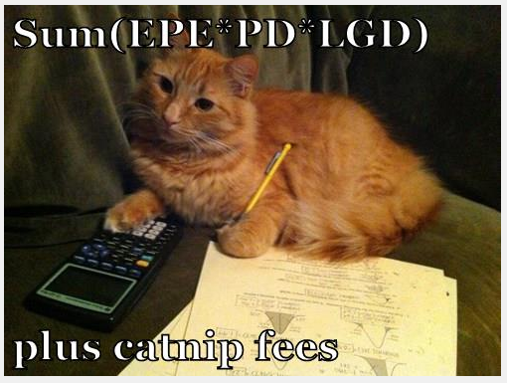
Quants at work

Slide 34
Computational requirements
CVA exposures must be calculated at the level of a netting set, not an individual derivative. Be sure the system has all the netted positions in the same bucket and can do forward valuation on all of them.
The extra optionality is almost always calculated by Monte Carlo simulation. If there are exotics which are priced with MC, then counterparty credit risk needs a second layer of MC – simulations within simulations.
There are at least two ways to solve this –
    More hardware – clusters of GPU
    Approximation – proxy the exotic with something less exotic but faster to do pricing simulations, and do something with the approximation error (Ignore it? Reserve for it? Other?)
    Typically firms do a bit of each.
    Can you do a Longstaff-Schwartz?

Slide 35
Long simulations
A key part of the Internal Models Methodology is projection of the EPE for the entire timespan of the longest-maturity derivative in the netting set, or at least the weighted-average maturity.
    Realistically, there is likely to be a financial crisis again in the next 30 years. If your netting set has 30-year swaps in it, have the model developers accounted for this?
    For Stress VaR you need a Stress CVA. How do you simulate this? How many past crises do you calibrate to? (2008-9, 2000-2001, 1998-9, 1987, etc etc, maybe the Great Crash of 1843?)

Slide 36
Long simulations
  The UK long bond rate rose 360 bp in 1974, and fell 188 bp in 1983. Since 1999, the largest annual rise was 39 bp and the largest annual fall was 82 bp. In the US, annual data from 1987 – present have the change in long bond yield vary from -92 bp to +75 bp. In 1986 it went down 235 bp, and in 1980 it went up 231 bp, and a further 223 bp in 1981.

Slide 37
Alpha
  Remember that fudge factor α = 1.4? To calculate this, you will need some deep Economic Capital calculations.
    The regulation says that to use your own estimate of alpha, “the bank may calculate alpha as the ratio of economic capital from a full simulation of counterparty exposure across counterparties that incorporates a joint simulation of market and credit risk factors (numerator) and economic capital based on EPE (denominator), subject to a floor of 1.2. For purposes of this calculation, economic capital is the unexpected losses for all counterparty credit risks measured at a 99.9 percent confidence level over a one-year horizon.”
    So you need a full simulation of EC with all the factors moving at once, calibrated to the worst year in a thousand.

Slide 38
99.9% Worst Year
  What does this mean? To calibrate ten-day 99% VaR, you need at least 1 year – 250 trading days – of data. So then a factor of 25:1.
  Then 99% 1 year EC needs 25 years of data, and 99.9% EC needs 250 years of data.
  The US declared independence in 1776, 14 years after the start of the 250-year calibration window. The validator should check where this ancient data came from. Might there have been some regime changes in the data timeseries?
  Since you don’t have it, what proxies did the model use? How long a history did you use? What is the truncation error?
  In a bad year, what was the interest rate compared to good years? For example, on Auction-Rate Securities?
    Illiquidity needs to be considered

Slide 39
More Alpha
  The alpha multiplier is intended to make counterparty credit risk economically equivalent to a loan.
  Evan Picoult of Citigroup figured out how to do this, worked out the details with Eduardo Canabarro (then GS, now Morgan-Stanley), and Tom Wilde (CSFB) and Basel adopted this methodology.
  Tom Wilde did some experiments and found a range of 1.02 - 1.43, with an average of about 1.1.
  Basel mandated α = 1.4 at first, but now allows internal calculations subject to the floor α = Max(α you calculate, 1.2).
  Whether your firm wants to do sophisticated enough simulation techniques to drive calculated alpha below 1.2 or not is a business question. Validate it as given.
  If your EPE includes all market and credit factors, plus liquidity and such, then α will be exactly one.

Slide 40
Q and R
  The MC generator for paths is using the real-world R measure since this is for risk, but any forward valuations are in the Q measure. You need to bounce back and forth.
    The validator should be very carefully checking which measure is used when.
    If you treat EPE as a present value, then you use the Q measure throughout.
  The model runs a netting set through a large set (convergence testing?) of MC scenarios to get an envelope of EPE, and some quantile is chosen.
  In the Hull-White paradigm, similar to the alpha calculation denominator, the credit and liquidity environment is not embedded in the path generator.
  In the Brigo-Pallavicini paradigm (note these two are my terms, not the industry standard) everything is modeled together – where does funding come from, how do repo rates interact with macroeconomic liquidity, how are you hedging, where are you funding your hedge, and so on. This leads to FVA.

Slide 41
Basel Capital

Slide 42
What is Economic Capital
  Capital is a “Rainy Day Fund” to ensure your institution does not go bankrupt in a bad period
  Potential unexpected loss, over a specified time horizon, at a specified confidence level.
    Market Risk Regulatory Capital = VaR - 99% ten day
      Worst 2 weeks of 4 years
    Basel Economic Capital - 99.9% one year
      Worst year of the millennium - somewhat hard to backtest
    Basel PD Floor (~ AA rating) Economic Capital - 99.97% one year
      Based on the .03% transition probability from AA-> D
      Third worst year in 10,000
      Very hard to calibrate or backtest with actual historical data
        What was the effect on your bank of the invention of agriculture? Of writing?
        How many of your swap counterparties defaulted when Rome was sacked?

Slide 43
Extrapolation
  In the 1000-year long run, your firm will default or otherwise vanish.
  How many of you (show of hands) work at a firm founded before 1014?
    The only derivative contract with a long history is the Japanese rice futures which has only a 400 year history, and most OTC derivatives trading started in the 20th century but did not exist in the 19th.
  You cannot do non-parametric extrapolation
    Mindless- assume Gaussian or lognormal – Basel expressly disallows this
    Crises usually do not follow the same statistics as ordinary times
    Now that counterparty risk includes downgrades the extrapolation is less tricky
    Extreme value theory is questionable since it assumes stationarity
    Better – what functional form fits the data you have so you can extrapolate
    I like the Tukey g×h distribution, where g controls skewness, h controls the fatness of the tail, and the quantiles are known.

Slide 44
Conclusions

Slide 45
Conclusions
  Counterparty risk models range from the very formulaic to the extremely exotic cutting edge.
  It is mandated by various regulators so you have to have it.
  There is a lot of CVA jargon.
  There are no laws of finance.
  Validation means asking questions. You are not building a better mousetrap, just testing theirs.
  Counterparty risk is reduced but not eliminated by collateral and CCP
  The decision on whether to get sophisticated enough to get α<1.2 is not up to the validator.
  Pay attention to the distant past.

Slide 46

Questions?

