Slide 1
Gini coefficients demystified Definition, use, alternatives
Martin Goldberg
martin@quantvalidation.com
March 11, 2013

Slide 2
Outline of this talk
Motivation
Who was Gini
What does it mean?
Alternative measures
Conclusion

Slide 3
Motivation for this talk

Slide 4
Why this talk?
S&P uses the Gini coefficient as the main summary number to communicate its ratings accuracy to the outside world.
Regulators, investors, issuers, etc. want a measure to compare S&P ratings to reality and to our competitors’ ratings.
Banks usually use Gini coefficients as the summary measure for how well their PD models perform.
We use it as a measure of the relative rank-ordered power of a ratings system.
It is a one-number summary, so some details get averaged out
Some of you may not know as much as you want to about this measure, or unsure of whether a certain Gini is “good” or “bad,” or may not be aware of alternatives.

Slide 5
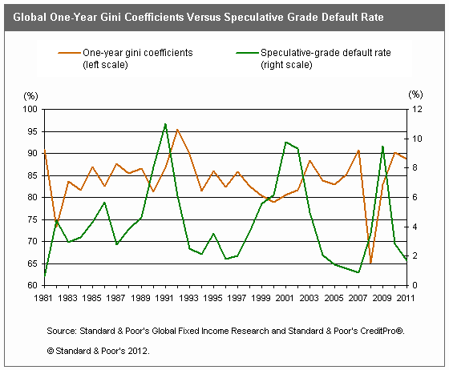
An example
From a GFIR report issued September 19th on RatingsDirect:

Slide 6
Who was Gini?

Slide 7
Corrado Gini
Dr. Corrado Gini (1884 – 1965) was an Italian statistician.
Although he published 800 papers, he is mainly known for the Gini coefficient, which is the subject of my talk today.
He also complained (in the late 1940’s) about the field of statistics becoming too formalized and disconnected with the real world, much like today’s criticisms of quants by leading quants such as Derman and Taleb.

Slide 8
The Gini Coefficient
Gini developed this as a measure of inequality of wealth. A Gini coefficient of zero means everyone has the same income, and a Gini of one means one person has all the income and everyone else is penniless.
Country | Gini (from CIA Factbook)
Namibia | 71%
South Africa | 65%
China | 48%
USA | 45%
Russia | 42%
Canada | 32%
Hungary | 25%
Sweden | 23%

Slide 9
What does it mean?

Slide 10
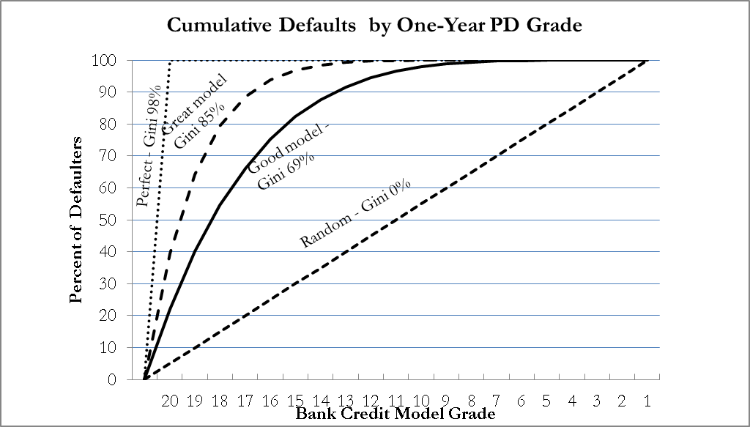
Gini coefficient for bank PD models
Higher Gini means better predictor of default
Assumes all defaults have happened or not already – measurement at end of prediction period
All defaults equally weighted
Equal weight for false default and false survival predictions
Gini coefficient is ratio of the shaded area divided by the area of the triangle above the diagonal.

Slide 11
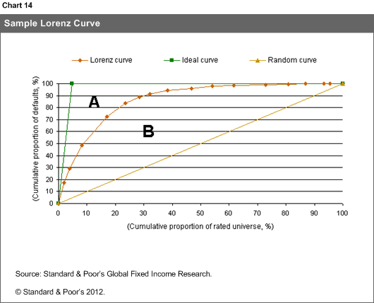
Gini coefficient for ratings
S&P ratings are not probabilities of default.
Measured credit event could be default, downgrade below CCC-, downgrade below Credit Stability Criteria limit, etc.
Usually S&P uses defaults, since less subjective
AAA
BB
BBB
A
CCC

Slide 12
Gini coefficient for ratings
An S&P rating on a 10-year bond has a horizon of 10 years, and not just one year. Measure Gini after some arbitrary interval.
Merging score categories will lead to a lower Gini. For example, this would happen if you ignored the + and – on ratings.
Defining a “perfect model” to calculate an Accuracy Ratio would require more assumptions; S&P GFIR uses Gini.
One-year Gini for S&P ratings, from RatingsDirect 9/10/2012
Performance varies over time

Slide 13
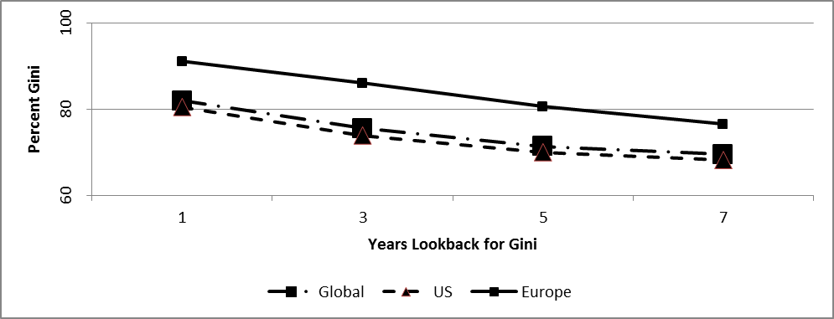
More on Ratings Gini coefficients
Gini coefficients of a less diverse pool will be lower.
Gini depends on portfolio composition and quality, which makes comparison of model performances across history, geography and asset classes difficult
The Gini gets worse for longer tenors – information decay
Corporate Ratings Gini Coefficients By Region (%)
Region | One Year | Three Year | Five Year | Seven Year
Global | 81.9 | 75.5 | 71.4 | 69.5
US | 80.5 | 73.9 | 70.0 | 68.2
Europe | 91.1 | 86.0 | 80.6 | 76.5

Slide 14
Is a reported Gini coefficient high enough?
Although comparing Gini over time and across asset classes is not an easy task, a general rule of thumb is that if Gini is less than a half – below 50% - it’s probably not something to brag about.
SF Gini may be artificially inflated by their subordination – within one deal, the lower rated tranches will certainly default before the more senior ones. One solution is to use only one tranche per structured deal in the Gini measurement.
Gini for asset classes with low default rates may not be as meaningful.

Slide 15
Alternatives

Slide 16
AR
Accuracy Ratio (AR), a summary of the Cumulative Accuracy Profile (CAP) curve, is the ratio of Gini coefficients $\frac{{Gini}_{model}}{{Gini}_{perfect}}$ which for the perfect model is a ratio of 1, for the random guess model is zero, and for the other two curves on the previous slide the AR are 70% and 87%.
One difference from a Gini is that even in a perfect model, although the Accuracy Ratio is 1 by design, the perfect model’s Gini coefficient is less than one.

Slide 17
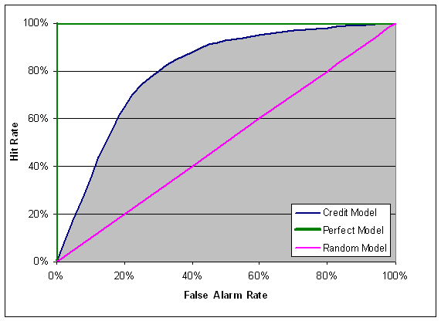
AUROC
A related measure, the Area Under the Receiver Operating Characteristic (AUROC) is the area under the curve of False Alarm Rate (FAR) (type 2 error – predicted defaults that didn’t happen) on the x axis plotted against the hit rate (accurately predicted defaults, also called Correct Alarm Rate CAR).
If false alarms and false non-alarms are equally important, there is a relation AR = 2 X AUROC - 1

Slide 18
Conclusions
Gini coefficients are a convenient shorthand
S&P regularly measures Gini of our ratings
There are other equally valid measures, but Gini is the best-known
Higher is better, but comparing Gini of different lookback periods or different asset types requires some judgment

