Slide 1
Model Pitfalls
Martin Goldberg
Senior Director
Head of Model Quality Review
Standard and Poor’s
martin_goldberg@standardandpoors.com

Slide 2
The Usual Caveats
This is not intended to be a fully inclusive handbook. Risk management is not a simple task, and you will have to put thought and effort into it beyond attending a conference, to get best practice at managing model risk.
The pitfalls that you avoid will always be easier to find than
the ones you missed.
My experience is primarily with valuation, VaR, Op Risk, and Credit Risk models, so this may be less informative about Enterprise Risk, stat arb and portfolio construction models.
I am not speaking as an authorized spokesperson for Standard & Poor’s.

Slide 3
Outline of My Talk
Definitions of Terms
Coding Bugs
Inappropriate Assumptions
Inappropriate Calibration
Model Replication Strategies
Extrapolation is NOT Interpolation
Inappropriate Use
Preventative Measures and Remediation
Conclusions

Slide 4
Outline of My Talk
Definitions of Terms
Coding Bugs
Inappropriate Assumptions
Inappropriate Calibration
Model Replication Strategies
Extrapolation is NOT Interpolation
Inappropriate Use
Preventative Measures and Remediation
Conclusions

Slide 5
Model
A quantitative model is a controlled view of certain real world dynamics that is used to infer the likely consequences of some pre-specified assumptions under various circumstances.[1] In other words, it is a calculation based on one or more assumptions. Models are not black boxes of revealed truth but merely numerical expressions of some view of how the world would be likely to behave.
The models used in finance rely on assumptions about the behavior of people, organizations, acts of the natural world, and the use of other models by market participants. Quantitative financial models embody a mixture of behavioral psychology, statistics, numerical methods, and subjective opinions.
Best practice is for the assumptions to reflect, whenever possible, the opinion of the firm – this requires that senior management be clear and consistent about the firm’s views, and that every model reflects those views.

Slide 6
Validation
I define the validation of a financial model as a test of how suitable it is for its intended use, which involves a simultaneous test of assumptions, inputs, calibration, implementation, and usage.
  The physical sciences have laws of nature called "theories," that observation or experiments can verify or disprove.
  In finance, however, there are merely significant tendencies and patterns
  Quantitative financial models are necessarily generalizations that events in the real world will sometimes contradict..
  Different assumptions and different intended uses will in general lead to different models.
  Models intended for one use may not be suitable for other uses.

Slide 7
Assumption part 1
Assumptions can be of several types:
Processes
  The generic process assumed by most naïve models is a lognormal, stationary, homoskedastic diffusion with no jumps – Black-Scholes.
Time frames
  Different assumed time frames may lead to entirely different models. Assuming that a model is to be used for high-frequency trading will likely lead to an entirely different model than the assumption that any “transient” effects of duration less than a few years are unimportant for the model’s intended use.
User demands
  A model that needs to produce a result in less than a millisecond will likely be very different than if you assume the user is willing to wait a few days for a result. This trade-off between speed and intricacy is a necessary decision in constructing most financial models. What effects are deemed “minor” and not modeled depends on, among other factors, timing.
  A model that the user doesn’t trust, can’t understand, and therefore won’t use is a “pointless” model.

Slide 8
Assumption part 2
Inputs
  All models require inputs. Which ones will be available at run-time, and how reliable are those inputs? Do they need preprocessing or manual adjustment?
Fixed Numbers and Parameters
  In some cases, a model parameter is set by another model, policy, the user, or by regulation. For example, VaR is required by Basel to assume you are calculating the 99th percentile. S&P Criteria assume values for some model inputs based on the firm’s expectations – e.g. S&P defines a AAA rating as being expected to survive a future crisis as severe as the US Great Depression of the 1930’s.

Slide 9
Pitfall
The dictionary defines a pitfall as “a hidden or not easily recognized danger or difficulty.”
I will not discuss the obvious bugs where the code blows up or the result is NaN or ∞.
Although some models can be shown to have issues, you cannot in general prove that none exist; only that you didn’t find any.
One especially nasty pitfall is if the model has the expected limiting behavior at extreme values but the questionable area is in the middle somewhere seemingly innocuous.

Slide 10

Beware of Hubris
A very serious pitfall is where the model is built to satisfy incorrect assumptions -the right answer to the wrong question.

Slide 11
Outline of My Talk
Definitions of Terms
Coding Bugs
Inappropriate Assumptions
Inappropriate Calibration
Model Replication Strategies
Extrapolation is NOT Interpolation
Inappropriate Use
Preventative Measures and Remediation
Conclusions

Slide 12
Types of Implementation Error
Correctly solving the wrong problem
  The contract states that the herd-of-llamas feature has a triple axel but your model has only a double axel.
  Intex has a weekly report of incorrectly coded waterfalls that they fixed that week.
Rushing to completion
  Most of us have deadlines to meet. Very complex models are harder to implement. Remember Hofstadter’s Rule, which states that everything takes longer than you think it will, even after you take Hofstadter’s Rule into account.
Not testing rarely used code
  The fundamental law of the universe is Murphy’s Law, stated by Feynman for quantum mechanics as “Anything not forbidden is compulsory.”
Insufficient error checking
  I define “production quality” code as meaning half the lines are comments, and half of the executable statements are error checking.

Slide 13
Outline of My Talk
Definitions of Terms
Coding Bugs
Inappropriate Assumptions
Inappropriate Calibration
Model Replication Strategies
Extrapolation is NOT Interpolation
Inappropriate Use
Preventative Measures and Remediation
Conclusions

Slide 14
Inappropriate Assumptions
Assumptions are not necessarily “right or wrong”
Are they suited to their intended use?
  Different assumptions and different intended uses will in general lead to different models, and those intended for one use may not be suitable for other, unintended uses. Weaker performance under such circumstances does not necessarily indicate defects in a model but rather that the model is being used outside the realm for which it was optimized.
Oversimplified or Overly Complicated Assumptions
  neglecting jumps, skew, seasonality, etc.
  So complicated that it is analytically intractible, impossible to implement, or takes too long to run
Too few or too many stochastic processes
Assuming calibrating instruments are more (less) liquid than in reality
Is a proxy appropriate for the intended use?
  (single stocks vs. S&P 500, bespoke tranches vs. iTraxx, CAD vol skews vs. USD vol skews)
Does your organization have a preferred framework for this to fit into?

Slide 15
Firmwide Consistency
There are very few truly monoline firms. Ensuring consistency across all products whenever possible is, in my opinion, essential to best practices.
Especially after a merger, it can be a serious problem if two related parts of the same company start trading against one another because they have different and incompatible assumptions or implementations.
This requires senior management involvement; otherwise you have the situation where one silo would rather plunge their arms in boiling oil up to the elbow rather than use the same model that the other silo built.

Slide 16
Linear Combination of Elephants
Ordinary Pearson correlations and Gaussian copulas are easy to work with and have very few parameters to calibrate.
If you assume every new data point is a regime change you can’t do any historical studies. If you assume no two assets have similar dynamics you can’t do panel studies or use proxies. On the other hand regime changes can and do happen.
Expediency and tractability can conflict with sophistication. This is a trade-off.
Linear Combination of Elephants Mixture-of-normals or mixtures of Gaussians and lognormals is analytically tractable. You have Poisson jumps between several Gaussians of different widths with associated probabilities which must add to one. Each Gaussian has 2 parameters μ and σ. Taking this approach to extremes we get the Linear Combination of Elephants Theorem: Any closed curve on the plane can be represented to any desired degree of accuracy by adding or subtracting sufficient numbers of elephant outlines in different sizes and orientations.
You use much smaller ones, rotated, to subtract off the legs, trunk, tail, and tusks that stick out too far, recursively.

Slide 17
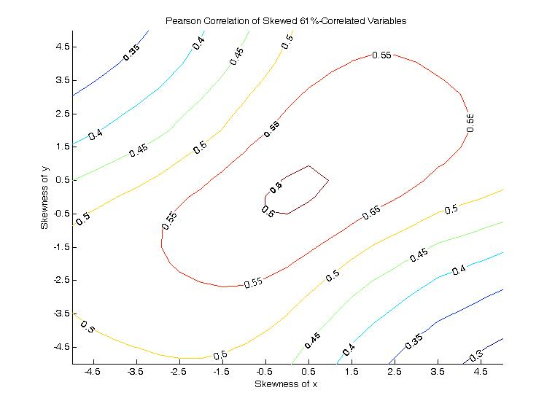
Assuming that Correlation is an appropriate measure
The classic variance-covariance framework used by many models assumes a stationary pair of Gaussian variables with a Gaussian copula.
Correlation is not a meaningful concept for non-elliptical (skewed) distributions.
“Correlations” in stressful times may be unrelated to the usual, or even reversed – this is part of contagion.
In this simulated example, the Gaussian drivers of two processes are 61% correlated. Consider scenarios where we test robustness to skewness in the distribution of one or both observed processes. A rank correlation remains stable, but the Pearson correlation is an underestimate of concordance. Skewness of equity indices: Australia is -2.8, US -1.2

Slide 18
Outline of My Talk
Definitions of Terms
Coding Bugs
Inappropriate Assumptions
Inappropriate Calibration
Model Replication Strategies
Extrapolation is NOT Interpolation
Inappropriate Use
Preventative Measures and Remediation
Conclusions

Slide 19
Some Potential Calibration Pitfalls
Deliberate Miscalibration
  “let’s leave out that event –we’ll never see anything like that again”
  “that must be a bad tick –the curve couldn’t be that kinked”
  “the trader just sold at a much lower price –your model is overpricing; fix it!”
Local Minima in the fitting function
Unstable calibration -leads to wild swings in hedging prescription
Calibrating to a bad tick (unscrubbed data)
Recalibrating too often or too infrequently
Calibrating to stale or fictitious market –if the model needs a price that doesn’t exist then you should use a simpler, or at least a different, model

Slide 20
Questions to Ask Yourself About Calibration
Are you calibrating the model to the appropriate instruments?
Is the calibration set the same as the intended hedge instruments?
Are you calibrating in the real world or in risk-neutral?
  Be careful. Sometimes you have, in the same model, both liquid-market parameters calibrated risk-neutral and historically estimated parameters calibrated in the real world measure.
Does your organization have a preferred framework for this to fit into?
  Don’t create unnecessary work for yourself by starting from scratch and conflicting with all the other models in your shop, unless you really have to.
If you create a new paradigm, does it extend to all the existing products done the old way?
Does your minimization algorithm to calibrate account for the relative liquidities and bid-ask spreads of the various calibrating instruments?
Does the model “smell wrong” to the users?
  Talk to the clients. Even quants need some people skills.
What does the calibration error look like? Graphics are very useful.

Slide 21
Another Question to Ask Yourself About Calibration
Is the algorithm robust and stable? Do you want it to be?
  Many of the statistical tests in the literature fall apart if anything is non-Gaussian or otherwise not i.i.d.
  On the other hand, if the intended use is just in the “tail” it may be better to get the tail right.
  A statistical modeling procedure is said to be robust if the output is relatively insensitive to small changes in the underlying assumptions, small changes in much of the input, or large changes in some of the input (“outliers” or “anomalies”). Some robust techniques work even when almost half the data are outliers. In the physical sciences these anomalies are often plausibly attributed to measurement errors; in finance there are usually separate data scrubbing procedures applied before the data enters the model. Referring to actual observed data as outliers is equivalent to a belief that the model is right and the data that don’t fit are drawn from a separate, irrelevant, or uninteresting model, and should be ignored, or represent phenomena that the modeler does not want to capture. These robust models claim to fit the relevant data even if almost half the data don’t fit. A graphical indicator that an extreme data point is not an “outlier” (neither a mismeasurement nor a draw from a different distribution) is if the point does not sit alone, but instead is consistent with extrapolation from the bulk of the data.

Slide 22
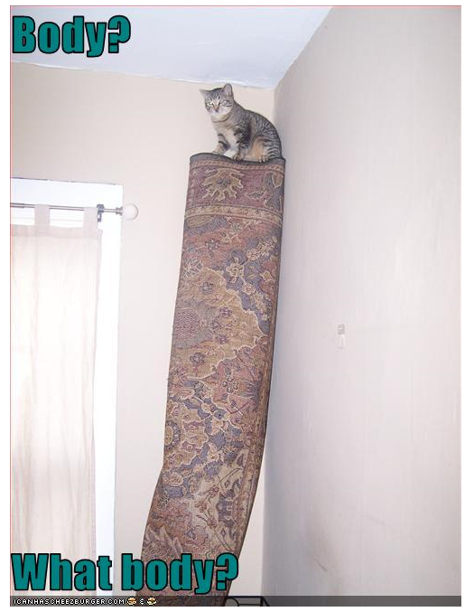
Are you missing something important?

Slide 23
Excess Sophistication
In my opinion, you should not invoke jumps just to cover up deficiencies in the model of the diffusion part. This is called the principle of basis set saturation - be sure you have fully modeled the simpler part you are sure is there (diffusion) as well as can be done, before you add in higher order effects (jumps). Otherwise you’re just adding “magic peanuts” to the elephant basis set.

Slide 24
Calibration Period
The UK long bond rate rose 360 bp in 1974, and fell 188 bp in 1983. Since 1999, the largest annual rise was 39 bp and the largest annual fall was 82 bp. In the US, annual data from 1987 – present have the change in long bond yield vary from -92 bp to +75 bp. In 1986 it went down 235 bp, and in 1980 it went up 231 bp, and a further 223 bp in 1981.
  Historical backtests might not cover historical periods stressful enough to expose model issues. No historical calibration using a currency with a pegged FX rate can test how the model handles FX rate shifts.
Basel rules require at least 1 year of daily data (~250 points) to calculate a 10-day 99% VaR. This implies 10 years to calculate a 100-day VaR, and ~25 years to calculate an annual 99% VaR. Going further, how much data does this mean you need for a one-year 99.9% VaR? 250 years?

Slide 25
What Data to Calibrate To?
Calibrating to live market data requires no assumptions of stationarity. However, if the market is very un-stationary, it has the same effect as unstable calibration -the hedge performance is lousy and the past is a poor indicator of the future.
Calibrating to a proxy or basket of proxies is a potential pitfall - how good is the proxy, and if you have too few data on the actual underlying, how can you tell if the proxy is good or not?
When you use a time series estimate, you have several choices, including:
  Assume stationarity and use all the data going back in time as far as possible.
  Use a digital-signal-processing type filter. The most common one in finance is the exponentially weighted moving average used by RiskMetrics, where you don’t actually calibrate the exponent, and there is no good reason to assume an exponential instead of cutting the filter with some other shape.
  Using only the most recent X years of data is another type of filter – does the data justify it?
  Statistical sampling error goes as T^{-1/2}. Assume the nonstationarity drift is linear (unless you have a better model for it) and then it goes as T. Then the total estimation error to minimize is λ₁T^{-1/2} + λ₂T. Estimate the λ from the data, and find the optimum data series length T*. This is easiest if you have equal data weights from today back to T* but you could modify this for some other filter shape. Preferably you would have some data-respecting reason to choose the particular filter shape. This technique is standard practice in atmospheric physics.
  Assume you know when the structural break was, and only use data from afterwards.

Slide 26
Expecting the Unexpected
Models used for ordinary risk (VaR, lending decisions, etc.) may completely miss the most serious risks.
  Events expected to happen less than twice per year are by definition not noticed in Value-at-Risk.
  Most retail credit scoring assumes that the historical patterns during the calibration period are a good predictor for next year – this is called “stationarity” – the past is assumed to be a good predictor of the future.
  One of the lessons from the sub-prime crisis, and most other crises from history, is that bubbles burst; markets change; and excessive optimism is the usual for most investors.
  Consider how some European governments, until quite recently, asserted that Greece is in fine shape, and could not conceivably default or leave the Euro.
  One solution is to augment the model with human judgment outside of any model.

Slide 27
Outline of My Talk
Definitions of Terms
Coding Bugs
Inappropriate Assumptions
Inappropriate Calibration
Model Replication Strategies
Extrapolation is NOT Interpolation
Inappropriate Use
Preventative Measures and Remediation
Conclusions

Slide 28
Right-sizing the number of parameters
Flexible enough to fit the “stylized facts” while remaining useable
  Too few parameters and neglecting some effects vs. too many and fitting to noise
  How many stochastic processes are needed for this product
Appropriate model for the intended use
Perfect calibration vs. Smooth surface with smooth derivatives
Parametrized (Structural) vs. Histogram (Reduced Form)
Try a few functional forms to see which works best

Slide 29
Who and what is the model intended for?
Clients can believe the calibration
  Every parameter tells a story
  Parsimonious models with very few parameters are easier to understand, but every parameter needs a descriptive and convincing name
  Graphical representation is extremely helpful –almost everyone likes good visuals
Understand what stresses will make your model collapse
  Allowing for contagion may need too many parameters, but then if it happens you knew your model would go wrong
  Decide in advance how far out in the tails you model is intended to look, even if it means performing poorly during uneventful times
  You may need different calibrations for different levels of stress

Slide 30
Replication Alternatives to Alleviate Pitfalls
Replication is the gold standard for testing straight coding errors
  build a new “toy version” of the model from the documentation, and run it head-to-head with the production version
  If the documentation is unclear, improve the documentation
  If you build the same model in the same language from the same documentation, you haven’t tested as much as you could
    Try to make your toy version more flexible; it doesn’t matter if it runs too slowly
    Consider using a different language for the toy version
    Consider using a different technique
      Binomial, trinomial, or multinomial grid [2] to replicate a Monte Carlo, or vice versa
      A more flexible stochastic process that has the production one as a limiting case (e.g. the Lambert W [3] generalized Gaussian, with or without jumps)
Test sensitivities to varying the assumed “fixed” parameters [4]
  Does a small change in parameter lead to large changes in results?

Slide 31
Outline of My Talk
Definitions of Terms
Coding Bugs
Inappropriate Assumptions
Inappropriate Calibration
Model Replication Strategies
Extrapolation is NOT Interpolation
Inappropriate Use
Preventative Measures and Remediation
Conclusions

Slide 32
Human Judgment
A simple interview question: Farmer Gray’s Organic Free-Range Eggs come from his small flock of ~300 hens on his small property on Long Island (note this is a fictitious example). Because of their outstanding quality, he charges $1.50 per egg, which is far more than the cost of supermarket eggs.
  How much would a box of a dozen eggs cost?
  How much would a truckload of a million eggs cost?
What would you have estimated a year ago as the chance of a revolution in Egypt? What about today? Same questions about Greece.
  Beware the implicit assumption that you can predict tail behavior from crunching existing data.
  Human judgment may be necessary to extrapolate to future dramatic events.
  In EVT, the tail of a distribution is by definition smooth and featureless. Every observed data point is a feature, which means it is not in the tail.

Slide 33
Outline of My Talk
Definitions of Terms
Coding Bugs
Inappropriate Assumptions
Inappropriate Calibration
Extrapolation is NOT Interpolation
Inappropriate Use
Preventative Measures and Remediation
Conclusions

Slide 34
Range of Appropriateness
Here is an example where the market moves outside the range of appropriateness
Calculate the forward implied volatility from given Black-Scholes implied vols from quoted options at 1 and 2 year tenors. Suppose the volatility of the 1 year option is 5%. The forward vol in a simple model (no jumps, no autocorrelation) would be
If the vol curve drops too quickly, as with some commodities, you need a more complicated model since imaginary forward vols are not meaningful
Imaginary forward vols

Slide 35
Inappropriate Extension
Suppose you have a model that works brilliantly for the US corporate loans market.
  Can you use it unchanged for the UK? What about if you recalibrate it?
  Can you recalibrate it to use in countries where charging interest is illegal?
  How well would the model work for exchange-traded rice futures?
  Will it still work for CLO when you need to have 5% “skin in the game”?
Suppose you have a model for electricity futures
  Does it work for spot? Probably not, because you can’t store electricity.

Slide 36
Outline of My Talk
Definitions of Terms
Coding Bugs
Inappropriate Assumptions
Inappropriate Calibration
Extrapolation is NOT Interpolation
Inappropriate Use
Preventative Measures and Remediation
Conclusions

Slide 37
Help to Avoid Pitfalls or at Least Climb Back Out
  Documentation written (or at least approved) by the business
    so what you coded was what they said they wanted
    Is what they wrote the same as what they meant?
  Business validation and independent validation / review
    Benchmarking to similar models, replication, test cases, stress testing
  Regular reappraisal
    Has the market or the firm’s assumptions changed enough to require model revisions?
  Comparison with firm’s other models to improve internal consistency
  Can you explain your model and justify its limitations to Senior Management?
  Consider combining human judgment with the model’s results.

Slide 38
Rabin’s Rules
(Mike Rabin was my boss in 1991)
Curiously, an electrician who installed an outlet in my basement had these same 3 rules for his work.
1. Pay Attention
  What are the features you are trying to model? Did you use the right day-count conventions? What did the client actually ask for?
2. Think About What You Are Doing
  You are going to dinner at Nobu in an hour, and the TV in the kitchenette is broadcasting your favorite team’s tie-breaking game. Neither of these should affect the nesting of parentheses on your if statement.
3. Double-Check Your Work
  Limiting cases and paper trading simulations
  Benchmarking against other models
  Compiler warning messages, rereading the term sheet, etc.
  A second set of eyes (independent validation)

Slide 39
Outline of My Talk
Definitions of Terms
Coding Bugs
Inappropriate Assumptions
Inappropriate Calibration
Extrapolation is NOT Interpolation
Inappropriate Use
Preventative Measures and Remediation
Conclusions

Slide 40
Conclusions
All models have limitations. These are just models, not reality. If it does what the users want, it doesn’t need to be a panacea. Some things are better handled separately outside the model.
Consistency across the firm is very important, but difficult to achieve.
A model could behave entirely self-consistently with different inputs yet still have flaws or issues.
Models are at best as good as their assumptions.
Think before you code.
Understand the nuances of the market where your model is to be used.
Make appropriate trade-offs.

Slide 41

Questions?

Slide 42
References
http://www2.standardandpoors.com/spf/pdf/media/On_The_Use_Of_Models.pdf
http://papers.ssrn.com/sol3/papers.cfm?abstract_id=259478
http://arxiv.org/abs/1010.2265v3
http://ssrn.com/abstract=1712086

