Slide 1
A Practitioner’s Short Course on Model Validation
November 30 – December 1, 2015
Martin Goldberg
Head of Model Validation
Executive Director, CME Group
martin@validationquant.com

Slide 2
The Usual Caveats
This course expresses my own personal opinions and may not represent the views of any past, present, or future employers. It may conflict with your views. Feel free to disagree.
If models were perfect, this would be a very different universe. This course is certainly incomplete.
This topic is hard, and a short course will not make you an expert. It may point you in some interesting directions, but there are many devils in the details.
No proprietary or confidential information is included in this course. You might decide afterwards that no information at all is in here.
I may go off-topic either deliberately or upon request.
This talk is intended more to suggest questions than to give answers. Regulatory changes may invalidate some or all of the current approaches.
I have been a quant for a long time so this course will be rather quantitative.
This is the first time I have given this talk, so please forgive any duplication of anecdotes.
  I think this will fill the two days, but I might have too much material here.

Slide 3
Session One:
Model Validation Defined and
Model Pitfalls

Slide 4
Outline of Session One
What is a model?
Checklist for a complete validation
Verification as a subset of validation
Testing assumptions and implementation and respecting your data
Right-sizing the number of parameters
Sensitivity / stress ladders and grids
Criticality testing of parameters
Stressing the stochastic process
Creative alternatives
Continuing education

Slide 5
What is a model – The Fed/OCC view
The Fed SR 11-7 defines a model as “the term model refers to a quantitative method, system, or approach that applies statistical, economic, financial, or mathematical theories, techniques, and assumptions to process input data into quantitative estimates. A model consists of three components: an information input component, which delivers assumptions and data to the model; a processing component, which transforms inputs into estimates; and a reporting component, which translates the estimates into useful business information. …..The definition of model also covers quantitative approaches whose inputs are partially or wholly qualitative or based on expert judgment, provided that the output is quantitative in nature.”
So a model is defined as any application that:
  uses some theory, technique, and / or assumption to
  process inputs
  through some calculation and
  produces quantitative output
  used by the business.

Slide 6
What is a model – quant view
A quantitative model is a controlled and idealized view of a small part of the real world that is used to infer the likely consequences of some pre-specified assumptions under various circumstances.
Not revealed truth but merely numerical expressions of one view of how the world would be likely to behave.
Models are stylized and simplified versions of the real world, which can be more easily manipulated than reality. The messiness of the real world is replaced with assumptions representing the informed opinion of the model designer. The reason models are useful is precisely these simplifying assumptions. There will almost always be unforeseen or unusual circumstances that “break” the model. A model can be “wrong” if it breaks too often, but models are never absolutely correct.

Slide 7
What is a model – operational view
Numerical outputs that depend on some inputs
  If the answer is always zero, it isn’t a model.
  Example: Non-model for pricing make-whole insurance on super-senior CDO tranches
Assumptions
  Adding a column of numbers – if they are dollar amounts that’s not a model, but if they are risk exposures, adding them together is assuming 100% correlation which is a strong assumption
Intended use – “useful business information”

Slide 8
Becoming a model
Alice creates a spreadsheet to aggregate the group’s positions for reporting – not a model
Bob enhances the spreadsheet with each position’s risk numbers from the daily risk report- still not a model
Carol enhances the spreadsheet with what-if calculations for potential buys and sells – maybe a model, depending on what kind of calculations
David codes the risk calculation into the spreadsheet so it can run more often than daily – now it’s definitely a model

Slide 9
What is not a model
Most organizations have a “Model Inventory” of all their models. I recommend having, either separately or together, a not-a-model inventory.
Databases are not models; computer systems are not models; programming languages (including Excel) are not models - BUT MODELS CAN BE HOUSED INSIDE THESE, OR BUILT WITH THESE
Whether it’s a model does not depend on who coded it, or in what language, or if it’s on a computer, or how indirectly it gets used.

Slide 10
Hierarchy of models
Not-model and no code verification needed
  Systems and programming languages
Not-model but code verification needed
  Accounting systems
Model but SR 11-7 Validation might not be needed
  “what-if” Excel scenarios used to make one-off trading decisions
Model needs validation – subject of this course
  Option Pricer; Loan Decision tool; etc.

Slide 11
Model Phobia
Models are just a formalized version of the model designer’s intuition.
In the popular press one often sees statements like “Since models caused the Subprime Meltdown, we should stop using models. They are obviously too dangerous, and wrong.”
This is wildly misguided, and probably due to math phobia – in fact you can’t avoid using models, and you have used them since you were born.

Slide 12
Your First Model - Eyesight
Look at another person’s face. Every few seconds, you will see their eyelids as they blink. You, too, blink every ~2 – 10 seconds. Does your perception of the outside world include the reality of it disappearing briefly when you blink, and seeing your eyelids?
It does not. Your vision model is hardwired to disregard the momentary blackouts caused by blinking. What you perceive is a somewhat idealized model of what photons do or don’t hit your retina.
My point is that models are not reality even when you think they are, and that their deliberate omissions may be helpful and desirable. Simplification to emphasize what’s important is a good thing.

Slide 13
What is model validation
Model validation is an independent determination of whether the model is fit for its intended use. The key principle is “effective challenge” – is the validation competent and thorough enough to find whatever flaws exist, and is the validator sufficiently empowered, with proper incentives, to point out these flaws without being penalized for “rocking the boat?”
There are two main reasons for validating models: one, to keep regulators at bay; two, to add value by suggesting improvements
  It is better for the validator to find a flaw in a model than for the external customers to find it or arb it
I would define the validation of a financial model as a test of how suitable it is for its intended use, which involves a simultaneous test of assumptions, inputs, calibration, implementation, and usage.
  The physical sciences have laws of nature called "theories," that observation or experiments can verify or disprove.
  In finance, however, there are merely significant tendencies and patterns
  Quantitative financial models are necessarily generalizations that events in the real world will sometimes contradict..
  Different assumptions and different intended uses will in general lead to different models.
  Models intended for one use may not be suitable for other uses.

Slide 14
What Validation Isn’t
There are no Laws of Finance. Financial data do not follow any stochastic process, but Wall Street uses heuristics – build models as if the models worked, so an approximate answer can be found.
The “Law of One Price” may go away with counterparty risk included, so don’t go calling the model cops.
Models are not intended to capture all the nuances of the real world.
All models are based on one or more assumptions.
Models are never “valid” in an absolute sense. They rely on assumptions about the behavior of people, organizations, acts of the natural world, and the use of other models by market participants.
A model is a mixture of behavioral psychology, statistics, numerical methods, and subjective opinions, and some parts of any model are dictated by law, regulation, or company policy. Validation of Basel 3 regulations is out of scope for any model’s validation.

Slide 15
Practitioners vs. Academics
There are no Laws of Finance.
Academics in Financial Economics or Finance will try to answer questions like “Why does the market behave that way?”
A Practitioner answers that question simply – “It doesn’t.” Any question that asks “why” is academic and irrelevant to the practitioner.
A practitioner’s questions are based on the philosophical premise that all financial models are strictly phenomenological – they seem to give acceptable answers in most circumstances, but for unknowable reasons.
Academics still obsess over whether the market is “efficient” in some academic sense; a practitioner’s version of that question is whether there is some trading strategy that is systematically likely to have a positive return – this is not strictly speaking an arbitrage but merely a gamble with seemingly good odds. How good the odds need to be is up to the trader, not the quant.
Validation of such models looks at whether they work as advertised, and if the model fits the market, but not at deep behavioral economic rationales justifying why the market fits the model.

Slide 16
Axe Validation 1
Models are not panaceas; they are just tools, like a can opener or an axe. To explain model validation, I will use the analogy of an axe. The intended use for an axe is to cut wood. The axe developer makes some assumptions, about which kind of wood is being cut, how strong the lumberjack is, how thick of logs, and so on. Model validation includes :
Verifying proper governance and control mechanisms – Does company policy ensure that the lumberjacks do not bring their own axes? Are broken axes reported to management? Do the lumberjacks get time to sharpen their axes? Do the lumberjacks get supplied with helmets, goggles, and gloves?
Verifying sufficiency of documentation – Does the documentation describe what kind of steel the axe blades are made of, how to sharpen and re-sharpen, how the handle is attached, how to train the lumberjacks with this new equipment, etc.?
Evaluation of conceptual soundness, including developmental evidence – Does the documentation explain why axes were chosen instead of chainsaws, and how these axes were tested on the intended kind of wood?
Verifying inputs – Look at the forest; are the trees the same kind of wood that the developer expected? Are the lumberjacks as strong as described by the developer?
Checking assumptions – Is the wood free of nails, as expected by the developer? Do the lumberjacks get sharpening stones? Is the wood in their forest the same kind as described in the documentation?
Checking the design – Are the handles the right size and shape to attach to the blades? Does the metal shop have the right kind of steel to make the blades as specified?
  If the firm buys the axes instead of making them, that is a vendor model.

Slide 17
Axe Validation 2
Checking implementation - The validator tests that the handles are attached as specified; the edges are sharpened properly; the lumberjacks are all trained; etc. The validator cuts some wood to test the axe.
Benchmarking against alternative approaches – The validators cut wood with the axes being validated, some other axes, chainsaws, and hand saws, and document how each performed in terms of speed, sawdust and wood chips, quality of the cuts, etc.
Replication – The validator lumberjacks build axes according to the documentation, and cut the same kind of wood with the replica axes and also with the axes being validated.
Checking the model's accuracy – Do the chips fly as described in the documentation? Do the axes stay sharp as long as described? Most important, does the axe actually cut the wood?
Demonstrating that the model is robust and stable – Do different lumberjacks get the same results? Does the axe cut well even when it gets a bit dull?
Assessing potential limitations – Can the axe cut standing trees or only logs? Does it need special tools to sharpen? Can it cut through knotty or wet wood?
Sensitivity analysis – Is slightly softer wood slightly easier and slightly faster to cut?
Stress testing, including scenarios that are outside the range of ordinary expectations – The validator cuts harder and harder wood, until eventually the axe breaks or bounces off. The validator cuts softer and softer wood until the axe gets stuck.
Ongoing monitoring – Do the axes continue to perform as well as when the initial validation was performed, and is the quality of the cuts deteriorating? Are the axes needing replacement more often than expected?
Monitoring model performance by periodic review, including back-testing – The validator checks back a year later to see if the lumberjacks have any complaints and to see if any unexpected problems with the wood, the axes, or the lumberjacks, have come up since the last review.

Slide 18
What should a validation report look like?
(Best practice, not a regulatory requirement)
Four sections:
  One page summary – short description of model, as-of date, pass/fail, major findings if any
  Non-technical report – business purpose, model description, all findings and observations briefly explained, non-technical description of what the developers did and what the validator did, charts and graphs
  Technical section – equations, technical descriptions, comparisons with alternatives, tables, detailed test results, details of findings and observations, rationale for final pass/fail, suggestions for additional testing, literature references
  (Not actually attached to the report) Audit trail – spreadsheet with archival locations of each computer program, data, test result, literature references [but don’t violate copyright laws], emails to and from developers and users, meeting notes, etc.

Slide 19
Euphemisms for pass/fail
Many of the places where I have worked do not “fail” models.
Instead they use euphemisms including
  Urgent issues found / Critical issues found
  Immediate attention required
  Unable to validate
  Unsuitable for intended use
  Remediation required

Slide 20
Checklist for Validation
The keys to good Model Validation are INDEPENDENCE and EFFECTIVE CHALLENGE.
Governance
Inputs
Assumptions
Theory
Implementation
Outputs and Use

Slide 21
Independence
Reporting lines should be separate from developer reporting lines
The validator asks questions, but often it is not their job to answer
Any detail about the model and its background can be disclosed to the validator without compromising independence
Validation staff can never give their code to the developers
Validators can suggest enhancements or alternative models but cannot, in general, tell the developers what to do – they are not developers
  I suggest that whenever validators offer an alternative, they try to offer at least two incompatible alternatives to avoid being told “I just did what you told me to do”
  The validation report is the best venue to make suggestions yet still maintain independence
  Suggestions should be in the form of references to publications when possible

Slide 22
More on Independence
Validators can tell the developers what not to do
  This is what Findings are
  Even if they may not have suggestions for alternatives, they should still flag inappropriate or flawed aspects of the model
Validators should not have to worry about consequences of their findings
  Sales projections should not be shared with validators if possible
The validators cannot do their job without communicating with developers and users, but they should not feel pressured to agree with the developer
Comparison to similar models elsewhere in the firm may require communicating with staff unconnected to the model under review.
Attending developer meetings does not compromise independence, but the validator should be careful about what they say in such a venue.

Slide 23
Effective Challenge
The validator’s job is to try to find flaws and areas for potential improvement
Must be skilled enough to have a chance of finding issues
Need access to data and time to question developers and users
Should not feel that compensation and promotions will be withheld as revenge
  (it happened to me)
Validators have less deadline pressure so they have more time to think about what best practice would be
Reports should include references to relevant literature

Slide 24
Checklist for Validation 1 - Governance
Policies and procedures formally documented
Clear description of who owns which responsibilities
Model risk appetite
Reporting lines and compensation structure manifestly independent
Validation Group scope
Who owns model risk?
Frequency of validation
Validation result – Pass, Pass for a short time, Fail
  Typically less than 5% of models fail.
Failures (pull the plug) versus Findings (needs repairs) versus Observations (potential model enhancements)
Full validation versus annual review
Some firms have a Model Risk Committee or the equivalent empowered to shut down failed models, based partly on validation report findings, that could override validators, thus insulating the validators from some of the potential fallout.

Slide 25
Who decides
Models are subject to all kinds of policies and requirements and regulations, but non-model “tools” aren’t.
The business has an incentive to classify as many of their tools not-models as possible.
The regulators and auditors probably have an incentive to count every tool as a model.
Tiebreakers could be the Model Validation group, some oversight committee, etc. but they have to have the authority to decide, and the incentives have to be right.

Slide 26

These decisions have consequences

Slide 27
Checklist for Validation 2 - Inputs
Inputs
  Data sources and data scrubbing
  Appropriate inputs for intended use
  Data Coverage and depth – e.g. pool vs loan
  Data Consistency and Integrity
  Contingency plans and fallbacks

Slide 28
Checklist for Validation 3 - Assumptions
Assumptions and approximations
  Who makes assumptions
    Rating Agency Criteria Committees
    Firmwide Consistency
  Appropriate assumptions for intended use
  Documentation
  Explanation and justification of approximations
  Time horizons
  Comparison with alternatives
  Limitations spelled out

Slide 29
Assumptions
Assumptions can be of several types:
  Processes
    The generic process assumed by most naïve models is a lognormal, stationary, homoskedastic diffusion with no jumps – Black-Scholes.
  Time frames
    Different assumed time frames may lead to entirely different models. Assuming that a model is to be used for high-frequency trading will likely lead to an entirely different model than the assumption that any “transient” effects of duration less than a few years are unimportant for the model’s intended use.
  User demands
    A model that needs to produce a result in less than a millisecond will likely be very different than if you assume the user is willing to wait a few days for a result. This trade-off between speed and intricacy is a necessary decision in constructing most financial models. What effects are deemed “minor” and not modeled depends on, among other factors, timing.
    A model that the user doesn’t trust, can’t understand, and therefore won’t use is a “pointless” model.
  Inputs
    All models require inputs. Which ones will be available at run-time, and how reliable are those inputs? Do they need preprocessing or manual adjustment?
  Fixed Numbers and Parameters
    In some cases, a model parameter is set by another model, policy, the user, or by regulation. For example, VaR is required by Basel to assume you are calculating the 99th percentile.

Slide 30
Checklist for Validation 4 - Theory
Theoretical underpinnings
  Firmwide Consistency if appropriate
  Good fit to risk type and available data
  Calibration stability and documentation
  Documentation of math and analytics
  Benchmarking to alternatives and literature

Slide 31
Checklist for Validation 5 - Implementation
Software / scorecard implementation
  Controlled code versioning
  Error checking
    Professional code is ½ documentation, ¼ error checking, and ¼ computation
    Trick interview question
  Developer testing
  Performance fast enough
  Ladder testing, stress testing
  Back testing
  Model Validation Replication and / or Benchmarking
  Convergence and stability

Slide 32
Types of Implementation Error
Code bugs
  Usually in sections of the code that don’t get used much
Correctly solving the wrong problem
  The contract states that the herd-of-llamas feature has a triple axel but your model has only a double axel.
  Intex has a weekly report of incorrectly coded waterfalls that they fixed that week.
  Poor or missing documentation, or not reading the documentation carefully, causes the programmer to make incompatible assumptions about what they think the firm wanted.
Rushing to completion
  Most of us have deadlines to meet. Very complex models are harder to implement. Remember Hofstadter’s Rule, which states that everything takes longer than you think it will, even after you take Hofstadter’s Rule into account.
.

Slide 33
Replication Alternatives to Alleviate Pitfalls
Replication is the gold standard for testing straight coding errors
  build a new “toy version” of the model from the documentation, and run it head-to-head with the production version
  If the documentation is unclear, improve the documentation
  If you build the same model in the same language from the same documentation, you haven’t tested as much as you could
    Try to make your toy version more flexible; it doesn’t matter if it runs too slowly
    Consider using a different language for the toy version
    Consider using a different technique as a benchmark
      Binomial, trinomial, or multinomial grid to replicate a Monte Carlo, or vice versa
      A more flexible stochastic process that has the production one as a limiting case (e.g. the Lambert W generalized Gaussian, with or without jumps)
Test sensitivities to varying the assumed “fixed” parameters
Does a small change in parameter lead to large changes in results?

Slide 34

Too Hurried

Slide 35
Checklist for Validation 6 - Outputs and Use
Intended uses
  Users and uses clearly documented
  End-users comfortable
  Timely and useful information
  Compatible with other models going into same use
  Usage limits tracked by firm
  Waivers and overrides documented

Slide 36
Verification
Part of validation, as described previously, is checking that the model as implemented does what the model as described expected it to do. This checking of the actual model at work vs the specifications of how it should work, is called verification.
Some firms have the validators do the verification, and others have a separate set of programmers code the model from the specs. As long as the verifiers are independent of the developers, either is probably okay.

Slide 37

Respecting your data - EDA
First, do some Exploratory Data Analysis to see if the theory, assumptions, and such bear any relation to the data

Slide 38
Respecting your data
Are there stylized facts that the model should reproduce (monotonicity, arbitrage-free, positive interest rates, etc)?
Are there clever tricks in the literature to get your model to respect the above data that may have been overlooked?
Are there stylized facts that the model was supposed to deliberately ignore?
If there are proxies for missing or unavailable data, are the traders, users, validators, and control functions okay with these choices?

Slide 39
Purpose of this sort of analysis
The reason to construct and look at graphs, many of which are uninformative, is to search for things worth noticing. Summary statistics, such as average and standard deviation, can often be misleading.
The normal distribution, also called Gaussian, or bell-curve, happens when many samples are chosen at random without regard to what was already chosen. Part of the reason for the crash of ‘08 is that this assumption was inappropriate - structurers probably did not, in general, do this random selection – the pool was adjusted to obtain some desired profile, so the distribution looks however they wanted it to.
Interest rates used to be mean-reverting (now they’re too low to tell) and FX might be mean-avoiding. There are statistical tests for this – I prefer to keep things as non-parametric as possible at the early stages.
Jumps and kurtosis may look identical under many tests – look at graphs.
Humans are better than machines at pattern recognition (but the NSA may disagree)

Slide 40
Testing assumptions
Getting a model to work right takes time. I will address here only models where the developer had the time to do it right, and not the ones where the trader demands a price before the customer comes back from lunch.
The model under development should have been tested at each stage:
    Did they use some technique that clients would object to?
    Are clients comfortable with estimating everything that the model assumes was a judgmental input? Is there a data-respecting alternative calibration?
    Is there some alternate simple approximation to use as a benchmark?
    Did they document the assumptions? Do the reasons for those assumptions look okay to you?

Slide 41
Testing the implementation
Does it converge to the right answer?
How quickly does it converge?
How well does it calibrate? Is the calibration getting stuck in a local minimum?
Is the hedge prescription relatively stable? Are there several areas of parameter space that fit the data about equally well?
What stress events might cause the model to fail?

Slide 42
Right-sizing the number of parameters
Flexible enough to fit the “stylized facts” while remaining useable
  Too few parameters and neglecting some effects vs. too many and fitting to noise
  How many stochastic processes are needed for this product
Appropriate model for the intended use
Perfect calibration vs. Smooth surface with smooth derivatives
Parametrized (Structural) vs. Histogram (Reduced Form)
Clients can believe the calibration
  Every parameter tells a story
  Parsimonious models with very few parameters are easier to understand, but every parameter needs a descriptive and convincing name
  Graphical representation is extremely helpful –almost everyone likes good visuals
Try a few functional forms to see which works best
Understand what stresses will make your model collapse
  Allowing for contagion may need too many parameters, but then if it happens you knew your model would go wrong

Slide 43
Linear Combination of Elephants
Ordinary Pearson correlations and Gaussian copulas are easy to work with and have very few parameters to calibrate.
If you assume every new data point is a regime change you can’t do any historical studies. If you assume no two assets have similar dynamics you can’t do panel studies or use proxies. On the other hand regime changes can and do happen.
Expediency and tractability can conflict with sophistication. This is a trade-off.
Linear Combination of Elephants: Mixture-of-normals or mixtures of Gaussians and lognormals is analytically tractable. You have Poisson jumps between several Gaussians of different widths with associated probabilities which must add to one. Each Gaussian has 2 parameters μ and σ. Taking this approach to extremes we get the Linear Combination of Elephants Theorem: Any closed curve on the plane can be represented to any desired degree of accuracy by adding or subtracting sufficient numbers of elephant outlines in different sizes and orientations.
You use much smaller ones, rotated, to subtract off the legs, trunk, tail, and tusks that stick out too far, recursively.
But is it a good idea?

Slide 44
Sensitivity ladders and grids
A ladder is a univariate sensitivity / stress test with equally spaced “rungs” – for example, suppose the parameter or input being tested is at 5.
A geometric ladder with 7 rungs could be
  .005, .05, .5, 5, 50, 500, 5000
An arithmetic ladder with 7 rungs might be
  -95, -45, 5, 55, 105, 155, 205
The point is to cover the entire range of possible and some impossible values.
You are trying to make the model blow up, and find out how far from the cliff you are.
  Most models blow up outside some range of validity.
  Remember they are just models, not reality.
A grid of the outer product of two or more ladders is probably too many tests, so some thought by the validator, or iterative experiment design, should be used.
  Although brute force and ignorance can be useful too.

Slide 45

Example of a Ladder Test

Slide 46
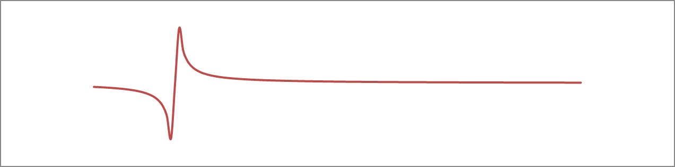
Criticality testing of parameters
I am using the terminology from Jarrow (J. Derivatives, Summer 2011, pages 89 – 98).
A parameter is some number, treated as exact by the model, that is an assumption based on some calibration, intuition, or some other model.
A model is robust to that parameter if a small change in the parameter causes a small change in the result.
A slight change in a critical parameter causes a large and/or discontinuous change in the model result.
It can happen that parameters are robust in some ranges but there is at least one critical region, often a regime change.

Slide 47
Criticality testing actual example
If the parameter was in the low 60’s, it is a critical parameter, elsewhere the model is robust to slight changes.

Slide 48
Stressing univariate stochastic process
Real financial time series are usually skewed and heavy-tailed. Idealized models, such as Black-Scholes, which ignore skew and kurtosis, are easier to code and the calculations run faster. Since validation models are toys and need not run very fast, they can be messier. In case the equations have no closed-form solutions if you include skew and kurtosis, Monte Carlo will work given enough CPU-hours.
The point is to add some extra dials to turn to stress the model in other ways.

Slide 49
The Tukey g×h Transform
Suppose the production model uses some parametric probability density function f(x) – most of the time this is Gaussian or lognormal, because that’s what we’re used to.
We can stress this normal distribution n(x) by skewing it and stretching it – here g controls skew and h controls kurtosis. A=g=h=0;B=1 returns the original n(x).
This is called the Tukey g×h function. The related Lambert W transform is used to back-transform the real data to a Gaussian.
This can be used to distort an observed distribution, as follows:

Slide 50
Skewed right

Slide 51
Skewed Left

Slide 52
Slightly fatter tails

Slide 53
Much fatter tails

Slide 54
Slightly thinner tails

Slide 55
Much thinner tails

Slide 56

Shy about tails

Slide 57
Creative Alternatives
One way to test the model’s assumptions and features is to use a custom benchmark model where one or more features can be switched off or new ones added.
Run the model and this partial benchmark model, on many scenarios with various portfolios, and see how much each assumption leads to different results, and look for synergistic effects.
Getting creative: take a few days to search the literature, especially arXiv.org. Almost anything that is relatively standard practice in physics will be new to finance, and some physicist wanting a job on Wall St. will have published on arXiv his idea of how to use his thesis topic’s technique for pricing options, or measuring systemic risk, or possibly something very similar to what the model you’re validating does.

Slide 58
Continuing Education
There are many published finance journals, but your firm won’t pay for subscriptions to all of them. (or maybe it will, and then fire you for reading all of them instead of getting work done)
I recommend that you spend some time keeping up with the literature. I read the arXiv.org Quantitative Finance (http://arxiv.org/archive/q-fin) abstracts every day while I eat breakfast. SSRN and NEP also have free or mostly free daily digests of new stuff. There are also many journals; my favorite is Wilmott (not really a journal but very informative, especially if you have £180,720 to spend on a Lamborghini Huracán)

Slide 61
Session Two:
Institutional Constraints and
Interpersonal Issues

Slide 62
Outline of this talk
Regulations and Brief History
Model Validation Timing and Staffing
Vendor Models
Pre-validation checks on paperwork and regulatory compliance
Enforcing independence
First line and Second line
Inventories
New vs. Improved

Slide 63
Regulations and Brief History
Model validation outside Finance goes back a long time.
By the mid-1980’s in computer science one flavor was called six-sigma
Jan Dash (who now works at Bloomberg) bought a book on six-sigma while chauffeuring his child to music lessons nearby, and introduced the same ideas into Finance in late 80’s.
By the late 1990’s several large banks were doing model validation more or less.
OCC 2000-16
GFC blamed by some on quants and models
Fed SR 11-7 / OCC 2011-12 – rumored to have been written in 2002 but took 9 years to release

Slide 64
Model Validation timing and staffing

Slide 65
How long does a Validation take?
More complicated models take longer.
The better the documentation, the less time it takes.
Typically this question has two simultaneous answers:
  An average of a person-month or so of the validation staff’s efforts
  Much longer of elapsed time because of questions.
    Me: Why did you do that?
    Them: Good question. We’ll look into it and get back to you in a week or two.

Slide 66

Validators may need some Mental Health time

Slide 67
How big is the Model Validation group?
My general rule of thumb, which you are free to ignore, is that you need roughly one validator per six or so model developers.
More validators than that is hard on the budget
Fewer than that may mean a backlog of unvalidated models growing larger over time.
Ideally, in a steady state you validate each new model version before it gets used, and the validation staff has a full schedule.

Slide 68
Who do you hire to be Validators?
Effective Challenge requires enough domain knowledge to ask the right questions
Easier to teach finance than advanced math
My estimate is that a Ph.D. is worth about 4 years experience
An MBA is worth maybe a bit under negative 2 years if you want them to do work and not just try to usurp their manager
Misogyny Arbitrage
  Women tend to be undervalued due to sexism
  As a general rule, being undervalued should be a Buy signal

Slide 69
Vendor Models
Build vs. Buy decision
  Model developers have no sales team
  Does management trust their employees more than vendors
90% instantly vs. 100% eventually
Vendor opacity
  Vendor models need to be validated to the same standards as internally-built models
  Some vendors hire external validator team and maybe release (redacted??) report to clients
  Anecdote – vendor quant flown in from France

Slide 70
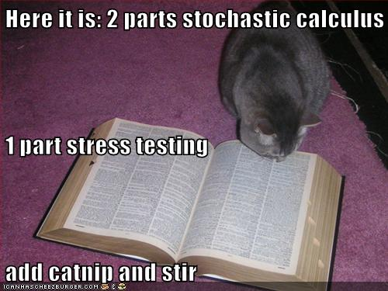
There is no Validation Cookbook cookbook

Slide 71
Pre-validation checks on paperwork and regulatory compliance
Documentation in place and signed off?
Is it good enough to allow validator to replicate model?
Developmental decisions adequately justified?
Developmental evidence
Ownership of model clearly acknowledged?
Difficult clients
  Good modelelers but bad documenters
  Complaints about excessive validation demands
  Ad hominem attacks
  Going past validators to complain to validation management
Risk culture – “doing the right thing” vs. “growing the business and not wasting time”

Slide 72
Enforcing Independence
Ownership of model risk
Reporting lines
Appeals and Model Risk Committees
Moral suasion without becoming a developer
Validator promotions vetoed
Whistleblowers always get punished
Compensation aligned with independence?
Compensation aligned with competition to retain staff?
Limits on revolving door between developers and validators- minimally one year

Slide 73
Three lines of Defense
Developers, Validators, Auditors
Developers should document why they are comfortable enough with the model to submit it for validation
  This word “comfortable” is very important. It says that the validator is assuming enough professionalism on the part of the developer that the standard for how much to test is their own sense of good workmanship.
Developer testing, process controls, monitoring, user involvement
Take the High Road
  The validator should not say “This documentation sucks”
  Instead say “You know this subject better than we do, so we need everything spelled out in the documentation since you know what it is but we don’t”
Difficult developer “This should be completely obvious to anyone of even the meanest intelligence – what’s wrong with you that you still are asking these questions”
Never take it personally – they are insulting the chair you sit in, not you, even if doesn’t sound like that
Remind them that it’s better for validation to find issues than regulators or the market
Validators need developers’ cooperation for future validations so try not to let things blow up too much
Designate a Lead validator for each model so 1st line has single point of contact
Try to call things “issues” instead of “model failures” or “bungling”
I have nothing interesting to say about Internal Audit

Slide 74
Inventories
Need a complete Inventory of all models
Attestation of completeness must come from 1st line
  If Validators really knew what models were being used they wouldn’t be sufficiently independent
  Only the developers really know what they are developing
Inventory of not-models (“tools”)
Are there proper incentives for developers and users to reveal models?
  “Secret” hidden models that don’t get validated don’t need documentation
  They can blow up more readily because validator has not checked them
  Need both carrots and sticks

Slide 75
New vs. Improved
Is every bug-fix change a new model VS only major changes (who decides what’s “major”) Vs flexibility (does this flexibility compromise independence or integrity?)
Multiple incompatible versions if change control not sufficiently rigid
Is code locked down?
“Sooner plunge my arm up to the elbow in boiling oil than use the damn New York version of the model”

Slide 76
Moore’s Law for Human Nature
Finance is driven by human nature. The assumptions that financial models make are more psychology than math.
Moore’s Law predicts that the number of transistors on a chip will double every 18 months. So far this has been about right.
The quality of computer screens doubles every 7 years or so.
Moore’s Law with a measurable doubling time is the usual for technological progress (see “How predictable is technological progress?” at http://arxiv.org/abs/1502.05274v1 )
The intelligence of the hairless ape pounding the keyboard doubles every few hundred thousand years at best.

Slide 79
Session Three:
Distributions and Data
Statistical Quirks

Slide 80
More caveats
If you don’t actually work any examples similar to what I will discuss, the talk will just be bubbles – shiny and pretty for a few seconds, then disappears in a spray of i.i.d. soap.
There may be some LOLcat pictures.
There are no Laws of Finance. Financial data do not follow any stochastic process, but Wall Street uses heuristics – build models as if the models worked, so an approximate answer can be found.
This session will be very quantitative.

Slide 81
Beyond
Multivariate Gaussian Stationarity

Slide 82
Traditional Assumptions
Variables are either normal or lognormal (MESOKURTICITY)
Pearson correlations describe the association between variables (the infamous GAUSSIAN COPULA)
A representative sample exists (HOMOGENEITY)
Past performance predicts future events (STATIONARITY)
One year’s data on 1000 companies is a good proxy for any one firm followed for a millennium (ERGODICITY)
Regressions are linear with no cross-terms or threshholding (LINEARITY)
Outliers can be disregarded (HUBRIS)

Slide 83
Why they are traditional
The great success of Black-Scholes does not mean all the underlying assumptions were correct, nor does it mean that we cannot improve on it 41 years later.
BS assumes everything is lognormal with constant volatility in a perfectly liquid market with zero bid-ask spread, etc.)
Lognormal processes have the advantage that they are easy to work with and never drop below zero.
Ordinary Pearson correlations and Gaussian copulas are easy to work with and have very few parameters to calibrate.
If you assume every new data point is a regime change you can’t do any historical studies. If you assume no two assets have similar dynamics you can’t do panel studies or use proxies. On the other hand regime changes can and do happen.
Expediency and tractability can conflict with accuracy. This is a trade-off.

Slide 84
Univariate
There are several alternatives to Gaussians and lognormals that I have used or seen used:
  1. Mixture-of-normals
  2. Generalized Gaussians
  3. Confluent Hypergeometric (Constant Elasticity of Variance), Bessel functions, Student-t, and other non-Gaussian “Special Functions” that integrate to one so you can use them as a probability density
  4. Empirical Histograms,usually smoothed using some kernel or spline
  5. Jump –Diffusions
  Don’t settle on your approach based on only one day’s data – the markets change and you want one that usually works okay, and not a model that’s perfect sometimes and lousy other times.

Slide 85

The Easy Way

Slide 86
Fat Tails
Most financial timeseries have fat tails (leptokurtic) and are not symmetric. But it is easy to check this for any that you care about.
Example: A few jobs ago I fit the distribution of 2-week changes in spreads of single-B bonds to a model with a fat-tailed distribution of ordinary changes plus skewed fat-tailed jump probabilities for up and down jumps.
The only way to say some moves were jumps was that I had already subtracted the best-fit fat-tail. Individual observations could not be definitively classified as jump or fat-tail.

Slide 87
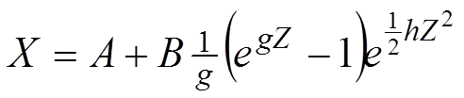
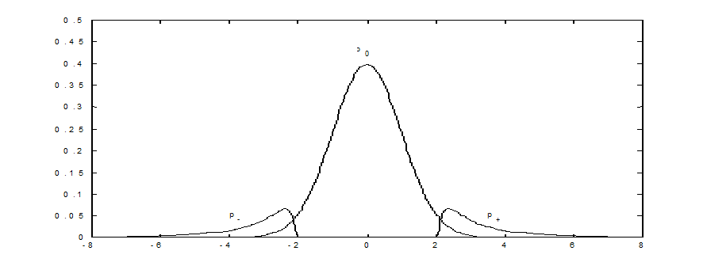
Tukey gXh
The functional form for my fat-tailed distributions was Tukey’s g×h
Where Z is (data – µ)/σ, g controls skewness, and h controls how fat the tail is.
Using one gXh for the bulk, and separate gXh for each tail, dramatically reduced fitting error.

Slide 88

Sometimes the tail can mask the rest of the picture

Slide 89

Other Copula Densities
GAUSSIAN
Upper and lower tail dependence of 1;
middle “local dependence” -1
The rank correlation is constructed to be
exactly zero. I designed this as a
counterexample.
It is more pathological than what you will
ever actually find
You can find funnel-shaped and
galaxy-shaped copula densities in real data,
but in a less exaggerated form than below.
Extreme Funnel Extreme Galaxy

Slide 90
My hints about copulas
It’s easier to do theorems and proofs using copulas (like CDF), but the copula density (like PDF) is easier to visualize.
A weighted sum of copula densities is a valid copula density, but copulas don’t combine easily.
Try Bernstein copulas if you really need to fit weird data features.(ref http://www2.warwick.ac.uk/fac/soc/wbs/subjects/finance/research/wpaperseries/2002/02-107.pdf ) - it’s a series expansion of sorts.

Slide 91
Extreme returns
If you eliminate the “boring” days from your timeseries (see my tonsuring article http://arxiv.org/abs/1110.4648 ) the number of “significant” eigenvalues gets even smaller. The folk-wisdom saying equivalent is that “in a crisis, correlations go to one.” This is not quite true; more correct is the funnel-shaped distribution where, when the stock market goes up, there is pairs trading and relative-value bets, but when the market plunges, many investors sell stock and buy Treasuries. Thus there may be some correlations that go close to -1 in that same crisis. In EVT this is called lower tail dependence.

Slide 92
Avoiding myopia
One way to help predict what could happen is to study history. For example, here is a graph of UK consol yields since 1729 and US long bond yields since 1798.
The UK long bond rate rose 360 bp in 1974, and fell 188 bp in 1983. Since 1999, the largest annual rise was 39 bp and the largest annual fall was 82 bp. In the US, annual data from 1987 – present have the change in long bond yield vary from -92 bp to +75 bp. In 1986 it went down 235 bp, and in 1980 it went up 231 bp, and a further 223 bp in 1981.

Slide 93

Why we assume stationarity in good times

Slide 94
Long histories vs stationarity
“History never repeats itself, but it rhymes” – misattributed to Mark Twain.
Another way of saying this is “Investors have short memories” or “That will never happen again.” All the above have some truth to them, but are not very quantifiable. The US financial panics of 1819, 1837, 1857, 1873, 1893, 1929, 1987, 1998, and 2007 were not identical. However, it is a near certainty that 2007 is not the last one.
No historical calibration using a currency with a pegged FX rate can predict the consequences of the peg breaking.
  What would you predict for the Greek drachma exchange rate in 2016?
  What was the effect on the Euro-GBP exchange rate of the Norman conquest? This is inside the 99.9th percentile of one year changes.
History is an evolutionary process that bleaches swans in a never-ending sequence. (J. Risk Model Validation 9(1))
I suggest using as long a history as you can get, and possibly using similar assets’ histories as proxies to get as many observations of the tails as possible.

Slide 95
Homogeneity - Retail Credit Scorecard Segmentation
Much effort at all loan or credit-card issuers is to decide who is likely to repay their debts. One of the methodologies used is to try to split the universe of borrowers into many nearly-homogeneous segments, based on as much information as you can get and are legally allowed to use (e.g. redlining is illegal). A scorecard is designed for each segment. A new applicant’s data is scored and compared to a low-default part of their segment. If they are on the good side of the threshold, extend credit, else reject the application. This works well with classifying people; less so with corporations and governments.
Your data may or may not be homogeneous; check first.

Slide 96
Ergodicity
If there were no systematic effects, and no historical trends, then everything could be a good proxy for the distribution of anything else.
But it isn’t so. Independent and Identically Distributed (i.i.d.) is only in textbooks.

Slide 97

No Ergodicity – not all cats are alike

Slide 98

Comfort zones

Slide 99
Inappropriate assumptions

Slide 100

Comfort vs. Reality
Messy reality
Easy to model – standard “thinking inside the box”

Slide 101
Mesokurtic History
From Poincaré, H. (1896) Calcul des probabilités page 171 (section 108):
“Everyone believes it (the normal distribution) as I was told by M. Lippmann, because the experimentalists imagine it to be a mathematical theorem, and the mathematicians that it is an experimental fact.”

Slide 102
Other assumptions
Assumptions are not necessarily “right” or “wrong”
Are they suited to their intended use?
  Different assumptions and different intended uses will in general lead to different models, and those intended for one use may not be suitable for other, unintended uses. Weaker performance under such circumstances does not necessarily indicate defects in a model but rather that the model is being used outside the realm for which it was optimized.
Oversimplified or Overly Complicated Assumptions
  neglecting jumps, skew, seasonality, etc.
  So complicated that it is analytically intractable, impossible to implement, or takes too long to run
  Too few or too many stochastic processes
  Assuming calibrating instruments are more (less) liquid than in reality
Is a proxy appropriate for the intended use?
  (single stocks vs. S&P 500, bespoke tranches vs. iTraxx, CAD vol skews vs. USD vol skews)
Does your organization have a preferred framework for this to fit into?

Slide 103
Documenting seemingly obvious assumptions
In NYC, on a window on the building at 40 Rector Street is a sign
This may seem like a tautology, but clearly there was a reason why they had to post this sign.
Overstating the obvious will make your model validation reports more pages long, which the regulators will like.
ENTRANCE TO
40 RECTOR STREET
IS NOW LOCATED AT
40 RECTOR STREET

Slide 104
Inappropriate calibration

Slide 105
Some Potential Calibration Pitfalls
Deliberate Miscalibration
  “let’s leave out that event –we’ll never see anything like that again”
  “that must be a bad tick –the curve couldn’t be that kinked”
  “the trader just sold at a much lower price –your model is overpricing; fix it!”
Local Minima in the fitting function
Unstable calibration - leads to wild swings in hedging prescription
Calibrating to a bad tick (unscrubbed data)
Recalibrating too often or too infrequently
Calibrating to stale or fictitious market –if the model needs a price that doesn’t exist then you should use a simpler, or at least a different, model

Slide 106
Questions to Ask Yourself About Calibration
Are they calibrating the model to the appropriate instruments?
Is the calibration set the same as the intended hedge instruments?
Are they calibrating in the real world or in risk-neutral?
  Be careful. Sometimes you have, in the same model, both liquid-market parameters calibrated risk-neutral and historically estimated parameters calibrated in the real world measure.
Does your organization have a preferred framework for this model to fit into?
  Did they create unnecessary work for you by starting from scratch and conflicting with all the other models in the shop when they didn’t really have to?
If they created a new paradigm, does it extend to all the existing products that were done the old way?
Does their minimization algorithm to calibrate account for the relative liquidities and bid-ask spreads of the various calibrating instruments?
Does the model “smell wrong” to the users?
  Talk to the clients. Even quants need some people skills.
What does the calibration error look like? Graphics are very useful.

Slide 107
Another Question to Ask Yourself About Calibration
Is the algorithm robust and stable? Do you want it to be?
  Many of the statistical tests in the literature fall apart if anything is non-Gaussian or otherwise not i.i.d.
  On the other hand, if the intended use is just in the “tail” it may be better to get the tail right.
  A statistical modeling procedure is said to be robust if the output is relatively insensitive to small changes in the underlying assumptions, small changes in much of the input, or large changes in some of the input (“outliers” or “anomalies”). Some robust techniques work even when almost half the data are outliers. In the physical sciences these anomalies are often plausibly attributed to measurement errors; in finance there are usually separate data scrubbing procedures applied before the data enters the model. Referring to actual observed data as outliers is equivalent to a belief that the model is right and the data that don’t fit are drawn from a separate, irrelevant, or uninteresting model, and should be ignored, or represent phenomena that the modeler does not want to capture. These robust models claim to fit the relevant data even if almost half the data don’t fit. A graphical indicator that an extreme data point is not an “outlier” (neither a mismeasurement nor a draw from a different distribution) is if the point does not sit alone, but instead is consistent with extrapolation from the bulk of the data.

Slide 108
What Data to Calibrate To?
Calibrating to live market data requires no assumptions of stationarity. However, if the market is very un-stationary, it has the same effect as unstable calibration -the hedge performance is lousy and the past is a poor indicator of the future.
Calibrating to a proxy or basket of proxies is a potential pitfall - how good is the proxy, and if you have too few data on the actual underlying, how can you tell if the proxy is good or not?
When you use a time series estimate, you have several choices, including:
  Assume stationarity and use all the data going back in time as far as possible.
  Use a digital-signal-processing type filter. The most common one in finance is the exponentially weighted moving average used by RiskMetrics, where you don’t actually calibrate the exponent, and there is no good reason to assume an exponential instead of cutting the filter with some other shape.
  Using only the most recent X years of data is another type of filter – does the data justify it?
  Statistical sampling error goes as T^{-1/2}. Assume the nonstationarity drift is linear (unless you have a better model for it) and then it goes as T. Then the total estimation error to minimize is λ₁T^{-1/2} + λ₂T. Estimate the λ from the data, and find the optimum data series length T*. This is easiest if you have equal data weights from today back to T* but you could modify this for some other filter shape. Preferably you would have some data-respecting reason to choose the particular filter shape. This technique is standard practice in atmospheric physics.
  Assume you know when the structural break was, and only use data from afterwards.

Slide 109
Calibration Period
The UK long bond rate rose 360 bp in 1974, and fell 188 bp in 1983. Since 1999, the largest annual rise was 39 bp and the largest annual fall was 82 bp. In the US, annual data from 1987 – present have the change in long bond yield vary from -92 bp to +75 bp. In 1986 it went down 235 bp, and in 1980 it went up 231 bp, and a further 223 bp in 1981.
  Historical backtests might not cover historical periods stressful enough to expose model issues. No historical calibration using a currency with a pegged FX rate can test how the model handles FX rate shifts.
Basel rules require at least 1 year of daily data (~250 points) to calculate a 10-day 99% VaR. This implies 10 years to calculate a 100-day VaR, and ~25 years to calculate an annual 99% VaR. Going further, how much data does this mean you need for a one-year 99.9% VaR? 250 years?

Slide 110
Range of Appropriateness
Here is an example where the market moves outside the range of appropriateness
Calculate the forward implied volatility from given Black-Scholes implied vols from quoted options at 1 and 2 year tenors. Suppose the volatility of the 1 year option is 5%. The forward vol in a simple model (no jumps, no autocorrelation) would be
If the vol curve drops too quickly, as with some commodities, you need a more complicated model since imaginary forward vols are not meaningful
Imaginary forward vols

Slide 111
Look at Your Data
This is called Exploratory Data Analysis, and it is, or should be, logically prior to doing any statistical tests of any sort. Form your hypotheses based on the data, and then test them statistically.
It’s easy to assume that two datasets or timeseries are “correlated”, but that presupposes an elliptical distribution. Skewness can make Pearson correlation meaningless.
It’s easy to attribute bad parts of the fit to the data as “jumps” but that could just be adding “magic peanuts” to the elephant basis set.

Slide 112
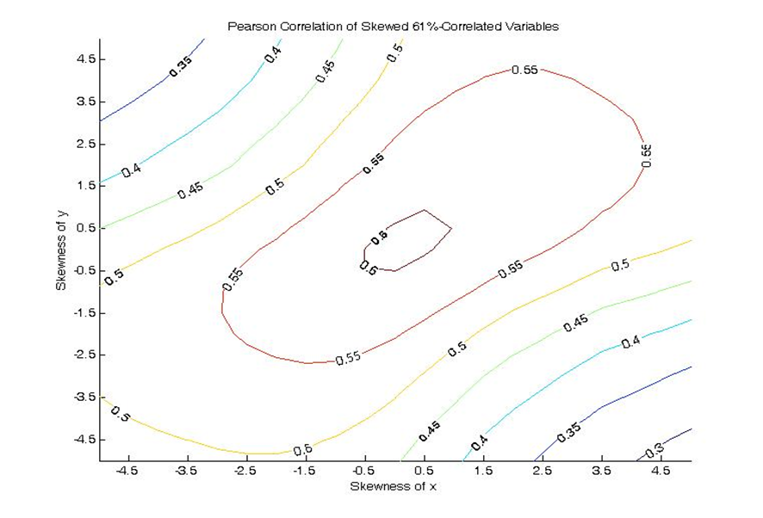
Skewed synthetic data
In this simulated example, the Gaussian drivers of two processes are 61% correlated. Consider scenarios where we test robustness to skewness in the distribution of one or both observed processes. A rank correlation remains stable, but the Pearson correlation is an underestimate of concordance. Skewness of equity indices: Australia is -2.8, US -1.2

Slide 113
My hints about copulas
It’s easier to do theorems and proofs using copulas (like CDF), but the copula density (like PDF) is easier to visualize.
A weighted sum of copula densities is a valid copula density. Same is true of copulas but they are harder to visualize.
Try Bernstein copulas if you really need to fit weird data features.(ref http://www2.warwick.ac.uk/fac/soc/wbs/subjects/finance/research/wpaperseries/2002/02-107.pdf ) - it’s a series expansion of sorts.

Slide 114
Principal Components and RMT
If you generate several short series of Gaussian random numbers, and look at their correlation matrix, the eigenvalues of that matrix will be distributed as Marcenko-Pastur according to Random Matrix theory. For financial timeseries, you get this plus a very few “real” market factors. Google it yourself. As an example, see Jim Gatheral’s talk http://faculty.baruch.cuny.edu/jgatheral/RandomMatrixCovariance2008.pdf

Slide 115
Extreme returns
If you eliminate the “boring” days from your timeseries (see my tonsuring article http://arxiv.org/abs/1110.4648 ) the number of “significant” eigenvalues gets even smaller. The folk-wisdom saying equivalent is that “in a crisis, correlations go to one.” This is not quite true; more correct is the funnel-shaped distribution where, when the stock market goes up, there is pairs trading and relative-value bets, but when the market plunges, many investors sell stock and buy Treasuries. Thus there may be some correlations that go close to -1 in that same crisis. In EVT this is called lower tail dependence.

Slide 116
Retail Credit Scorecard Segmentation
Much effort at all loan or credit-card issuers is to decide who is likely to repay their debts. One of the methodologies used is to try to split the universe of borrowers into many nearly-homogeneous segments, based on as much information as you can get and are legally allowed to use (e.g. redlining is illegal). A scorecard is designed for each segment. A new applicant’s data is scored and compared to a low-default part of their segment. If they are on the good side of the threshold, extend credit, else reject the application. This works well with classifying people; less so with corporations and governments.
Your data may or may not be homogeneous; check first.

Slide 117
Replication and Benchmarking
Since validation replicas and benchmarks don’t need the speed of a closed form solution, don’t worry about modeling with numerical tricks.
Monte Carlo or quasiMC can of course handle any pdf you can specify.
A binomial tree does not have enough degrees of freedom to converge to any arbitrary diffusion pdf.
A trinomial tree probably doesn’t either. Consider using a many-nomial tree (explicit forward differences) (see http://ssrn.com/abstract=2199780 ) or a many-nomial implicit finite difference grid – Dick Feynman and Mark Kaç reassure us that the numerically solved SDE fitting the pdf, and the numerically solved PDE, are the same thing. If you use implicit grids remember that you may need to impose artificial boundaries, either absorbing or reflecting. These false boundaries should be far enough out to not affect the results.
Don’t use trees or grids outer-producting 4 or more underlyings – the curse of dimensionality.

Slide 118
Missing Data issues

Slide 119
An Example from a Data Aggregator
Suppose the algorithm for quoting prices of a security is the arithmetic average of all contributor quotes if 3 or more contributors, else repeat yesterday’s price.
5 contributors, each supplying a constant price on this schedule:
Contributor | Monday | Tuesday | Wednesday | Thursday | Friday
A | 65 | 65 | 65 | 65 | 65
B | 60 |  |  |  | 60
C |  | 57 | 57 | 57
D | 70 | 70
E |  |  |  | 55 | 55

Slide 120
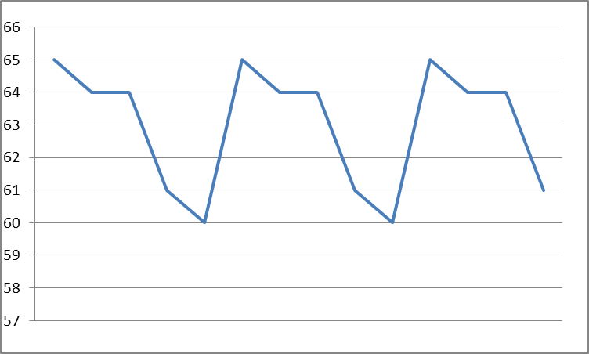
False Volatility
The reported price time series from the vendor looks like active trading, but it isn’t.

Slide 121
Not Positive Definite
Many times you need a matrix inverse, or a Principal Components Analysis, or such. Here we see missing data causing problems again.
Three stocks partially observed on three days.
  Day 1 – A goes up, B goes down, C not traded
  Day 2 – A goes down, B not traded, C goes up
  Day 3 – A not traded, B goes up, C goes down

Slide 122
Matrix mess
So the correlation matrix is
And the inverse is 0 -.5 -.5
-.5 0 -.5
-.5 -.5 0
Eigenvalues -1, 2, 2 so it’s not positive definite, and can’t be used for most financial calculations. A more subtle version of this often shows up in corporate VaR calculations when some time series are more liquid than others.
1 | -1 | -1
-1 | 1 | -1
-1 | -1 | 1

Slide 123
Partial Solution
At one of my previous jobs, the way they dealt with this was to have a multi-step inversion:
  Arrange the timeseries in descending order of liquidity.
  Invert the covariance matrix of the fully observed timeseries, which will be (almost) positive definite.
  Augment with often-observed risk factors, and force the upper left of the approximate pseudo-inverse to exactly match step 2.
  Repeat for a few more tiers of liquidity.
Note that filling in missing values with, for example, EM, reduces volatility and might change the covariance structure.

Slide 124
New Assets / New Risk Factors
Suppose you want to calculate correlations based on 5 years of daily data, but some of your asset classes have only existed for 2 years.
What would you suggest doing?
What if one of the new asset classes was so new that there was no data at all?
What if the asset was a currency exchange rate, say CHF/EUR, that was pegged until a few weeks ago?
What if the new asset was a currency that is still pegged but your firm’s economists or psychics expect to come unpegged next week?

Slide 125
Extrapolation
  In the 1000-year long run, your firm will default or otherwise vanish.
  How many of you (show of hands) work at a firm founded before 1015?
    The only derivative contract with a long history is the Japanese rice futures which has only a 400 year history, and most OTC derivatives trading started in the 20th century but did not exist in the 19th.
  You cannot do non-parametric extrapolation
    Mindless- assume Gaussian or lognormal – Basel expressly disallows this
    Crises usually do not follow the same statistics as ordinary times
    Now that counterparty risk includes downgrades the extrapolation is less tricky
    Extreme value theory is questionable since it assumes stationarity
    Better – what functional form fits the data you have so you can extrapolate (but that also assumes stationarity)
    I like the Tukey g×h distribution, but you probably guessed that by now.
  There are tricks to counteract non-stationarity, but they may work differently depending on whether the parameter drift is gradual or a sudden regime change

Slide 126
Digression Deep into Quant Land
  Can we distinguish between a stationary but not Gaussian process, gradual regime shifts, and abrupt regime shifts (jumps)?
  One approach is found in “ Multiscale Local Change Point Detection with Application to Value-at-Risk ” by Vladimir Spokoiny, Annals of Statistics 2009, Vol. 37, N0. 3, 1405-1436
  Here we use a non-parametric approach and don’t distinguish why the regime changed, only how sure we are that it has.
  Thus we can inject our judgment of how large a change λ is a real change and not just noise.

Slide 127
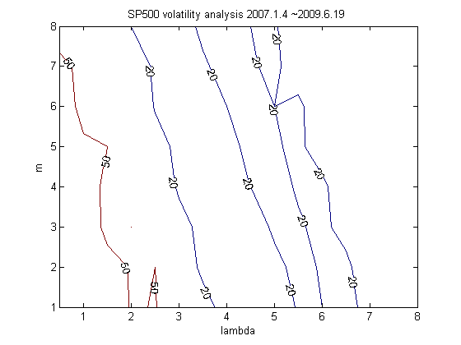
Change points detection with sliding threshold λ
  Number of change points detected through tuning parameter
Figure 4: # of change points detected in the volatility LCP model based on parameter tuning (SP 500 Index)
Upper plot: , 50 change points
Lower plot: , 20 change points

Slide 128
Preventative Measures and Remediation
  Documentation written (or at least approved) by the business
    so what was coded was what they said they wanted
    Is what they wrote the same as what they meant?
  Business validation and independent validation / review
    Benchmarking to similar models, replication, test cases, stress testing
  Regular reappraisal
    Has the market or the firm’s assumptions changed enough to require model revisions?
  Comparison with firm’s other models to improve internal consistency
  Can you explain the model and justify its limitations to Senior Management?
  Validation asks questions, but it may not provide answers

Slide 129
Compromises

Slide 130
Tradeoffs
If you make one of the above assumptions because it was true in the past, it may stop being true in the future.
If it wasn’t true in the past, it is highly unlikely for the market to become simpler.
You have to decide if the extra effort in building more sophisticated analytics will have enough impact to be worth the bother.
More elaborate models need more calibration and can become less useful. If they are incomprehensible to the intended user, they may not get used. Compromise between showing off your quant skill and giving the users levers to use their judgment.
The key is transparency – no surprises or misrepresentation.

Slide 131
Time vs Effort
Modeling all the nuances would take forever. Academics and practitioners all have deadlines. At some “point of diminishing returns” you have to decide you’ve done enough on that problem, and move on to another task.
If your manager suggests it’s time to move on, do so.
If your regulator suggests you dig deeper next time, your manager will agree with the MRA.

Slide 134
Session Four:
Honored Guest
Jon Hill - Morgan Stanley

Slide 135

Session Five:
Moral Dilemmas
Case Studies
My Own Little Whale

Slide 136
Case Study #1:
After starting an engagement, the validator finds the developer’s documentation to be hopelessly incomplete and in some cases erroneous. The validator is now faced with the following set of less-than-optimal choices:
  Stop the validation and wait for the client to complete the documentation.
  Proceed with the validation by holding a series of face-to-face meetings with the developers to verbally fill out the missing elements.
  Agree to the client’s suggestion that the model validation team should pitch in and help to correct and complete the documentation as they are performing the validation.
Which, if any, of these choices do you think the validator should select?

Slide 137
Case Study #2:
The validation team declines the invitation to help complete the model documentation. The client then suggests that if the validation team were just a little smarter they would be able to design a clever set of tests that could be run on the developer’s model whose results would then reveal all of the important details about how the model actually works.
What is wrong with the client’s suggestion?

Slide 138
Case Study #3:
A validator challenges a developer on his lack of sufficient testing as part of the review of his ‘developmental evidence’. The exasperated client tosses the issue back at the validator, by asking “Okay, what tests do you want me to run?”
How should the validator respond to this question?

Slide 139
Case Study #4:
A model developer is confronted with 3 different modeling methodology choices. To ensure that his model will receive validation approval he calls the lead validator and asks for the validator’s opinion about which is the best of the 3 approaches.
Should the validator answer this question by telling the developer which model he thinks is best choice?

Slide 140
Case Study #5:
During a validation the validator creates an independent replica of the client’s model from the documentation. In the course of the testing, the validator discovers that by adding an additional market index regressor, the replica model performs even better than the client’s model. This presents the validator with a dilemma: the client’s model is performing acceptably well according to back-testing results, but the validator has discovered a way to build an even better mouse trap.
What should the validator do with this information? Tell the developer how to improve his model, keep silent, or suggest that the developer should further investigate ways to improve the model’s performance?

Slide 141
Case Study #6:
During a validation the validator confirms the client’s MLE (maximum likelihood estimator) optimization method by using an independent global optimization technique such as ‘simulated annealing’. Both methods yield essentially the same optimal parameters but the global method is more computationally efficient. After the validation engagement ends the developer asks the validator if it is okay for him to also use the simulated annealing method for his production model.
How do you think the validator should respond to this request?

Slide 142
Case Study #6:
During a validation the validator confirms the client’s MLE (maximum likelihood estimator) optimization method by using an independent global optimization technique such as ‘simulated annealing’. Both methods yield essentially the same optimal parameters but the global method is more computationally efficient. After the validation engagement ends the developer asks the validator if it is okay for him to also use the simulated annealing method for his production model.
How do you think the validator should respond to this request?

Slide 143
Case Study #7:
During a validation the client offers to correct his model after the validator has uncovered an error, re-run the full suite of developmental tests and deliver the new test results back to the validator.
Is there anything wrong with the client’s ‘fixing problems’ uncovered by a validator during the course of an engagement? What might be the consequences of allowing this to become standard operation procedure during validation engagements?

Slide 144
Case Study #8:
A development team suggests a meeting to give the validation team advance notice of their intention to introduce a new modeling methodology, but they have not yet decided between a set of possible approaches. The lead developer suggests that the validation team should review the modeling options with the developers before they begin implementing the final model selection to make sure the developers don’t go down a wrong path.
Is there anything wrong with the validation team offering guidance prior, or during, the model development process?

Slide 145
Case Study #9:
A development team asks the model validation team’s help in devising a comprehensive suite tests that can be used during development to gauge the model’s performance.
Is there anything wrong with the validation team suggesting what tests should be run during the model development process to determine the suitability of the model?

Slide 146
Case Study #10:
A very high executive in your firm has staked his career on a particular novel and innovative CVA model. You are quite aware that this model cannot fail, or it would end his career and yours.
The model implementation is a disaster, and if it came from the regular developers you would fail it instantly. The main quant for the model has abruptly left the firm.
How much do you like your job vs. valuing your integrity?

Slide 147
Some war stories

Slide 148
Names have been changed to protect the guilty
1991 documentation
Quants don’t run this bank
Agreed to disagree
Those New York quants don’t understand
$20 billion assume it’s zero
$60 billion it’s not a model / hidden model
Ozone hole in the loan book

Slide 149
My little whale
This is taken from public documents so I am not revealing anything confidential
The SEC sued Barbara Duka, and the filing is at https://www.sec.gov/litigation/admin/2015/33-9706.pdf
25. Duka’s concerns about S&P’s conservative criteria culminated in mid-December 2010. At the time, S&P’s Model Quality Review group (“MQR”) had just produced a draft report concerning the CMBS model. The purpose of the MQR review was to determine whether the model was an appropriate computer implementation of the S&P criteria. The model MQR reviewed used the methodology based on the criteria constants, as determined by the CMBS criteria committee.
38. Duka also used vague language internally in responding to the MQR review of the CMBS model, which was not concluded until June 2011. MQR focused part of its review on the loan constants, and explicitly requested that Duka certify that she was “comfortable with the assumption that loan constants used to derive debt service are appropriate to estimate the debt service amount.” In response, Duka stated that “we consider both the constants in [Criteria Table 1] and the actual constants,” and that “New Issuance would use the actual (if higher) but look at both if the actual constant is lower than the [Criteria Table 1 constant].” This language suggested that Duka’s group engaged in some sort of analysis when deciding upon which constant to use, when in fact Duka had decided to simply use a 50/50 blended constant for all loans in all pools.
39. Significantly, even though Duka’s CMBS Group changed the model in the midst of the MQR review, Duka never showed the new model to MQR. Instead, Duka knowingly allowed MQR to perform its important internal control function with a model that was outdated and applied criteria that the CMBS Group had rejected. Duka’s frustration of the MQR process violated the ……

Slide 150
Brief Digression - On Presentation of Talks
(or) Why All the Cat Pictures?
One goal of any speaker is to maximize the Eye-to-Chin Ratio
  How many people are looking at you
  How many slumped back asleep and showing off their chins
  (Some measures include the number slumped forward asleep to show off how well their hair is parted)
  Cute cat pictures help keep you awake
Many speakers have very little on their slides yet have long speeches
I typically have too much on the slides
You will get copies so you don’t need to be able to read the slides

Slide 151


Eye-to-Chin Ratio
High
Zero

Slide 152
Some Aphorisms

Slide 153
The Egg Question
Farmer Gray’s Organic Free-Range Eggs come from his small flock of ~300 hens on his small property on Long Island (note this is a fictitious example). Because of their outstanding quality, he charges $1.50 per egg, which is far more than the cost of supermarket eggs.
a. How much would a box of a dozen eggs cost?
b. How much would a truckload of a million eggs cost?

Slide 154
Rabin’s Rules
(Mike Rabin was my boss in 1991)
Curiously, an electrician who installed an outlet in my basement had these same 3 rules for his work.
1. Pay Attention
  What are the features you are trying to model? Did you use the right day-count conventions? What did the client actually ask for?
2. Think About What You Are Doing
  You are going to dinner at Nobu in an hour, and the TV in the kitchenette is broadcasting your favorite team’s tie-breaking game. Neither of these should affect the nesting of parentheses on your if statement.
3. Double-Check Your Work
  Limiting cases and paper trading simulations
  Benchmarking against other models
  Compiler warning messages, rereading the term sheet, etc.
  A second set of eyes (independent validation)

Slide 155
Martin’s Rules for Managing Quants
1) Always try to hire quants who are smarter and more knowledgeable than you are. Then the rest is easy. As their manager, whatever great thing they do, you will get credit for it.
2) Always treat quants as adults, even when they don’t act like them.
3) Managing quants is like herding cats – and cats don’t herd well.
4) The trick to getting quants to go where you want is to simply plant a treat (i.e. bonus $) at the desired destination - them let them figure out their own way to get there. You have to convince them that what you want is what they want.
5) Never insult, condescend, or scream at your quants - it's counterproductive because morale suffers and their opinion of you suffers even more. Plus, if you obeyed rule #1, they are smarter than you and able to devise extremely unpleasant ways of getting even.
6) Always practice openness & honesty, with no content-free press-release generalities. Quants can see right through those because of rule #1.
7) As with Ford Prefect, fear is contagious, so DON'T PANIC. (But always keep track of where your towel is, just in case.)
8) Always tell this to your employees, and follow through when the time comes: If a quant employee thinks their career is better served by going elsewhere, they should let you know, and you will give them a good recommendation. (Don’t ask for company loyalty – this rule will get you far more loyalty, and they would leave with or without your help; this way you keep them as a contact elsewhere.)

Slide 156
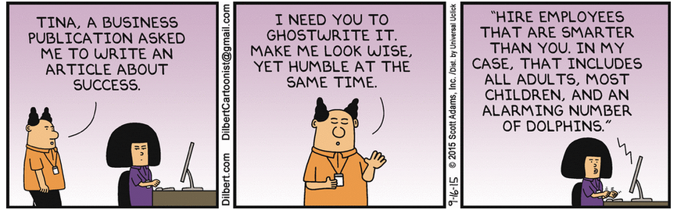
Dilbert Rules for Managing

Slide 157
Qualitative Inputs
For some models whose inputs are all qualitative, how does that affect validation? This includes retail loan scorecard models, AML modeling, etc.
  Related question, for models like AML or stress testing, where there is no actual catastrophe to backtest against (hopefully – some banks have been caught laundering money, and there was a stress event for banks a few years ago, which you may remember as the GFC) how do you do a backtest or otherwise show satisfactory performance?
Reproducibility of qualitative inputs
How do you know the expert judgments have expertise?
  Firmwide standards (Criteria at S&P)
  Apprenticeship
  Testing for comparability?

Slide 158
Model Results Where Inputs are Qualitative
Reverse backtesting from hypothetical scenarios or historical
How does policy / regulations / documentation define “acceptable performance”?
How do you do sensitivity or ladder tests against qualitative inputs?
  Binary scorecard answers
  Ordinal rankings
  PCA or cluster analysis
Class discussion: how to keep the regulators and Internal Audit satisfied with results? Senior management?
How do you know the model isn’t being gamed by the business?

Slide 159
Circus Management
Most of you will be familiar with this, especially if you deal with a large IT organization.
Suppose, as you arrive at the circus there are 20 clowns and 20 clown cars. What will happen?
19 cars will stay empty, and all 20 clowns pile into the same car.
Then management changes priorities, and all 20 clowns get out of the previous car and all pile into a different car.
This means:
Management views all their employees as fungible clowns.
With all that getting in and out of cars, no driving is accomplished, and none of the cars move at all.
Faced with complaints that the cars are late, management will have a clown reorg and move them all to a third car.
Class discussion – how do you persuade developers to not do this?

Slide 162
Session Six:
Hedging,
CVA, VaR,
Model Risk Quantification, and Credit

Slide 163
The Usual Caveats Redux
This presentation expresses my own personal opinions and experience, and may not represent the views of any current or former employer. I am not speaking as an authorized spokesperson for CME. I am speaking as a validator, and my talk assumes you are one also. It may conflict with your views. Feel free to disagree.
Discussion is good. Ad hominem attacks are less good, so only get personally vicious if you can be extra witty. Mocking me with a cat picture is best.
No proprietary or confidential information is included in these slides. You might decide afterwards that no information at all is in here.
I may go off-topic either deliberately or upon request.
This talk is intended more to suggest questions than to give answers. Regulatory changes may invalidate some or all of the current approaches.
This topic is hard, and this talk will not make you an expert. It may point you in some interesting directions, but there are many devils in the details.
If models were perfect, this would be a very different universe. This course is certainly incomplete.
I have been a quant for a long time so this course will be rather quantitative.

Slide 164
Table of Contents
Model Risk Quantification
What is counterparty risk
PIT, TTC, S&P
Comparison to Issuer Credit Risk
Why CVA is not counterparty risk
Pallavicini xVA vs Hull-White CVA
Most CDO Models are Invalid
VaR and EC – Extrapolation is not Interpolation
Static Hedges, Dynamic Hedges, Hedges as Prop Trades
Regulatory Capital and Economic Capital

Slide 165
Model Risk Quantification is Hard
Possibly required by regulators
Model Risk is defined (by me) as “Risk of monetary loss or other adverse result due to use or misuse of faulty or inappropriate models.”
Very political since usage is involved.
If a model result has some qualitative overlay, the person doing the overlay will always be biased, consciously or subconsciously, in favor of their preferred direction. How much does overlay count as model risk?
  If a business unit, biased in favor of short-term profits.
  “Regulatory capture” by profit-taking units.
  Same for model design assumptions even if no overlay.
  The main function of the human conscious mind is to justify post-hoc the decisions already taken by the subconscious.

Slide 166
Model Risk Quantification Example
Mars Climate Orbiter built by Lockheed-Martin for NASA
  Lockheed Martin controls produced results in pound-seconds
  NASA specified Newton-seconds
  1 N-sec = 4.448 lb-sec
  Too little deceleration thrust
The Mars Climate Orbiter probe was launched on December 11, 1998 and disintegrated in the Martian atmosphere.
The Lockheed-Martin software did exactly what their engineers designed it to do, and NASA communications worked flawlessly.
The model fault was in the interface between them.
In a financial firm, there may be many models, tools, databases, etc. interacting.
  There may be incompatibilities that only show up very far downstream.
Some uses may be inappropriate even if the model is appropriate

Slide 167
Model Risk Apportionment
Consider a swap pricer
  Yield curve inputs
  Data scrubbing
  Interpolation
  Price float leg
  Price fixed leg
  Subtract and get swap price
  Aggregate into books and records
  Compute market, credit, and operational risk
  Economic capital
From a software perspective, the subtraction is trivial
From a political perspective, it is the first place where the model(s) are actually used for a business purpose
Class discussion – If the desk puts on a $100MM swap, how much model risk goes to each piece? Is it additive? Should it be?

Slide 168
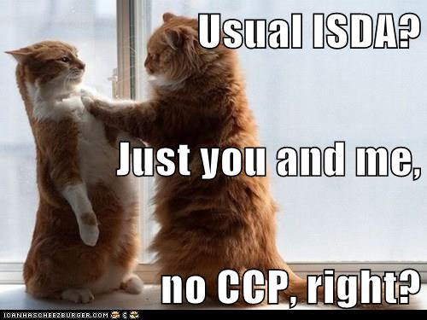
Risky Counterparty – the Bad Old Days

Slide 169
Counterparty Risk
Counterparty risk is the credit risk that you will have a loss on a derivative position because your counterparty defaults / downgrades when they owe you money.
    Less when your counterparty has a better credit rating.
    Less if unrealized P/L is collateralized.
Different from issuer credit risk since the contract’s value does not depend explicitly on the counterparty.
    If the issuer and the counterparty are highly correlated, this is called “wrong-way risk.”
    Example – buying a CDS on the Greek government from a Greek bank.
    Worse example – buying a CDS on Citi from Citi.
  Since the loss is floored at zero, this introduces an additional layer of optionality – swaps become swaptions, options become compound options, etc.
  Basel-type regulations take a simplified view which is easier to implement and less messy but maybe not as realistic.
  As usual for credit risk regulations, they see everything as a loan equivalent as much as possible.

Slide 170
PIT, TTC, and S&P
Credit risk is the risk of default (or maybe it includes upgrades / downgrades)
Typically, banks measure this as a probability of default based on a (usually logistic) regression over some time period
  This is a statistical measure, so you have to balance statistical noise from too small a sample of defaults and non-defaults vs. non-stationarity from too long a sampling period
  The banks who assume a short sampling window get “Point-in-Time “(PIT) PD’s.
  Using a long window assumes such a thing as a “financial cycle” exists, and thus their PD is called “Through-the-Cycle” (TTC).
  S&P Ratings are none of the above. They are stress tests – what severity of macroeconomic stress could this firm survive?
  The US 1930s Great Depression is AAA, an uneventful year is single-B, and the Great Recession is BBB or A-.
  The Fed Severely Adverse Scenario is roughly BBB.
  The above is not quite true, since bank ratings are usually validated by benchmarking to S&P / Moody’s / Fitch ratings.
  So validating any internal ratings models requires philosophical assumptions about what a credit rating means.

Slide 171
Credit Risk
If counterparty risk is credit risk, then it can be viewed, like the usual credit risk, as
  CCR = PD * LGD * EAD
    where CCR is counterparty credit risk
    PD is Probability of Default of the counterparty
    LGD is the percent loss of “the” value, given default
    EAD is the exposure, or “value,” at default
    PD and LGD are relatively easy to model and validate. EAD is so messy that it may fundamentally change all derivatives pricing.
  Note the above is a default-only view, which is not sufficient – counterparty risk involves downgrade risk as well.

Slide 172
Alphabet Soup for CVA
There are several acronyms involved with counterparty risk pricing adjustments:
Netting set – a portfolio of derivatives that legally can be netted at bankruptcy
CVA – Credit Valuation Adjustment is the incremental dollar exposure of a netting set to counterparty default
DVA – Debit Valuation Adjustment is the counterparty’s incremental exposure to your firm’s default
FVA – Funding Valuation Adjustment is the incremental P/L of funding the derivative positions and hedges and collaterals.
LVA – Liquidity Valuation Adjustment is controversial and not completely accepted
NVA – Nonlinearity Valuation Adjustment is a Brigo/Pallavicini correction since their method otherwise involves double-counting

Slide 173
Alphabet Soup for CCR
PFE – Potential Future Exposure is the maximum on a given future date of {zero, value of the portfolio} under a particular scenario
PE – Peak Exposure is the n% confidence level highest PFE on a given date under many scenarios – similar to a VaR
MPE – Maximum PE between now and a given date
EE – Expected Exposure is the average (note: Monte Carlo) of the distribution of PFE exposures from the derivative portfolio at each future date
EPE – Effective Positive Exposure is the weighted time-average EE
EEE – Effective Expected Exposure is the maximum EE between now and some particular future date
EEPE - Effective Expected Positive Exposure is the weighted time-average EEE
CSA – Collateral Support Annex adds bilateral collateralization to the netting agreement.

Slide 174
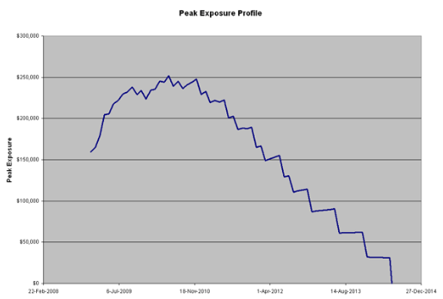
Archetypal PE graph
MPE

Slide 175
CVA is not CCR
In the previous slide counterparty exposure, you simulate under the real-world measure over the life of the exposures.
CVA is a price so it must be computed under the risk-neutral (pricing) measure.
Trying to do counterparty risk under the risk-neutral measure is a bad idea.
  Harvey Stein shows in http://papers.ssrn.com/sol3/papers.cfm?abstract_id=2365540 that computing counterparty exposures under a risk-neutral measure gives any result you want. The computations look similar, and the exposure data inputs are the same positions, so you might think you can use the same calculation for both.
  But it ain’t so.
Keep this in mind if you are validating this kind of model.

Slide 176
Netting Sets
Portfolios of derivatives between your firm and the same counterparty might lead to a single net exposure at default, or might not. An important aspect of validating counterparty risk is to ensure that each derivative position is assigned to the right netting set in a legally binding way.
A netting set is the set of derivatives covered by the same netting agreement.
Each counterparty may have zero, one, or more netting agreements with you. Some may be collateralized (CSA), some use a Central Counterparty (CCP), some maybe neither.
At default, the creditors will try to collect on any position where the solvent counterparty owes the defaulted one, and try to say that those positions do not net with any others, if you cannot prove otherwise.
Verify that all the netting agreements have good legal opinions, and that your trade capture systems put the positions into the proper netting set. Is there a process to monitor netting set assignments and correct errors quickly?
The Lehman vs. LBHI case shows how this issue can tie up funds for years.
If the trades are centrally cleared all these worries go away.

Slide 177
CVA - Hull-White View
  The market-clearing price is the price on the screen, which is the same for all market participants.
  An additional CVA charge for taking the counterparty’s credit risk, less a DVA charge for them taking on your credit risk, can be passed on as part of the trade’s cash exchange at inception.
  Other costs of production (funding, hedging, funding the hedge, etc. should not be part of the price passed on from seller to buyer, because it could lead to arbitrage and perverse incentives.
  This view is comforting, but it does not explain some of the odd behavior during the crisis. Some prices of vanilla instruments on the screen began to violate standard no-arbitrage relationships.
  Do we really need to abandon our usual models just because they failed during the GFC? (Class discussion)
  Compare with widget pricing in the non-finance world

Slide 178
CVA - Brigo-Pallavicini View
  In the older paradigm without counterparty risk, derivatives were priced in isolation from their buyers, sellers, or environment, they were, as the QED physicists would say, “naked” prices.
  Including realistic things like funding the trades, collateral, credit risk of the counterparty defaulting, your credit risk increasing if you borrow money to fund the trade, etc., the trade’s value is “dressed.” The various “adjustments” CVA, DVA, FVA, and possibly others, are the “clothing.”
  With counterparty risk, the “Law of One Price” does not apply internally – the risk-neutral value now includes asymmetric components so the accounting value of the exit price differs from the seller’s value, which differs from the buyer’s value.
  Viewed this way, the price is the actual dollar amount paid directly at deal inception from buyer to seller, which is not the seller or the buyer’s change in value due to the new position, and may include some CVA/DVA. The adjustments are the difference.
  Since no two firms are exactly alike, the adjustments for one firm differ from those of the counterparty. They are not quite additive.
  How much of these adjustments can the seller pass on to the buyer?

Slide 179
Dealing with Regulators
There are several ways to model counterparty risk, which are mutually exclusive. Basel has strict rules against using one method for some trades but a different one for others. The most complex method probably leads to lower charges, but is more computationally intensive and may be infeasible for some exotic derivatives.
You can’t easily change your mind about which to use.
So pick one methodology, be sure you have documents and supporting evidence, and validate for consistency with that methodology.
Don’t mix and match.

Slide 180
Formula for Credit Risk
Credit Risk is usually measured as Risk = EAD × LGD × PD
PD is the Probability of Default
  Do not assume that the PD of counterparties to derivatives transactions is the same as for a typical bond issuer or loan borrower.
  Part of your validations should be to check whether the PD in the model is calibrated to the kind of counterparty who does OTC derivatives with your firm.
LGD is the Loss Given Default, which is 1 – Recovery Rate
  Again, this may be different for derivatives counterparties than your usual corporates.
  Until 2007, you might not have had much default data to calibrate a counterparty LGD model.
  After Lehman, Merrill, Bear-Stearns, etc. you probably have lots of data. Did the model developer use it?
EAD is Exposure At Default. Here is where the fun begins.

Slide 181
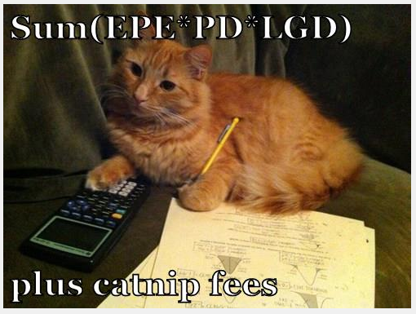
Quants at work

Slide 182
The Nature of Derivatives
The price of a derivative varies with time, the price of the underlying, the market’s perceived implied volatility (for options), discounting rates, etc.
Once you add counterparty risk, everything is an option – the counterparty can choose to default or you can choose to default., so the payoff of CVA / DVA has an extra level of optionality compared to the default-free valuation.
Collateral mitigates but does not extinguish counterparty risk – the side that fails to post collateral after a margin call has some time – the “cure period” also called the margin period of risk– to post it, and the market moves during that time. Typically this is 5 days for CCP and 10 days for a standard CSA.
Central Clearing Parties (CCP) – not to be confused with the old Soviet Union – CCCP – are not considered entirely risk-free. Historically, clearinghouses almost never go bankrupt, but they sometimes drive some or all of their clearing members into insolvency.
Once you buy / sell an underlying, you don’t care who you bought it from / sold it to. For derivatives, you are still exposed to the seller / buyer.
If the counterparty defaults on a centrally cleared trade, and nobody bids in the auction, then you could have a much larger loss. However, usually the CCP provides quite a reduction in counterparty risk.

Slide 183
The Current Exposure Method
The CVA is measured by a very approximate Basel rule. DVA and FVA are more-or-less ignored.
CVA is set to current MTM exposure plus a PFE set at notional times the conversion factor based on instrument types and tenors in the netting set. The netting of PFE is mandated to be
PFEnet = [.4 * Σ(individual PFE)]
+ [.6 * Σ(individual PFE * Net-to-gross ratio) ]
Not much here to validate. Just compare the model to Basel and to the Fed rules.
This method gives little or no insight into your actual counterparty risks, unless you are very long or very short. However, be sure you can pass the use test.

Slide 184
Computational requirements
CVA exposures must be calculated at the level of a netting set, not an individual derivative. Be sure the system has all the netted positions in the same bucket and can do forward valuation on all of them.
The extra optionality is almost always calculated by Monte Carlo simulation. If there are exotics which are priced with MC, then counterparty credit risk needs a second layer of MC – simulations within simulations.
There are at least two ways to solve this –
    More hardware – clusters of GPU
    Approximation – proxy the exotic with something less exotic but faster to do pricing simulations, and do something with the approximation error (Ignore it? Reserve for it? Other?)
    Typically firms do a bit of each.
    Can you do a Longstaff-Schwartz? ( http://arxiv.org/abs/1509.02179 )

Slide 185
Most CDO models are invalid
In general, a pricing model for derivatives is as good as its hedging prescription- Black-Scholes says the price is the price of maintaining a hedge with the underlyings and financing.
CDO are derivatives.
Consider a CLO with 100 liquid underlying syndicated loans, each trading at Libor + 40, and 2 tranches – 0-50 and 50-100.
How do you hedge the senior tranche with underlyings? Which underlyings?
Suppose 50 of the underlyings improve to Libor+10, and 50 go south to Libor + 600.
Now how do you hedge the senior tranche with underlyings? Which underlyings?
If your model assumes a large homogeneous portfolio it can’t handle the above.

Slide 186
Extrapolating VaR
  If you have a historical VaR, you cannot extrapolate at all past the worst it got during your data window.
  With a parametric VaR, what do the tails look like? Is contagion modeled?
  For Expected Shortfall, you need to explicitly model the tails.
  Extreme Value Theory tells us that tails can only have 3 shapes – Gaussian, abrupt cliff, and Frechet fat tail.
  EVT also tells us that tails are by definition smooth and featureless, but any data point is a feature.
  So by definition you have no data on the tail.
  EVT estimation is an extrapolation from “near” the tail to assuming that the tail acts the same as that data. This is not interpolation.

Slide 187
Static hedges, dynamic hedges, prop trades
  A traditional hedge is a dynamic strategy that actively trades to reduce some metric (delta in B-S) to zero. Time horizon is how long it takes for the trade to get done.
  A static hedge statistically averages over the set of future scenarios to get a nearly constant portfolio value of derivative plus hedges on a certain future date. Until then the portfolio value might bounce around. These are cheaper than dynamic hedges since fewer trades, but those intermediate marks-to-market might be unpalatable.
  If the trader decides when the dynamic hedge is far off enough to need rebalancing, you have a potential hidden prop trade from timing.
  What’s the difference between day trading and legging in to a big position while minimizing market impact?

Slide 188
What is Economic Capital
  Capital is a “Rainy Day Fund” to ensure your institution does not go bankrupt in a bad period
  Potential unexpected loss, over a specified time horizon, at a specified confidence level.
    Market Risk Regulatory Capital = VaR - 99% ten day
      Worst 2 weeks of 4 years
    Basel Economic Capital - 99.9% one year
      Worst year of the millennium - somewhat hard to backtest
    Basel PD Floor (~ AA rating) Economic Capital - 99.97% one year
      Based on the .03% transition probability from AA-> D
      Third worst year in 10,000
      Very hard to calibrate or backtest with actual historical data
        What was the effect on your bank of the invention of agriculture? Of writing?
        How many of your swap counterparties defaulted when Rome was sacked?

Slide 189
What is Really the Worst Year in 1000?
  How many of you work at firms started before the year 1015?
  No current firm or government has survived in its current form for 1000 years.
  The financial system of capitalism is only a few hundred years old.
  Long-distance trade is the difference between humans and Neanderthals.
  When validating something like VaR or EC, consider how likely it is to have a financial crisis again. How many big crises have there been since, say, Napoleon was defeated?
  What assumptions is your firm making about this sort of tail risk?
  If you are fully collateralized against all tail risks, then you must not be holding any government debt since sovereigns can default.
  Precious metals can plummet in value – that’s why Spain had massive inflation due to all that New World silver and gold.
    During the 16th century, Spain held the equivalent of US$1.5 trillion (1990 terms) in gold and silver received from New Spain. Ultimately, however, these imports diverted investment away from other forms of industry and contributed to inflation in Spain in the last decades of the 16th century: "I learnt a proverb here", said a French traveler in 1603: "Everything is dear in Spain except silver."

Slide 192
Session Seven:
Stress Testing,
CCAR, and
Scenario Expansion

Slide 193
Table of Contents
Old and Naïve
Tails
Correlation, Copulas, and Concordance
Stationarity
Stress Events
Rhyming
Scenarios vs. Shocks
Validating the CCAR Narrative with Tonsured Correlations
Levels of Stress and Intended Model Use
Calibration, Data, and Judgment
Stress Testing for Validation vs. Stress Tests for Risk Management or Capital
Stressed Copulas

Slide 194
Old and Naïve
The traditional way of doing stress tests 30 years ago was to pick a few important risks, alter these, recalculate hypothetical losses, and you’re done.
Typically at a bank these were Rates Up 300 bp and Rates Down 300 bp.
PD and LGD were rarely stressed at the same time as rates.
All that has changed now.
CCAR is a very prescriptive set of 2 stresses, Adverse and Severely Adverse, stressing over 2 dozen variables with a prescribed trajectory over 9 fiscal quarters. If your firm does not have a plausible script of management reactions to this prolonged slump you fail CCAR.
If your firm does not plausibly stress most or all of its portfolio and most or all risk factors including those not specifically prescribed, you fail CCAR.
Assuming a Gaussian stationary distribution for some of these risk factors could make your firm (guess the end of this sentence).

Slide 195
Traditional Modeling Assumptions that Might Endanger CCAR
Variables are either normal or lognormal (MESOKURTICITY)
Pearson correlations describe the association between variables (the infamous GAUSSIAN COPULA)
A representative sample exists (HOMOGENEITY)
Past performance predicts future events (STATIONARITY)
One year’s data on 1000 companies is a good proxy for any one firm followed for a millennium (ERGODICITY)
Regressions are linear with no cross-terms or threshholding (LINEARITY)
Outliers can be disregarded (HUBRIS)

Slide 196
Red Flags from Donald Van Deventer
From http://www.nasdaq.com/article/bac-best-practice-model-validation-for-fed-stress-testing-value-at-risk-and-credit-var-cm404198 :
Red flags that call for intense scrutiny:
  To use the historical data set provided by regulators for modeling with no additions. For example, the Fed data set includes foreign exchange rates but no interest rate variables for the foreign countries. No arbitrage FX rates can't be modeled without knowing local interest rates, as we discuss below. We need to supplement the Fed data set to ensure no arbitrage.
  To use the data field (say the 30 year fixed rate mortgage yield) provided by regulators without consideration for the proper no arbitrage specification for linking mortgage yields to macro factor movements. We discuss that below.
  To assume the historical variables are normally or lognormally distributed with a constant mean and variance
  To assume that the historical variables are independently and identically distributed over time
  To use the phrase "that's not intuitive to me" to override a valid model

Slide 197
Tails
Stress events are only considered to be in the tail of a distribution if you believe that they are in the same distribution but just further out.
However, stress is not the same as a bad day. The dynamics are different.
This does not mean they are “outliers” – I don’t believe there are outliers in finance because that says your model is right and the historical data – the real world - is wrong.

Slide 198
Physics Envy
In the experimental sciences, there is a concept of “outliers” which are a few data far outside the range of the rest – scientists often assume these are due to measurement error and discard these measurements.
  That is how they missed the Antarctic ozone hole for so long
However, in finance there are usually separate data scrubbing procedures applied before the data enters the model.
Referring to actual observed data as outliers reflects a belief that the model is correct and the data that do not fit are drawn from a separate, irrelevant, or uninteresting model, and should be ignored, or represent phenomena that the modeler does not intend to capture.
  The “flash crash” actually happened.

Slide 199
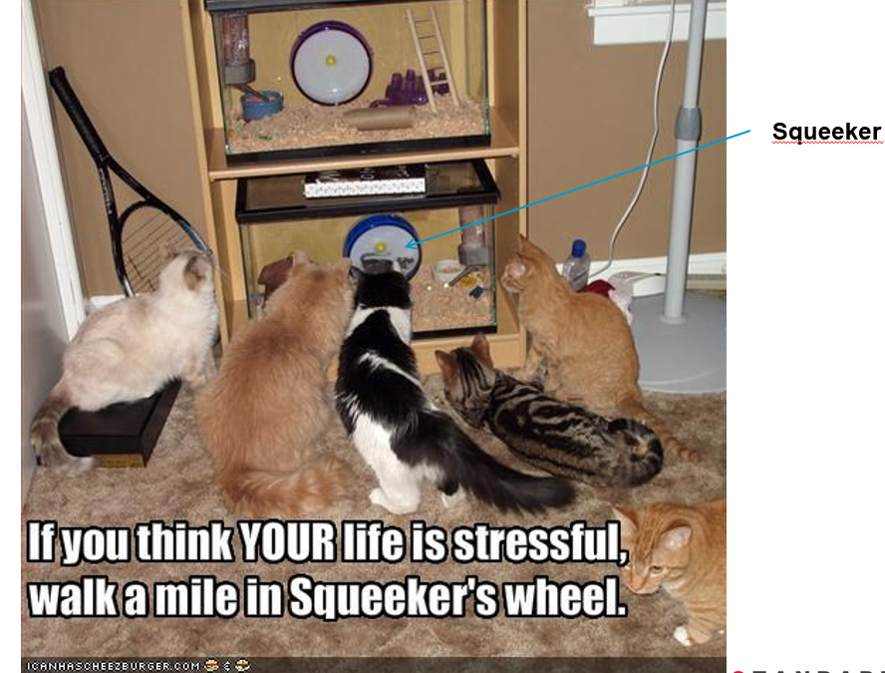
Stress is not Just a Bad Day
A bad day is more cats.
Stress is when the glass breaks.

Slide 200
Plausible Stress Tests
Going slightly off-topic, what makes a firm’s stress test plausible?
Anything in recent history is plausible because it actually happened.
How recent? (EU regulations for CCP’s say 30 years or as long as reliable data have been available. The Russian Revolution happened; is it a plausible stress to re-run 1917 but in the USA this time? How about in Greece?
Should not be so stressful that money is irrelevant – e.g.
  “30-mile-wide asteroid strikes Earth; oceans boil; all life above water goes extinct”
  (less extreme but still to much) “Religious extremists take over; banking is outlawed and all financial professionals are jailed”
Should not be too innocuous either
  At least some cages should shatter, as in the previous slide

Slide 201
Correlation, Copulas, Concordance
A similar issue to assuming that stress is just a bad day is the assumption that correlation is unaffected by stress.
This is assuming that the same (usually Gaussian) copula connects risk factors during stress as during benign periods.
As a validator, you might want to effectively challenge such assumptions.
Contagion means that when one firm gets sick, the infection is not entirely idiosyncratic risk, but can be systemic and infect other firms or sectors.
In a stress, the issue is not correlation, but what are the channels of contagion, and what might be circuit breakers to close off or narrow those channels.
Stress design may require subjective expert judgment on what would happen to X if Y went bad. This is more traders and economists projecting than anything testable.

Slide 202
Frailty
This is a term from health.
  If I fall down, I get bruised a bit and get back up. No connection to increased mortality.
  If someone old and frail falls down, they might break a hip, and then are quite likely to die within six months. Strong connection here between falling and mortality.
In finance, we have the concept of frailty-correlated defaults. http://papers.ssrn.com/sol3/papers.cfm?abstract_id=2128480 estimates that 40% of systematic variation in defaults in the US during the GFC was due to frailty.
“The basic idea is an application of Bayes’s Rule to update the posterior distribution of unobserved risk factors whenever defaults arrive with a timing that is more or less clustered than would be expected based on the observable risk factors alone. In the statistics literature on event forecasting, the effect of such an unobserved covariate is called ‘frailty.’ ”
  This is empirically testable but only during crises.
  See Duffie et al, http://www.darrellduffie.com/uploads/pubs/DuffieEcknerHorelSaita2009.pdf

Slide 203
Stationarity
In the real world, no financial time series is stationary – any description of the average or of “volatility” will change over time.
The naïve assumption of stationarity – pretending that the nature of the market will be about the same in the near future as it has been in the past - worked poorly for, say, Barings Bank, or for 1916 Russian debt personally guaranteed by the Czar.
For the concept of stationarity to be a useful measure for a dataset, the implicit assumptions are that there are no jumps or parameter drift, and that the market is near equilibrium – in a stress situation this is almost by definition wrong.
So as a validator, be very leery of stress scenarios making use of historical trends to justify the scenario.
Also question the assumed reaction to a stress.
Agent based models assume human nature is stationary and humans interacting cause change.
Trying to model the nonstationarity will lead to some parameters, which are themselves probably not stationary.

Slide 204

Stationary Cat Time Series
Of course we know that cats jump.

Slide 205
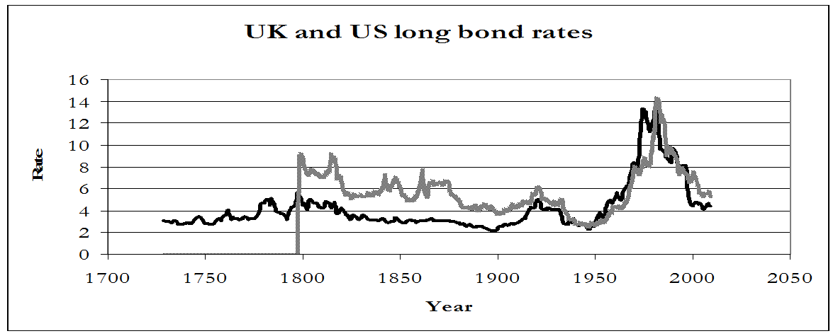
A long view
Loosely speaking, a stationary time series has the same distribution in each “business cycle.” Of course, there is no such thing as a fixed-length fixed-severity business cycle; and so forth. A long-history example:
The UK long bond rate rose 360 bp in 1974, and fell 188 bp in 1983. Since 1999, the largest annual rise was 39 bp and the largest annual fall was 82 bp. In the US, annual data from 1987 – present have the change in long bond yield vary from -92 bp to +75 bp. In 1986 it went down 235 bp, and in 1980 it went up 231 bp, and a further 223 bp in 1981.

Slide 206
Stress Events
Events are jump discontinuities in the usual meander.
Events usually have news stories attached, but these may just be post hoc rationalizations.
Severe stresses are rare and usually you cannot assign a numerical likelihood because of sparse or no data.
For many practical purposes in finance, the stress events are much more important to your corporate survival than the ordinary days.
CCAR does not try to predict a likelihood of stress. It just says, if the event happens, how well do you cope?

Slide 207
Rhyming
A quote misattributed to Mark Twain is “History doesn’t repeat itself, but it rhymes.” Another way of saying this is “Investors have short memories” or “That will never happen again.” All the above have some truth to them, but are not very quantifiable. The US financial panics of 1819, 1837, 1857, 1873, 1893, 1929, 1987, 1998, and 2007 were not identical. However, it is a near certainty that 2007 is not the last one.
Generals are always fighting the last war, because they know what happened.
If you are prepared to fight the last few wars, and some hypothetical ones that have not yet happened, the next stress is more likely to have features rhyming with something you wer prepared for.
As a validator, check if the different stresses used by your firm are really different from each other.

Slide 208
Scenarios vs. Shocks
Shocks are instantaneous changes, usually with the assumption that it is a regime shift and no aftershocks are expected.
An example is ten-day VaR wich is usually treated as a magnitude of a fortnight’s moves, but occurring all at once.
A scenario is a movie, with many sub-plots and a timeline for the narrative.
Stress scenarios in real life typically have 4 phases:
  The initial collapse
  Contagion spreads the collapse to other participants and starts a cluster of defaults
  Fire sales of assets from the defaulted firms further depresses the market
  Long drawn-out recovery, possibly slowed or speeded by policy changes or market regime changes
Not all stresses are scenarios – some have no time element, and some leave many relevant variables unchanged.
Not all scenarios are stressful. Finding good stress scenarios is more an art than a science. You can use brute force and ignorance (Monte Carlo) or subtlety.

Slide 209
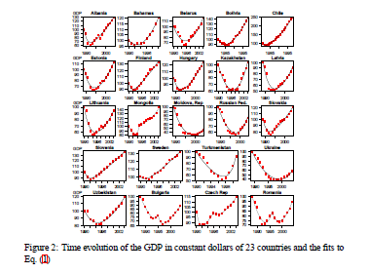
Universality of Recession Timelines
An interesting graph of various countries’ depressions looking alike is from http://arxiv.org/abs/0802.2004v5

Slide 210
Non-Anticipating
When validating a CCAR scenario, check for an inappropriate assumption that the firm’s management can correctly call the bottom – usually the Fed scenarios have 4 quarters of recession and then 5 quatrers of recovery, but if this were actually happening you would not know which quarter was the nadir.
A simple check on this is to run the scenarios shifted by a quarter or two – start the crash in Q2 or Q3 so the bottom is in Q5 or Q6, and see if their plans still work.

Slide 211
Validating CCAR narrative with tonsured correlations
This is from some work I did a while ago. Instead of rejecting “outlier” data, this strips out “inlier” data to get a clearer picture of how the market changed for larger moves in the past.
This is an exploratory data analysis technique I call “tonsuring,” intended to highlight infrequent features of the observed data, and does not posit any mechanism for explaining such features. If one assumes that future extremes will be similar to the extremes of the past, it can help with scenarios of stressful times yet to come.
All the details are at http://arxiv.org/abs/1110.4648

Slide 212
Tonsuring
For this example, I will talk about tonsured correlation.
Start from a bivariate data set that is assumed scrubbed. Assume stationarity. Calculate the mean/median.
Each datum j is some distance δ_{j} from the centroid:
Discard data closer than some cutoff (δ_{j} < T). Vary T from 0 to ∞.

Slide 213

Tonsured Copula Density – Brent vs Kerosene

Slide 214
Copulas
Most models in Finance with two or more variables use an approximation of the relationship between them called Pearson correlation, ρ, or just correlation. For more than two variables, typically we use a matrix of pairwise ρ (the correlation matrix) and ignore three-body effects. Strictly speaking, ρ is only appropriate for elliptical distributions (both variables Gaussian with zero skew and no jumps, and are associated by a Gaussian copula).
Even if the separate variables (called “marginals” in copula jargon) are Gaussians, for real financial time series the copula is not Gaussian.
  For example, see “THE JOINT DISTRIBUTION OF STOCK RETURNS IS NOT ELLIPTICAL” ( http://arxiv.org/abs/1009.1100 )
We can stress the copula by increasing/decreasing the contagion (includes tail dependence), while leaving the marginals unchanged. This is yet another dial to turn to try and “break” the model.

Slide 215
What are Copulas
First convert each variable separately to a quantile (e.g. Excel RANK() function)
A copula is a number between 0 and 1 describing what fraction of the data is below and to the left of each point.

Slide 216
What are Copula Densities
The copula density is the derivative of the copula.
Copula densities can be combined – if d1 and d2 are both copula densities, so is (x d1 + (1 – x) d2).
Copula densities make better graphics than copulas, and so lend themselves more to human judgment and pattern recognition.
Plotting a copula density is easy – just plot rank(x) vs rank(y) for each data point.

Slide 217
Fiendish copula density
The most fiendish copula tweak I have come up with starts with independent variables and makes them contagious for large moves and anti-contagious for small moves. (Not symmetric in x and y) Here is the resulting copula density.

Slide 218
Tonsuring Correlation 1871 – 2004 between annual changes in US stocks and bonds

Slide 219
Tonsured Historical Beta – Bank of America stock

Slide 220
Use for CCAR and stress tests
So this technique, although it does not predict stresses, hints at what will happen to the concordance between X and Y during large moves. If the scenario being validated is not consistent with the tonsuring graph’s hint, ask the developer whether this is a bug or a feature.
Concordance increasing with stress may imply more contagion, but decreasing during stress might imply a circuit breaker or a natural crisis hedge.

Slide 221
Levels of Stress and Intended Model Use
How stressful of a stress you use will depend on what you are using it for.
A circular argument would measure the level of stress by how much loss it causes to your firm’s portfolio, and then run a stress test at the decided level to see how big a loss was caused.
  Do you want this level to be painful, very painful, equal to N times average VaR, big enough to cause CCAR failure, or some other objective?
Less circular is if level was defined by losses on some “standardized” portfolio that was sort of like the real one but had no hedging or dynamic rebalancing.
Using these standard portfolios, one suggestion for multiple stress scenarios is to scale them to the same loss on the standardized portfolio. If you know in advance which scenario is more stressful in a given run, or it’s always the same scenario every time (often monthly) you run them, you’ve done it wrong.
Either the positions are not being altered to lower stress losses, or the tests themselves need work.

Slide 222
Calibration, Data, and Judgment
The larger the stress, the less historical data there is that had such a large stress.
So for less severe stresses, you can calibrate it vs. the historical record of your own economy or a proxy similar country’s economy.
The further back in time or less similar the proxy economy was to here and now, the less informative the comparison, so it’s more a suggestion than a calibration.
Subjective assessment is needed for larger stresses, on plausibility and on relevance.
  The validator should ask themselves what biases are inherent in the person or committee making these subjective judgments.

Slide 223
Stress Testing for Validation vs. Stress Testing for Risk
Stressing a Model
Stresses so large that the model “breaks” or misbehaves
Designed to test model
Stresses to test facets of model, not necessary to be plausible or meaningful
Examine each result separately
Choose a few representative positions
Only report results that are informative or unexpected
Calibrate if needed, and not necessarily to any particular date
Stresses usually ad-hoc, need not be plausible or multidimensional
Stresses might include regime changes or variant stochastic processes
Modeling a Stress
Stresses large but plausible OR Monte-Carlo with no plausibility test
Designed for informative outputs
Meaningful broad-based scenarios, preferably with descriptive titles
Possibly only use ensemble statistics
Run entire portfolio through each stress
Report all results, but probably aggregated or summarized
Periodic up-to-date recalibration to retain plausibility
Stresses subject to senior management scrutiny
Has market changed regimes enough to make model irrelevant or obsolete?

Slide 224
Validation stresses – a menu
There are several ways of choosing validation stress tests, and often it is helpful to use more than one.
  Historical scenarios – observed past intervals, usually involving large changes, that might be a useful test for the model. This is also called backtesting.
  Sensitivity tests – Here the start date and the end date are both now, and all but one (or perhaps a few) of the inputs are unchanged. (Instantaneous jumps)
  Ladder (grid) tests – a set of sensitivity tests with various widely spaced values of the same input(s).
  Monte Carlo – Generate lots of random scenarios, examine each individually, and see which ones are stressful – they cause the model to behave oddly or unexpectedly. Use a generator with fatter tails than any calibration. Look for patterns. This is not the same as statistical analysis of the result distribution.
  Process alterations – Add a new tunable parameter where the model assumes this is tuned to zero.
  Manual selection – What particular few stress patterns are most instructive about the model’s behavior and limitations? This is often informed by prior MC stresses.

Slide 225
Stresses for validation
The point of running stress tests for validation is to try to cause the model to misbehave, separately from any details about the positions that are being modeled. The size of portfolios being stressed should, in my opinion, all be quite small, and at least as diverse as anything you plausibly might use the model for in the foreseeable future.
This tests the model’s response to inputs and parameters, not the validity of the inputs or the plausibility of the stresses. In a realistic stress scenario, you may wish to include the feedback effects of portfolio or model changes that could be caused by embedded contract triggers or company policies. Validation stresses need not be realistic.

Slide 226

Unrealistic is okay

Slide 227
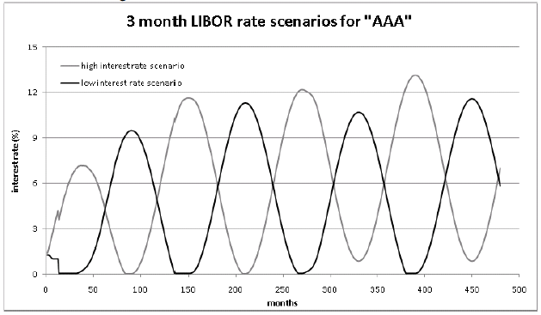
Stressed Time Series Scenario

Slide 228
Stressing the Copula
Here I start with the independence copula density
And add some lower tail dependence
and some more
You can do this with any two time series; it leaves marginal densities unchanged but adds tail dependence.

Slide 229
Stresses for Risk Management or CCAR
Ideally there should be a mix of historical stresses and hypothetical ones.
Try informing your models with user expertise and judgment in the selection of hypothetical scenarios. There are several ways of doing this:
Let the user choose and then fill in the details they omitted. The best of these have pithy names like “China Invades Taiwan” or “Mr. Fusion” or “Hyperinflation”
Stress scenarios need not have a probability assigned, but a catchy name helps.
Choose past time periods that illustrate the effect or stress you want to model.
Run Monte Carlo and grab some of the scenarios the computer generated – they won’t make any sense but there will be arbitrarily many of them unrelated to each other.
(PLUG FOR MY COLLEAGUE) Craig Friedman et al (see http://papers.ssrn.com/sol3/papers.cfm?abstract_id=1722871 ) has a better way, but I won’t discuss it here.

Slide 232
Session Eight:
Intended Uses and
User Approvals

Slide 233
Session Outline
Good, bad, and pointless models
Internal consistency
Inappropriate use
Fiefdoms
Divorce and Path Integrals
More anecdotes

Slide 234
Model Risk “Red Flags”
Novelty - Is the model unlike other generally accepted models for similar products in similar markets?
Fragility - Do small changes in market data, parameters, or assumptions cause large changes in the prices or Greeks?
Immaturity - Is the market relatively recently established and not well understood?
Exotic - Are there few or no similar products that have observable prices?
Benchmarks - Do alternative models give dissimilar prices and risks?
Illiquidity - Are the model inputs not reliably observable?
Complexity - Is the model very complicated relative to the capabilities of the model builders?
Noncomprehensive - Is the model useful only over a narrow range of market conditions?

Slide 235
Good Bad Pointless
A good pricing model has very little hedge slippage.
A good risk model backtests well.
A good stress test model seems plausible.
If the simpler model says your firm needs $50 Million in reserves to cover that risk, and you can build a much more accurate model that fits the data perfectly and says the firm needs $1.25 Billion, it may be a poor choice for your career to build that excellent model unless you have to. This is a “bad” model in the most selfish sense.
A model that the user doesn’t trust, can’t understand, and therefore won’t use is a “pointless” model. This can be the fault of poor communication skills, poor documentation, a bad model, or sometimes something more personal.
Model Validation Course 235

Slide 236
Divorce and Path Integrals
If the head trader just got divorced from a quant who always used Path Integrals (Green’s Functions), don’t reuse their ex’s techniques for that asset class. (Names and techniques changed to protect the guilty)
It is extremely important to remember that, unless you are a consultant, and even then maybe, you will have to work with the same developers on future validations, so try to be gentle even when you are failing their model. I still have a good relationship with some of the developers whose models I failed.
One trick is to remind them that it is better for Validation to find a flaw than if customers or regulators find it.
  At a previous job, they got a very angry call from a client about an obvious bug in a model that was next on my queue for validation – the quoting convention for most currencies is x/$ but for GBP it’s $/£ and the programmer missed it.
Model Validation Course 236

Slide 237
Internal Consistency
Suppose you have a model that works brilliantly for the US corporate loans market.
It should be mostly the same as for syndicated loans.
It should be quite similar to the UK loan model unless there is a good reason not to be.
It should be quite similar to a bond or CDS model in some ways, or at least useful as a benchmark, and not entirely contradictory.
The validator should not assume internal inconsistency is wrong, but if the rationale for the difference is not compelling it can be an issue.

Slide 238

Validator models vs. both Production models

Slide 239
Inappropriate Use
Suppose you have a model that works brilliantly for the US corporate loans market.
  Can you use it unchanged for the UK? What about if you recalibrate it?
  Can you recalibrate it to use in countries where charging interest is illegal?
  How well would the model work for exchange-traded rice futures?
Suppose you have a model for electricity futures
  Does it work for spot? Probably not, because you can’t store electricity.
There are usually quirks of any particular market that don’t transfer to other intended uses, but most of the main methodology should be remarkably consistent if they are used by the same firm.
As a validator, can you construct a cross-market arbitrage where there is inconsistency?
Example – if the swaps desk uses a different curve interpolation than the swaptions desk, there are certainly some odd-tenor swaps that are mispriced relative to swaptions on those same tenors, and there is an arb strategy there somewhere.

Slide 240
Fiefdoms
One of the most common reasons for internal inconsistency can be summed up by the phrase (spoken by the head London quant):
  “I’d sooner plunge my arm up to the elbow in boiling oil than use the New York model.”
The head Tokyo quant thinks (but is of course too polite to say):
  “A pox on both your houses. I’ll model it the Japanese way.”
Add to this a tendency to change models when a new head quant takes over, and soon you have a stew of competing incompatible models for exactly the same thing, all sharing the same name so you can’t tell which is which.
This is far from hypothetical. I’ve seen this at most institutions.
The validator can do a real service here to prevent desks being arbed against each other by a third party (it happens all the time; I’ve seen it) by pointing out this problem.
At one previous job, a trader for the bank’s treasury fixed this by telling both fiefdoms he was going to arb the two desks against each other by putting on offsetting $1 Billion notional trades often enough to suck the profit out of both desks and make Treasury look really profitable. The two desks agreed on a common methodology within a few days.

Slide 241
Last few anecdotes
Discrimination Arbitrage
  Many managers discriminate against women and minorities. They pay the less favored class less and give them less recognition.
  As a Wall Streeter, you probably are aware that if something is undervalued, it’s a buy signal.
Innovative but not quite right
  At a previous job, the head counterparty risk trader came up with a way to separately model PD and LGD implied in CDS spread curves. Nobody else on the Street could do this at the time.
  Unfortunately, he couldn’t either. The implied recovery rates would often go quite negative.
  He said “but if that’s what the data imply….”
  Because of regulatory requirements, I did not get fired for my team making him fix it. He fixed it and we are still on good terms all these years later.

Slide 242
Random musings
Zen
  The nature of model validation is ultimately to render a qualitative judgment on a quantitative process.
  If you are an independent validator, this judgment is purely advisory, and is at least party unenforceable.
When you are getting nasty-grams from the model owners, (and you will certainly get some if you are doing your job well) remember that it is not you that they are attacking, it’s the chair you are sitting in.
Model Validation Course 242

Slide 245
Session Nine:
More Tools for the Validator’s Toolbox from Recent Literature

Slide 246
Rationale
One important part of validation is to present alternatives to the production model.
The more alternative methodologies you know about, the more likely it is that one of them will be useful for the particular validation that you are working on.
One of the things I am trying to convey in this course is that you should be keeping up with the literature.
Validators are not academics; let the academics invent things, and then you can plagiarize apply them.(http://www.lyricsfreak.com/t/tom+lehrer/lobachevsky_20138409.html )
Principle of Least Action
This session will be extra extra quantitative and more vague than usual.

Slide 247

Break free of the usual assumptions

Slide 248
Where Do You Find these Things?

Slide 249
Sources
Ideas from the developer’s previous models
Textbooks
  Use the Harry Gray method for choosing textbooks:
    All publishers have pretty good texts, so the most recent copyright date is the best one to get
Journals – these have the advantage of being peer-reviewed but costs may be prohibitive
arXiv.org – Quantitative Finance
  Some are preprints or postprints of journal articles
  Some are journal-quality but the author is not interested in paying page fees or dealing with referees
  Some are too unconventional for most journals but are nonetheless valid ideas
  Some are just nutty or otherwise wrong, but get posted anyway
SSRN.com
IDEAS.repec.org
Masters and PhD theses of people you are interviewing

Slide 250
How Do I Code These Things?
My answer, remembering the principle of least action, is that you don’t.
Any weird algorithm will have an R package that does it and that you can download.
Most will be in a Matlab toolbox, and some will have a Mathematica implementation.
For C++ you are probably out of luck as these functions, in say Quantlib, may be too buggy and require incompatible structures to call properly, but that’s just a guess.
  I never code in C++ so I may be being overly pessimistic.
I can’t comment on availability in SAS or SAS/Enterprise Miner because I haven’t used SAS in decades.

Slide 251
Freezing the Drift in LMM
Most implementations of the Libor Market Model use MC and freeze the drift at its deterministic initial value
Alternatives are discussed in http://mpra.ub.uni-muenchen.de/32972/
7 ways of freezing the drift
MC and a n-nomial (but more than 2 or 3) lattice compared
Their lattice is about as fast as the usual MC but more accurate
This paper is a perfect example of what you want to do as a validator – add value by making suggestions of how they could do it better, even if there’s nothing wrong with how they are doing it now
But be careful not to lose your independence

Slide 252
Frequency Domain
For reasons I cannot explain, economists hate Fourier transforms.
The standard text “Analysis of Financial Time Series” by Ruey Tsay has not a word about wavelets, frequency analysis, spectral analysis, or anything similar. (but it’s a good book anyway)
A good example is “cointegration” meaning that two variables tend to “drift” together regardless of short-term correlation.
  This cointegrated process is posited to be stationary.
  A more frequency-oriented way of looking at this, which is more useful and fits the data better, is to look at the bispectrum. At high frequencies, like a daily correlation, you analyze the amount of power (technical term). (High-pass filter)
  Filtering out these high frequencies, how much power is there at various other frequencies? (Low-pass filter) If there is a lot at, say, quarterly to quadrennial, use that as a band-pass filter, re-convert to the time domain, and you have a correlation for CCAR use. If the power is all at zero frequency, then it’s a real stationary cointegration.
Of course, filtering out uneventful days, then low frequencies, you probably have no data left.

Slide 253
Wavelets
Applications using wavelets in disciplines other than economics are extensive, with many papers published in areas such as acoustics, astronomy, engineering, medicine, forensics, and physics. Economics (and to a lesser degree, finance) is conspicuous in its absence from this list. This is only recently changing.
A wavelet is an ideal way to model non-stationary timeseries, (http://ideas.repec.org/p/wpa/wuwpem/0503017.html ) and it’s great for capturing seasonality effects.
It’s sort of the same spirit for timeseries as B-splines for curves – there are knot points and basis functions in between, but here the basis functions are various choices of mother and father wavelets. Frequency limited and time limited.
Use of wavelets for hedging is discussed in http://papers.ssrn.com/sol3/papers.cfm?abstract_id=2573235
Singular spectrum analysis (SSA) is another nonparametric tool for decomposition of an observed time series into sum of interpretable components such as trend, oscillations and noise. (http://arxiv.org/abs/1308.4022 )
Don’t be too scared of imaginary numbers.

Slide 254
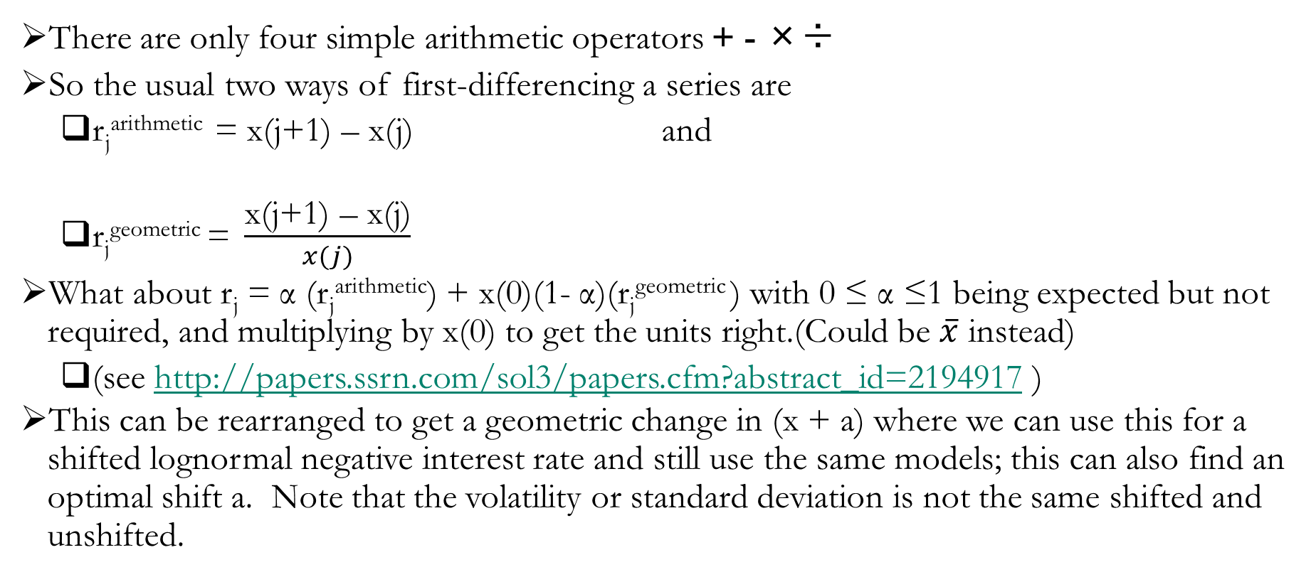
Displaced Diffusion
There are only four simple arithmetic operators + - ×÷
So the usual two ways of first-differencing a series are
  r_{j}^{arithmetic} = x(j+1) – x(j) and
  $\text{r}\text{j}\text{geometr}\text{ic} \text{= }\frac{\text{x}\text{(}\text{j}\text{+1) – }\text{x}\text{(}\text{j}\text{)}}{x(j)}$
What about r_{j} = α (r_{j}^{arithmetic}) + x(0)(1- α)($\text{r}\text{j}\text{geometric}$) with 0 ≤ α ≤1 being expected but not required, and multiplying by x(0) to get the units right.(Could be $\overline{x}$ instead)
  (see http://papers.ssrn.com/sol3/papers.cfm?abstract_id=2194917 )
This can be rearranged to get a geometric change in (x + a) where we can use this for a shifted lognormal negative interest rate and still use the same models; this can also find an optimal shift a. Note that the volatility or standard deviation is not the same shifted and unshifted.

Slide 255
Stepwise Regression
In some fields, notably retail credit scoring, it is assumed that a linear or logistic regression is appropriate.
Typically one chooses a handful of explanatory variable out of the hundreds available, then regresses on those few. The choosing is either
  Top-down – start with all variables, then discard those that fail a significance test.
  Bottom-up – choose individually those explanatory variables that pass a significance test
  Mixed – some each of bottom and top, and some expert judgment thrown in
This is called “stepwise regression” and is probably statistically invalid. (see Wikipedia)
  If it is used mostly to justify expert judgment then it’s not quite as bad
Alternatives with more theoretical support include CART, random forests, and other tree models, SVM, neural nets, and probably lots more.
The issue is to avoid data dredging – once you have used the data to select variables, you do not have as many degrees of freedom to regress on those selected variables, and the significance levels get way overstated. Also regressions may work by coincidence – correlation not causation.
A related set of tests of multiple testing is at http://arxiv.org/abs/1304.4920
There are Bayesian versions that allow expert judgment priors.
  If an expert judgment is based on many years experience, how quickly does the expert adapt to regime changes? Unknowable.

Slide 256
Stop Making Sense
Remembering that in Finance all explanations of the data are wrong, but we pretend that the data come from some mathematically defined process. The key for practitioners is to fit the data to the degree desired without justifying why your chosen function gives a good fit.
Academics hate this. The academic comes up with a function or process based on “economic reasoning” (DSGE is probably necessary to get tenure), and then tries to show that the data come pretty close to their prediction.
Practitioners want to fit the data as well as possible, or as well as possible out-of-sample, based on whatever works. It doesn’t have to have any good reason to work. Academics call this “cheating.”
Francis Longstaff once told me that the way to merge these was to have his academic rationale predict something close, with a constant somewhere in there based on DSGE, and then make the “constant” time-varying or position-dependent so you can fit the actual data well enough to use the model.
As a validator, if your alternative model fits the data well in and out of sample, but is too compute-intensive for production, that’s okay.

Slide 257
Flexible distributions
An example here is to take a probability density function that you are used to, like Student-t or lognormal, and then stretch and twist it to fit, assuming the data is unimodal.
I have already mentioned the g×h distribution, which modifies a Gaussian.
A more flexible technique comes from http://arxiv.org/abs/1406.7674v2
Start with any unimodal 1-d distribution.
Use 2 parameters to mush the left side, and 2 more to mush the right side. (mush is not the correct technical term)
Adjust the scale so the two sides meet at the mode.
They call this the “double two-piece” transformation.
It may get messy or impossible to integrate over, or price options with, analytically; numerical integration always works and computers are fast nowadays.
Beware of overfitting that doesn’t work out-of-sample.

Slide 258
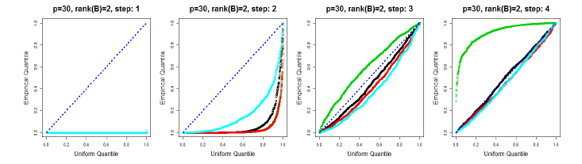
More on PCA
A requirement for CCAR is, given the Fed-mandated 27 or so time series for the 9 future hypothetical quarters, expand that compatibly to the zillions of risk factors that your institution is exposed to. One way of ensuring plausibility is to use a PCA approach and extrapolate along the set of 27 or fewer principal components from a historical regression.
Is a PCA of rank 27 too many or too few? Remember that some of it is idiosyncratic random noise that will test badly out-of-sample.
A frequentist test for how many components are significant is found in http://arxiv.org/abs/1410.8260.

Slide 259
More Complicated is Not Necessarily More Correct
The Black-Scholes model for volatility is that every option at every strike and every tenor on the same underlying has the same volatility.
Local volatility models have a vol surface that fits the market as of when it’s calibrated, and then assumes that surface has the same shape forever.
  Sticky strike means the surface does not shift if the underlying’s price moves.
  Sticky delta means the whole surface moves as much as the underlying so the option implied vol is constant when the underlying moves around.
Stochastic vol methods are even more complicated, but I am not discussing them on this slide.
As a validator, consider the alternative α*Stickystrike + (1 – α)*Stickydelta where you can calibrate α to recent history.
An option pricing model is as good as it’s hedging performance.
For vanilla AUDUSD FX options, http://arxiv.org/abs/1406.2133 finds that Black-Scholes is no worse than the local volatility model. In fact the Black-Scholes model performs significantly better than sticky delta local volatility, particularly for in and at-the-money options.
But for some other underlyings, sticky delta may work better, and for a particular short-rate interest rate model calibrated from 1999-2005, α was about ½.

Slide 260
Agent-Based Modeling
This is an entirely different paradigm than treating “the” market as the object to be modeled.
As mentioned earlier, human behavior is probably as close to stationary as you can get. Maybe humans seem a bit more civilized today than 20,000 years ago, but ISIS is a counterexample.
In agent models, you have a diverse set of “agents” (humans) making decisions based on heuristics and sentiment. Maybe some use mathematical models and some don’t.
Unlike classical Chicago economics, there is no single “representative” agent acting “rationally” based on perfect information and unlimited computing power.
An example, “The Economics of Radical Uncertainty” (http://www.economics-ejournal.org/economics/discussionpapers/2015-40 ) gives an example of a very simple pure sentiment model of the business cycle, in which agents use simple heuristic decision rules, including imitation. It is nevertheless capable of approximating a number of deep features of output growth over the cycle.
Has anyone here used this kind of model? I have not.

Slide 261
Hawkes Processes for Contagion
A standard technique in earthquake modeling, Hawkes processes are an extension of Poisson processes (jumps) where the jump probability increases after a jump occurs and then gradually decays back to baseline. This leads to clustering, and is called a “self-exciting” process.
This same clustering paradigm can be used for defaults, or for fat tail events.
A recent paper http://ssrn.com/abstract=2635436 extends this to contagion – tail events in one place increase the likelihood of more tail events in the same and other markets. The magnitude of the initial shock, and of precursor small shocks, might affect the amount of increase – this hypothesis can be tested statistically on the historical time series.
The magnification effect is asymmetric – US stock market crashes increase the likelihood of an EU crash with a different multiplier than the EU affects the US.
A Hawkes process can be quadratic and not just linear, see http://arxiv.org/abs/1509.07710 where they fit NYSE data.

Slide 262
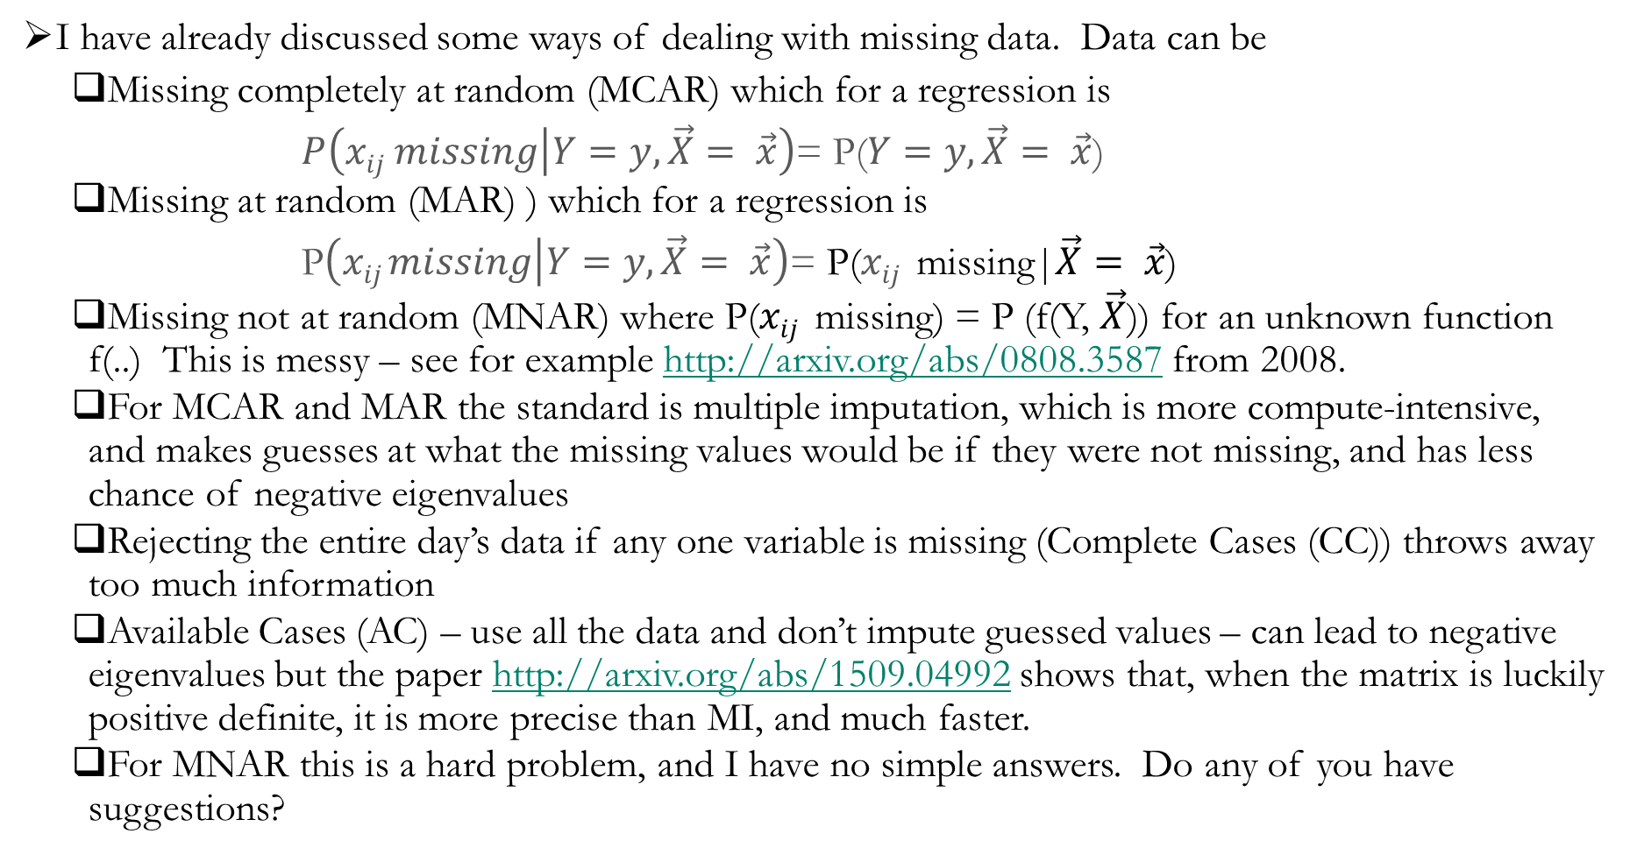
A Different Approach to the Problem of Missing Data
I have already discussed some ways of dealing with missing data. Data can be
  Missing completely at random (MCAR) which for a regression is
        $P\left(xij missing | Y=y,\vec{X}= \vec{x}\right)$= P($Y=y,\vec{X}= \vec{x}$)
  Missing at random (MAR) ) which for a regression is
        P$\left(xij missing | Y=y,\vec{X}= \vec{x}\right)$= P($xij$ missing|$\vec{X}= \vec{x}$)
  Missing not at random (MNAR) where P($xij$ missing) = P (f(Y, $\vec{X}$)) for an unknown function f(..) This is messy – see for example http://arxiv.org/abs/0808.3587 from 2008.
  For MCAR and MAR the standard is multiple imputation, which is more compute-intensive, and makes guesses at what the missing values would be if they were not missing, and has less chance of negative eigenvalues
  Rejecting the entire day’s data if any one variable is missing (Complete Cases (CC)) throws away too much information
  Available Cases (AC) – use all the data and don’t impute guessed values – can lead to negative eigenvalues but the paper http://arxiv.org/abs/1509.04992 shows that, when the matrix is luckily positive definite, it is more precise than MI, and much faster.
  For MNAR this is a hard problem, and I have no simple answers. Do any of you have suggestions?

Slide 265
Last words
I hope this class has been instructive, or at least amusing.
An earlier version was reviewed as “quirky but fascinating.”
Your memory of all this will fade over time unless you put some of it to use.
There is more to validation than what I have told you, but I may not know what it is.
The important thing is to learn from your experiences, other people’s experiences, and the written or spoken word.
Try to learn enough that the rate of learning is faster than the rate of forgetting.

Slide 266

Audience questions?

