Slide 1
Statistical Quirks, Subtleties, and Surprises in Financial Data
Martin Goldberg, Ph.D.
ValidationQuant.com
Presentation Given to Rutgers Masters Program in Financial Statistics and Risk Management
January 31, 2014

Slide 2
Preamble
These are my opinions.
If financial data were well-behaved, we would not be here today.
There are no Laws of Finance. Financial data do not follow any stochastic process, but Wall Street uses heuristics – build models as if the models worked, so an approximate answer can be found.
If you don’t actually work any examples similar to what I will discuss, the talk will just be bubbles – shiny and pretty for a few seconds, then disappears in a spray of i.i.d. soap.
There may be some LOLcat pictures.

Slide 3


Slide 4
Outline
Missing Data Issues
The Usual Assumptions
Compromises
Conclusions

Slide 5
Missing Data issues

Slide 6
An Example from a Data Aggregator
Suppose the algorithm for quoting prices of a security is the arithmetic average of all contributor quotes if 3 or more contributors, else repeat yesterday’s price.
5 contributors, each supplying a constant price on this schedule:
Contributor | Monday | Tuesday | Wednesday | Thursday | Friday
A | 65 | 65 | 65 | 65 | 65
B | 60 |  |  |  | 60
C |  | 57 | 57 | 57
D | 70 | 70
E |  |  |  | 55 | 55

Slide 7
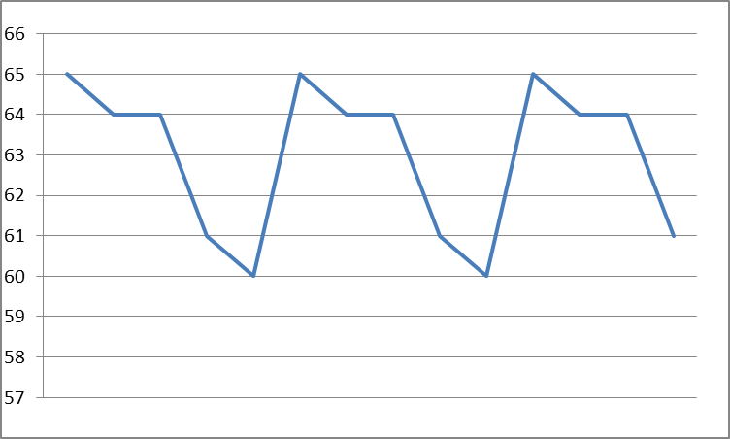
False Volatility
The reported price time series from the vendor looks like active trading, but it isn’t.

Slide 8
Not Positive Definite
Many times you need a matrix inverse, or a Principal Components Analysis, or such. Here we see missing data causing problems again.
Three stocks partially observed on three days.
  Day 1 – A goes up, B goes down, C not traded
  Day 2 – A goes down, B not traded, C goes up
  Day 3 – A not traded, B goes up, C goes down

Slide 9
Matrix mess
So the correlation matrix is
And the inverse is 0 -.5 -.5
-.5 0 -.5
-.5 -.5 0
Eigenvalues -1, 2, 2 so it’s not positive definite, and can’t be used for most financial calculations. A more subtle version of this often shows up in corporate VaR calculations when some time series are more liquid than others.
1 | -1 | -1
-1 | 1 | -1
-1 | -1 | 1

Slide 10
Partial Solution
At one of my previous jobs, the way they dealt with this was to have a multi-step inversion:
  Arrange the timeseries in descending order of liquidity.
  Invert the covariance matrix of the fully observed timeseries, which will be (almost) positive definite.
  Augment with often-observed risk factors, and force the upper left of the approximate pseudo-inverse to exactly match step 2.
  Repeat for a few more tiers of liquidity.
Note that filling in missing values with, for example, EM, reduces volatility and might change the covariance structure.

Slide 11
New Assets / New Risk Factors
Suppose you want to calculate correlations based on 5 years of daily data, but some of your asset classes have only existed for 2 years.
What would you suggest doing?

Slide 12
The usual assumptions

Slide 13
Why Assumptions are Good
Look at another person’s face. Every few seconds, you will see their eyelids as they blink. You, too, blink every ~2 – 10 seconds. Does your perception of the outside world include the reality of it disappearing briefly when you blink, and seeing your eyelids?
It does not. Your vision model is hardwired to disregard the momentary blackouts caused by blinking. What you perceive is a somewhat idealized model of what photons do or don’t hit your retina.
My point is that models are not reality even when you think they are, and that their deliberate omissions may be helpful and desirable. Simplification to emphasize what’s important is a good thing.

Slide 14
The Usual Suspects
Variables are either normal or lognormal (MESOKURTICITY)
Pearson correlations describe the association between variables (the infamous GAUSSIAN COPULA)
A representative sample exists (HOMOGENEITY)
Past performance predicts future events (STATIONARITY)
One year’s data on 1000 companies is a good proxy for any one firm followed for a millennium (ERGODICITY)
Regressions are linear with no cross-terms or threshholding (LINEARITY)
Outliers can be disregarded (HUBRIS)

Slide 15

Comfort vs. Reality
Messy reality
Easy to model – standard “thinking inside the box”

Slide 16
Fat Tails
Most financial timeseries have fat tails (leptokurtic) and are not symmetric. But it is easy to check this for any that you care about.
Example:A few jobs ago I fit the distribution of 2-week changes in spreads of single-B bonds to a model with a fat-tailed distribution of ordinary changes plus skewed fat-tailed jump probabilities for up and down jumps.
The only way to say some moves were jumps was that I had already subtracted the best-fit fat-tail. Individual observations could not be definitively classified as jump or fat-tail.

Slide 17
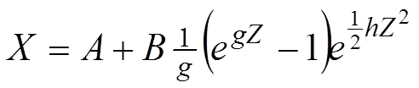
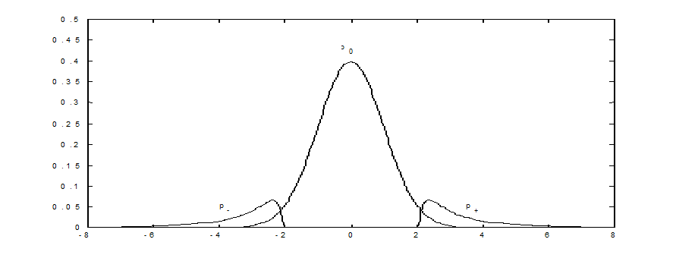
Tukey gXh
The functional form for my fat-tailed distributions was Tukey’s g×h
Using one for the bulk, and separate gXh for each tail, dramatically reduced fitting error.

Slide 18
COPulas and Dependence

Slide 19
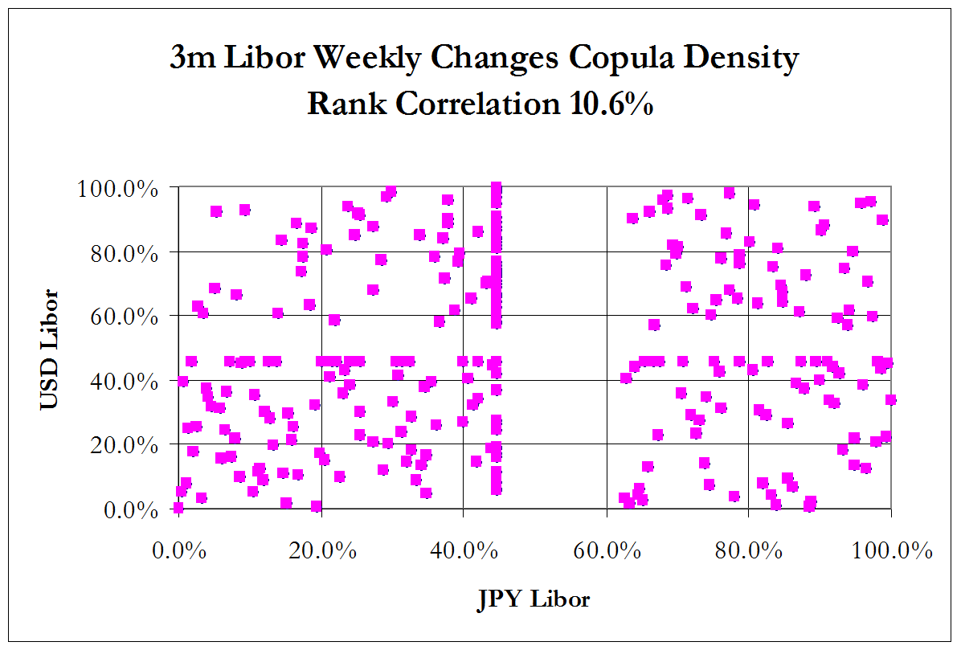
Copula density of LIBOR is not continuous
unchanged

Slide 20
Look at Your Data
This is called Exploratory Data Analysis, and it is, or should be, logically prior to doing any statistical tests of any sort. Form your hypotheses based on the data, and then test them statistically.
It’s easy to assume that two datasets or timeseries are “correlated”, but that presupposes an elliptical distribution. Skewness can make Pearson correlation meaningless.

Slide 21
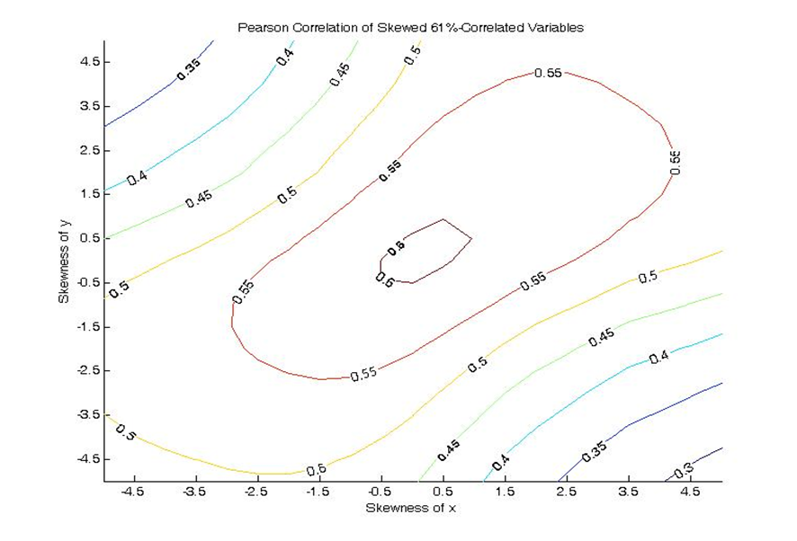
Skewed synthetic data
In this simulated example, the Gaussian drivers of two processes are 61% correlated. Consider scenarios where we test robustness to skewness in the distribution of one or both observed processes. A rank correlation remains stable, but the Pearson correlation is an underestimate of concordance. Skewness of equity indices: Australia is -2.8, US -1.2

Slide 22
My hints about copulas
It’s easier to do theorems and proofs using copulas (like CDF), but the copula density (like PDF) is easier to visualize.
A weighted sum of copula densities is a valid copula density, but copulas don’t combine easily.
Try Bernstein copulas if you really need to fit weird data features.(ref http://www2.warwick.ac.uk/fac/soc/wbs/subjects/finance/research/wpaperseries/2002/02-107.pdf ) - it’s a series expansion of sorts.

Slide 23
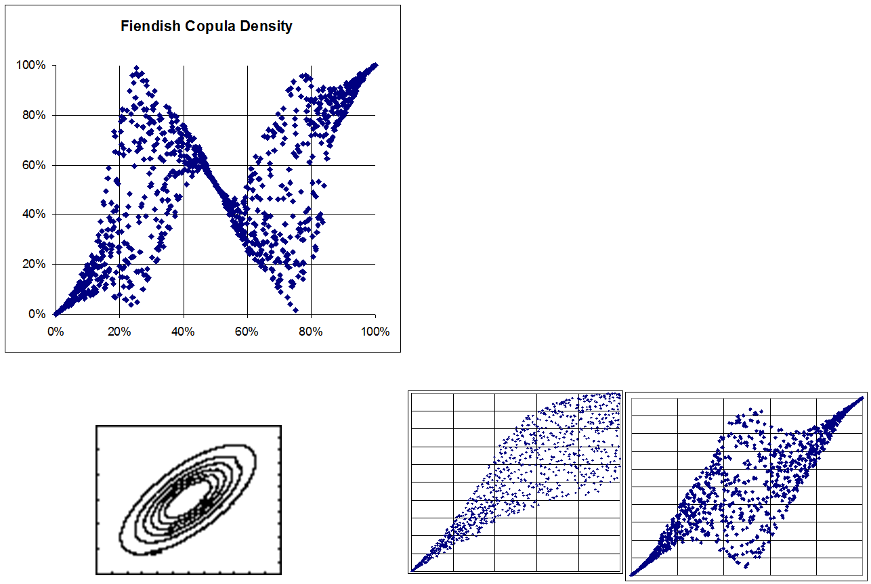
Some copula densities
Galaxy-like, both upper and lower tail dependence
Funnel-like, e.g. Clayton
Gaussian

Slide 24
Principal Components and RMT
If you generate several short series of Gaussian random numbers, and look at their correlation matrix, the eigenvalues of that matrix will be distributed as Marcenko-Pastur according to Random Matrix theory. For financial timeseries, you get this plus a very few “real” market factors. Google it yourself. As an example, see Jim Gatheral’s talk http://faculty.baruch.cuny.edu/jgatheral/RandomMatrixCovariance2008.pdf

Slide 25
Extreme returns
If you eliminate the “boring” days from your timeseries (see my tonsuring article http://arxiv.org/abs/1110.4648 ) the number of “significant” eigenvalues gets even smaller. The folk-wisdom saying equivalent is that “in a crisis, correlations go to one.” This is not quite true; more correct is the funnel-shaped distribution where, when the stock market goes up, there is pairs trading and relative-value bets, but when the market plunges, many investors sell stock and buy Treasuries. Thus there may be some correlations that go close to -1 in that same crisis. In EVT this is called lower tail dependence.

Slide 26
homogeneity

Slide 27
Retail Credit Scorecard Segmentation
Much effort at all loan or credit-card issuers is to decide who is likely to repay their debts. One of the methodologies used is to try to split the universe of borrowers into many nearly-homogeneous segments, based on as much information as you can get and are legally allowed to use (e.g. redlining is illegal). A scorecard is designed for each segment. A new applicant’s data is scored and compared to a low-default part of their segment. If they are on the good side of the threshhold, extend credit, else reject the application. This works well with classifying people; less so with corporations and governments.
Your data may or may not be homogeneous; check first.

Slide 28
Stationarity

Slide 29
This Time Is Different
A quote misattributed to Mark Twain is “History doesn’t repeat itself, but it rhymes.” Another way of saying this is “Investors have short memories” or “That will never happen again.” All the above have some truth to them, but are not very quantifiable. The US financial panics of 1819, 1837, 1857, 1873, 1893, 1929, 1987, 1998, and 2007 were not identical. However, it is a near certainty that 2007 is not the last one.

Slide 30


Slide 31
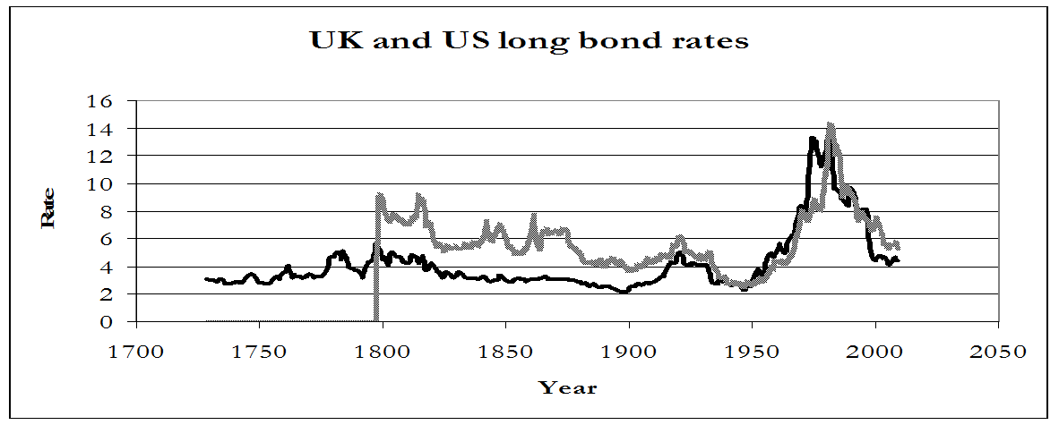
A long view
Loosely speaking, a stationary time series has the same distribution in each “business cycle.” Of course, there is no such thing as a fixed-length fixed-severity business cycle; and so forth. A long-history example:
The UK long bond rate rose 360 bp in 1974, and fell 188 bp in 1983. Since 1999, the largest annual rise was 39 bp and the largest annual fall was 82 bp. In the US, annual data from 1987 – present have the change in long bond yield vary from -92 bp to +75 bp. In 1986 it went down 235 bp, and in 1980 it went up 231 bp, and a further 223 bp in 1981.

Slide 32

No Ergodicity – not all cats are alike

Slide 33
COMPROMISES

Slide 34
Time vs Effort
Modeling all the nuances would take forever. Academics and practitioners and students all have deadlines. At some “point of diminishing returns” you have to decide you’ve done enough on that problem, and move on to another task.
Remember Hofstadter’s Rule, which states that everything takes longer than you think it will, even after you take Hofstadter’s Rule into account.

Slide 35
Palatability
If the simpler model says your firm needs $50 Million in reserves to cover that risk, and you can build a much more accurate model that fits the data perfectly and says the firm needs $1.25 Billion, it may be a poor choice for your career to build that excellent model unless you have to.
If your manager just got divorced from a quant who always used Finite Elements, don’t reuse their ex’s techniques. (Names and techniques changed to protect the guilty)

Slide 36
conclusions

Slide 37
Take-aways from my talk
Statistical subtleties are actually present in Finance and often are worth investigating.
Use EDA first, then decide what hypotheses to test, unless your manager or regulator says otherwise.
The field is evolving rapidly. I personally get a daily digest from the statistics site stat@arXiv.org
Even if all models are wrong, it often pays to use models that are less wrong.
Some humor and LOLcats may lead to less of the audience falling asleep.

Slide 38

Audience questions?

