Slide 1
Validating Stress Testing Models
Martin Goldberg, Executive Director
Clearing Compliance and Risk Management
CME Group
martin.goldberg@cmegroup.com

Slide 2
The Usual Caveats
This course expresses my own personal opinions and may not represent the views of any past, present, or future employers. It may conflict with your views. Feel free to disagree.
If models were perfect, this would be a very different universe. This course is certainly incomplete.
This topic is hard, and a short talk will not make you an expert. It may point you in some interesting directions, but there are many devils in the details.
No proprietary or confidential information is included in this talk. You might decide afterwards that no information at all is in here.
I may go off-topic either deliberately or upon request.
This talk is intended more to suggest questions than to give answers. Regulatory changes may invalidate some or all of the current approaches.
I have been a quant for a long time so this talk will be rather quantitative.

Slide 3
Outline
Model Risks in stress tests
Good model governance
Understanding model limitations/weaknesses
Challenging models
Applying controls
Outcome analysis

Slide 4
Model Risks in Stress Tests

Slide 5
Model Risks in stress tests
Two distinct kinds of stress test
  Stress shocks are instantaneous changes having immediate effects- e.g. VaR
  Stress scenarios have a well-defined time period and a narrative of aftershocks and reactions – e.g. CCAR
Plausible shocks are easier to design, since they have no plotline
Scenarios are more informative but harder to get plausibility
You cannot just run Monte Carlo and use some of the more stressful computer-generated scenarios; they won’t make sense
In a crisis environment many models break down
  What is the value of a product that nobody wants to buy?
  How do you hedge in an illiquid market?
  Can your yield curve model handle negative rates?
  What happens in hyperinflation with 3-month Treasuries at 150%?
Severe stresses are rare and usually you cannot do a traditional backtest because of sparse or no data. Aesthetics and subjective plausibility are the best you can do.
Have they included contagion and circuit breakers in longer scenarios?
Good documentation by the stress designer, explaining why the stress is that way, is crucial to getting the stress validated.

Slide 6
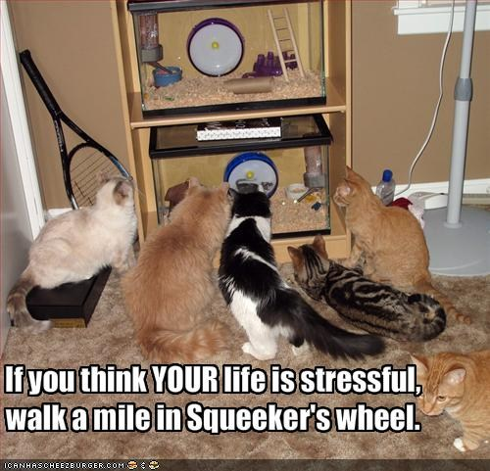
A bad day is more cats. Stress is when the glass breaks.
Squeeker

Slide 7
Imaginary Forward Volatility
Shock the 2 year implied volatility up and down, but not the 1 year.
Calculate the 1-year forward implied annual volatility from given stressed volatilities at 1 and 2 year tenors. Suppose the volatility of the 1 year option is 5%. The forward vol in a simple model (no jumps, no autocorrelation) would be
If the vol curve drops too steeply in your stress scenario, your regular model will not work. You may need a more complicated volatility model since imaginary forward vols are not meaningful.

Slide 8
Scenario Expansion
Since a stress shock or scenario should involve all your positions, both long and short, all the underlying factors should be stressed.
An essential part of validating a stress is deciding whether the scenario is plausible and appropriate to its intended use.
“Scenario Expansion” is one term used to describe how the thousands of factors will move when a few dozen key ones define the scenario (such as the Fed-prescribed ones in CCAR).
It may be tempting to use historical correlations to decide how far to stress other factors, but it would not be plausible.

Slide 9
Tail Dependence
Markets that are not very related in good times can plummet together in bad times. For example, when times are good in equities, traders do pairs trading, betting which of two related stocks will do better. In bad times, the firm may tend to close out all its equity positions and buy Treasuries.
The only really original idea I ever published deals with quantifying this effect. For details see http://arxiv.org/abs/1110.4648

Slide 10
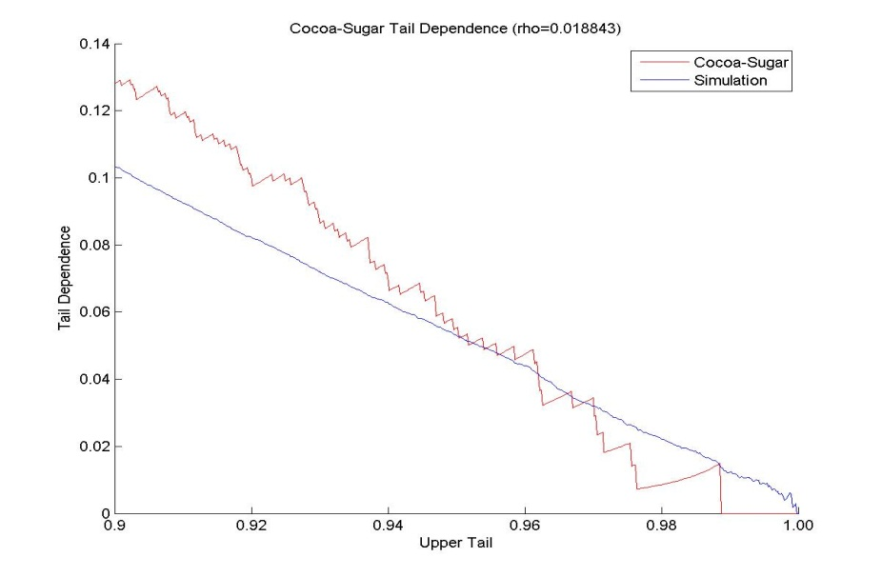
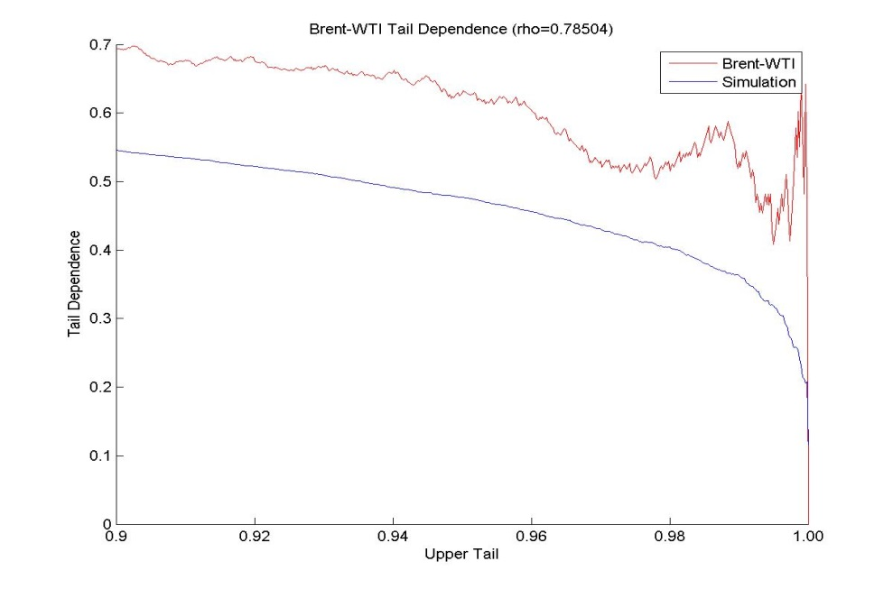
Tail Dependence Graphs
Correlation is a good measure of dependence only for elliptical distributions. Tail dependence (contagion) means local correlation for large moves is larger than the full-sample number.
For comparison, the tail dependence for Gaussian random numbers with the same Pearson correlation is shown. Note Gaussian copulas have zero tail dependence. Cocoa-sugar is not tail-dependent but Brent and WTI are.

Slide 11
Example - Adding Lower Tail Dependence
Here I start with the independence copula density
And add some lower tail dependence
and some more

Slide 12
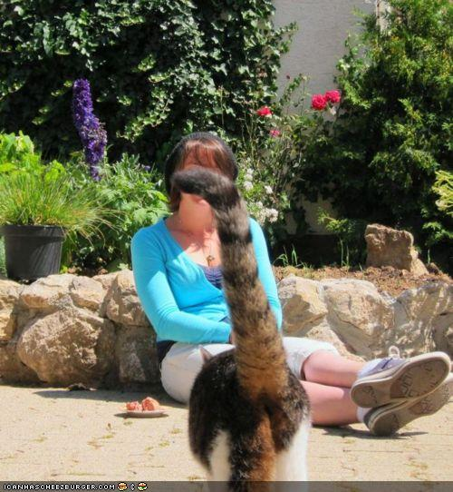
Sometimes the tail hides the rest of the picture

Slide 13
Tonsuring
This is an exploratory data analysis technique I call “tonsuring,” intended to highlight infrequent features of the observed data timeseries. If one assumes that future stresses will be similar to the extremes of the past, it can help with scenarios of stressful times yet to come.
By progressively throwing out “inliers” – boring days when not much happened in the market (defined by being closer to the center of a bivariate dataset) you see what happens to the correlation.
Please forgive my “scary equations” on the next slide.

Slide 14
Tonsuring
For this example, I will talk about tonsured correlation.
Start from a bivariate data set that is assumed scrubbed. Assume stationarity. Calculate the mean/median.
Each datum j is some distance δ_{j} from the centroid:
Discard data closer than some cutoff (δ_{j} < T). Vary T from 0 to ∞.

Slide 15
Tonsured Copula Density – Brent vs Kerosene

Slide 16
An example of tonsuring

Slide 17

Other Tail Dependences
  Upper and lower tail dependence of 1; middle “local dependence” -1
  The rank correlation is constructed to be exactly zero. I designed this as a counterexample.
  It is more pathological than what you will ever actually find
  You can find funnel-shaped and galaxy-shaped copula densities in real data, but in a less exaggerated form than below.
  Extreme Funnel Extreme Galaxy
ss
Gaussian Copula Density – Easier to model but not always plausible

Slide 18
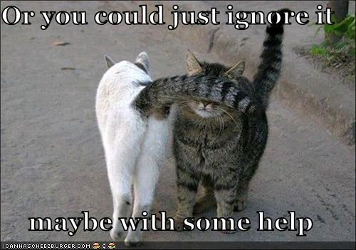
Disregarding Complexity

Slide 19
Avoiding myopia
One way to help predict what could happen is to study history. For example, here is a graph of UK consol yields since 1729 and US long bond yields since 1798.
The UK long bond rate rose 360 bp in 1974, and fell 188 bp in 1983. Since 1999, the largest annual rise was 39 bp and the largest annual fall was 82 bp. In the US, annual data from 1987 – present have the change in long bond yield vary from -92 bp to +75 bp. In 1986 it went down 235 bp, and in 1980 it went up 231 bp, and a further 223 bp in 1981.

Slide 20
Model Governance

Slide 21
Model Governance
First line and second line
Inventory and attestation
No model – assume CDS on CDO worth zero – lost tens of billions
Model documentation
Does the model still work under stress conditions?
Was the stress designed to go easier on some market segments than others due to favoritism?

Slide 22
Good Model Governance
How stressful of a stress do you really use?
How many scenarios at each stress level?
The various scenarios should be scaled to be roughly of equal severity so each of them is a meaningful exercise
  Same stress as the CCAR Severely Adverse
  Ten times worse
  Private ownership of assets is outlawed
It should not be clear which scenario will dominate next time you run the stresses.
Do not penalize good hedging / diversification behavior. It may help to set the scaling factor on random portfolios of the desk’s asset classes rather than on the actual hedged desk holdings, to ensure fairness.

Slide 23
Sizing a stress test
S&P ratings are stress tests – AAA means they think you could survive the next 1930’s US Great Depression, single-B means you can surely survive the coming year, and various levels between. The Fed Severely Adverse scenario is roughly a BBB stress.
Different markets will in general react differently to the same macro-economic stress, and idiosyncratic changes that would be stressful for one market segment may be benign for another.
VaR is the 99th % worst ten-day period, Basel II wants the loss of the 99.9th % worst year, and a AA rating is often assumed to be the 99.97th % worst year.
  Of course in reality no firm or nation has ever survived the third-worst year out of ten thousand.
  Show of hands – how many of you have employers that were in the same or a similar business when the Magna Carta was signed? When agriculture was invented?
The more stressful a shock, the further out you have to extrapolate from historical data.

Slide 24
Institutional Acceptance
The firm’s culture needs to be considered.
  Cowboy culture – “Après moi la deluge”
  Arrogance – TBTF so it doesn’t matter
  Risk-averse – any loss causes panic and terminations
  Asperger – “We set the risk tolerance already so it is what it is.”
    Most models work like this because the calculation is simpler.
    Very few risk managers and no high executives are like this.
For longer scenarios, will the culture be changed by the stress?
Contingency planning differs by type of stress?
Know who your clients are.
Detailed non-quantitative explanation of why the stress model is or isn’t validated.

Slide 25
More Suggestions for Scenario Design
To expand a shock or scenario to cover all your firm’s diverse assets and liabilities, it can help to give each scenario a short meaningful name and a back-story. My own made-up examples:
  Euro currency breakup
  US Congress can’t pass budget - US defaults
  China invades Taiwan
  “Mr Fusion” - free electricity
Be sure the stress scenario has included knock-on effects on all other markets, with plausible lags
  Historical correlations are irrelevant here
  Delayed shocks due to fire sales by dying firms

Slide 26
Qualitative Failures of CCAR Modeling
What would management realistically do in Q4?
  They wouldn’t know that recovery starts in Q5
Do you know what your positions are?
How liquid would they be?
Cautionary tale: Auction Rate Securities

Slide 27
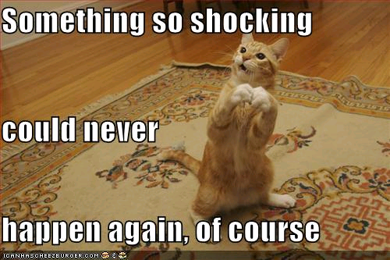
Underestimating Stress

Slide 28
Model Limitations

Slide 29
Model Limitations
Intended purpose of stress test should affect design – CCAR/DFAST, regulatory capital, internal risk management, Economic Capital, hedge design, befuddlement
Next disaster not the same, but more scenarios is more safety
If enough people don’t like the model or the scenario design it won’t be used. This becomes a “pointless” model
One suggestion is to get agreement on the scenario or shock from all parties before anyone knows what the result will be. This is similar to the Operational Risk methodology. This will help get buy-in from model users and builders if something unfortunate turns up in your testing.
The key is transparency – no surprises or misrepresentation.
Ameliorate the governance issue of “Quants don’t run this bank”

Slide 30
Model Limitations
“Remember that all models are wrong; the practical question is how wrong do they have to be to not be useful.”
There are no Laws of Finance. Financial data do not follow any stochastic process, but Wall Street uses heuristics – build models as if the models worked, so an approximate answer can be found.
Models are not intended to capture all the nuances of the real world.
Models are useful specifically because they omit part of messy reality
All models are based on one or more assumptions.
  Models are just a formalized version of the model designer’s intuition.
Models are never “valid” in an absolute sense. They rely on assumptions about the behavior of people, organizations, acts of the natural world, and the use of other models by market participants.
A model is a mixture of behavioral psychology, statistics, numerical methods, and subjective opinions, and some parts of any model are dictated by law, regulation, or company policy. Validation of CCAR regulations is out of scope for any model’s validation.

Slide 31
Your First Model - Eyesight
Look at another person’s face. Every few seconds, you will see their eyelids as they blink. You, too, blink every 2 – 10 seconds. Does your perception of the outside world include the reality of it disappearing briefly when you blink, and seeing your eyelids?
It does not. Your vision model is hardwired to disregard the momentary blackouts caused by blinking. What you perceive is a somewhat idealized model of what photons do or don’t hit your retina.
My point is that models are not reality even when you think they are, and that their deliberate omissions may be helpful and desirable. Simplification to emphasize what’s important is a good thing.
The above does not mean that your vision is invalid, except that for optical illusions it does mean what you see is not appropriate to what’s there.
Like all models, there are boundaries to where your vision model can be relied on – push it far enough and it falls off the cliff.
An important way of challenging a model is to find how far away the cliff is.

Slide 32
Long histories
“History never repeats itself, but it rhymes” – misattributed to Mark Twain.
No historical calibration using a currency with a pegged FX rate can predict the consequences of the peg breaking.
  What would you predict for the Greek drachma exchange rate in 2016?
  What was the effect on the Euro-GBP exchange rate of the Norman conquest of 1066? This is inside the 99.9th percentile of one year changes.
I suggest using as long a history as you can get, and possibly using similar assets’ histories as proxies to get as many observations of the tails as possible.

Slide 33
Challenging Models

Slide 34
Challenging Models
There are two distinct things to challenge for validation of a stress test
Is the shock or scenario plausible? Is it severe enough?
Given the stress, do the pricing, hedging, management reaction, etc., models seem appropriate? Do they still work in 2015, even if they might have worked in 2008?

Slide 35
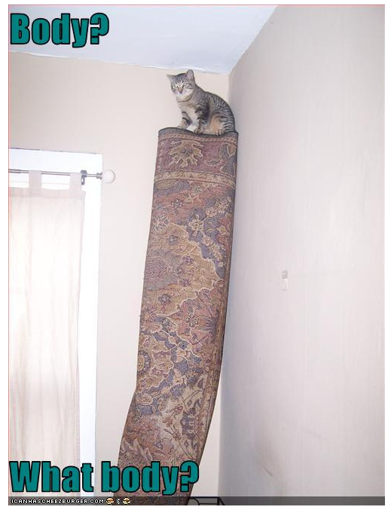
Prestidigitation - Elephant in the room

Slide 36
The Egg Question
Farmer Gray’s Organic Free-Range Eggs come from his small flock of ~300 hens on his small property on Long Island (note this is a fictitious example). Because of their outstanding quality, he charges $1.50 per egg, which is far more than the cost of supermarket eggs.
a. How much would a box of a dozen eggs cost?
b. How much would a truckload of a million eggs cost?

Slide 37
Models are hard to build
Most of us have deadlines to meet. Very complex models are harder to implement and take longer to validate.
If the model is incomprehensible to the intended user, it may not get used. Is the model a good compromise between showing off the developer’s quant skills and giving the users an appropriate tool?
Is the stress a good match for the firm’s positions?
Remember Hofstadter’s Rule, which states that everything takes longer than you think it will, even after you take Hofstadter’s Rule into account.
The fundamental law of the universe is Murphy’s Law, stated by Feynman for quantum mechanics as “Anything not forbidden is compulsory.”

Slide 38
More ways to challenge
Consistency with similar models
Complete, well-reasoned rationale for all assumptions and developmental decisions
Reproducible results
Small changes to stress produce small changes to results
  Except when they don’t
    these are called critical parameters or critical values
    a slight change in a critical parameter causes a large and/or discontinuous change in results
  Some scenarios just barely trigger, or just barely miss triggering, any knock-outs, contingencies, turbo-ing, covenants, etc., in the portfolio being modeled.
  Is the intended use to hover just at that breaking point?

Slide 39
Applying Controls

Slide 40
Applying Controls
Be sure that there is an audit trail for everything.
Was the development process, the implementation, the inputs, outputs, overrides, etc. fully documented and signed off according to your firm’s policies?
Were any overrides done “outside the model” to evade detection or to soften the blow of the stress?
Was the validation rigorous enough? Can you prove that it was more than a “light touch, just kick the tires” cursory effort?
Were the stress results communicated properly as intended, and signed off by the right people?

Slide 41
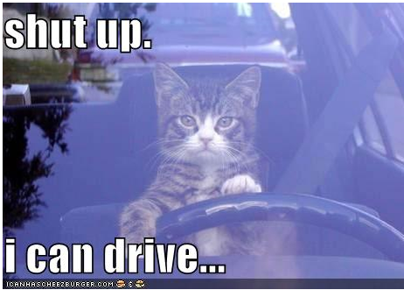
Some Decisions May Have Been Made For Odd Reasons

Slide 42
Outcomes Analysis

Slide 43
Outcomes analysis
The purpose of running a stress is to get some results that go into some report or decision-making process; otherwise it was pointless
The intended purpose of the stress test should have been decided and documented before it was run.
  CCAR to show the Fed and the public that your institution can survive the mandated stress and you understand how your business would work in those stressful times
  Shocks to set limits or stop-loss hedges
  Economic Capital – how much will a huge stress hurt?

Slide 44
Outcomes analysis by backtesting
You hopefully will not experience a stress so severe that you can accurately compare the results of a predicted stress to what actually happened.
Since you can’t do a backtest, the analysis has to be somewhat qualitative and subjective.
One key takeaway from a well-designed stress test is that the various stressed risk-taking units of the firm can decide whether they need to change their positions or their behavior in light of the stress test results.

Slide 45
Rabin’s Rules for Success
(Mike Rabin was my boss in 1991)
Curiously, an electrician who installed an outlet in my basement had these same 3 rules for his work.
1. Pay Attention
What are the features you are trying to model? Did you use the right currency conventions? What did the documentation actually ask for?
2. Think About What You Are Doing
You are going to dinner at Nobu in an hour, and the TV in the kitchenette is broadcasting your favorite team’s tie-breaking game. Neither of these should affect the nesting of parentheses on your if statement.
3. Double-Check Your Work
Limiting cases and “toy” simulations
Benchmarking against other models
Compiler warning messages, rereading the regulations, etc.
A second set of eyes (independent validation)

Slide 46
Digression – Why the cat pictures?
One goal of any speaker is to maximize the Eye-to-Chin Ratio
  How many people are looking at you
  How many slumped back asleep and showing off their chins
  (Some measures include the number slumped forward asleep to show off how well their hair is parted)
Cute cat pictures help keep the audience awake

Slide 47
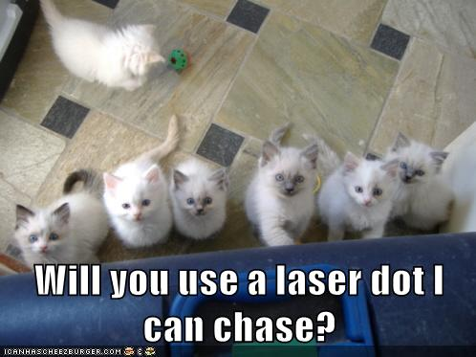
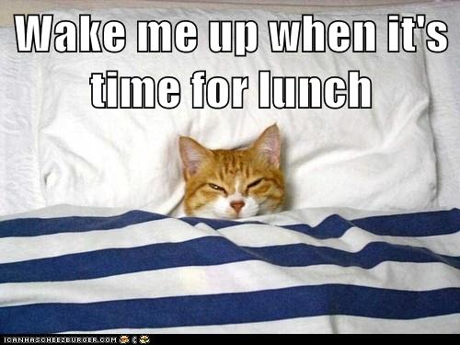
Eye-to-Chin Ratio
High
Zero

Slide 48
Summary
Stresses are more than just a bad day
Right-sizing the number of stresses considered
Real markets are jumpy with fat tails and contagion
Knock-on effects are rarely smooth
Each firm is different

Slide 49


